Slide 1
2026 Account Planning Guide and Templates
September 2025

Slide 2
CONTENTS
Account Planning Guide
  Core Principles & Guidelines
Account Planning Template
  Sales Goals & Historical Revenue by Prioritized Solution
Sales Plan Template
  Go-to-Market Strategies, Target Contacts & Outreach Tactical Plans
IDENTIFY YOUR TARGET COMPANIES
KNOW YOUR CUSTOMER
DETERMINE POSSIBLE SOLUTIONS FOR YOUR TARGET COMPANIES
DEVELOP YOUR SALES PLAN FOR EACH TARGET ACCOUNT

Slide 3
PLANNING GUIDE
Target Prospecting
Review your Account Planning Template provided to see your list of target companies. (These are segments 1,2, & IMOs)
Are there other companies you would like to explore, that may currently be outliers?
If so, please add to your Account Planning Template.
Know your Customer
Navigate the organization (see appendix for various reports with a wealth of member contacts)
Determine Possible Solutions
From the “Know Your Customer” exercise, understand and prioritize revenue opportunities based on:
Develop your Sales Plan
Work with your team to develop your sales plan. It should include go-to-market strategies, target contacts and tactical plans for each target account.
Please use the Sales Plan Template provided.
Where is the “white space” (review the account planning template to find gaps in product utilization)
Research the company (see appendix for various sources of company intel)
a. The “White Space”
b. Quality contacts and existing relationships
c. Company research

Slide 4
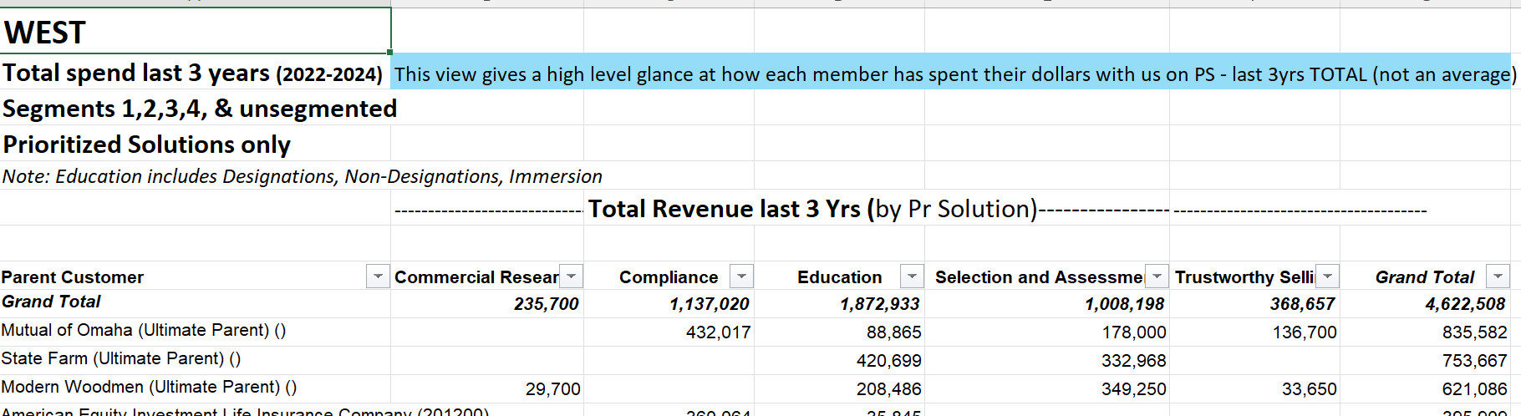
ACCOUNT PLANNING Template (PENDING for updated numbers)
This template will be populated when updated numbers are available for 2025 and 2026
Use this Account Planning Template – 2026 Goals & Historical Revenue All 6 Sales Territories (2023,2024,2025 YTD) to understand your sales goals and the historical spend of your target companies. The following is included:
All segment 1 & 2 companies are listed as target companies; you can add additional companies you would like to explore
The prior 3 years of revenue per company is listed for each prioritized solution (2023,2024,2025 YTD)
The 2026 sales goal per territory is listed in total and for each prioritized solution
An excel calculator to help you plan, monitor and revise your sales goals by prioritized solution as necessary.
  Revised goals by product should be based on your member’s needs.
  The “Total Team Sales Goal” however, must remain the same.

Slide 5
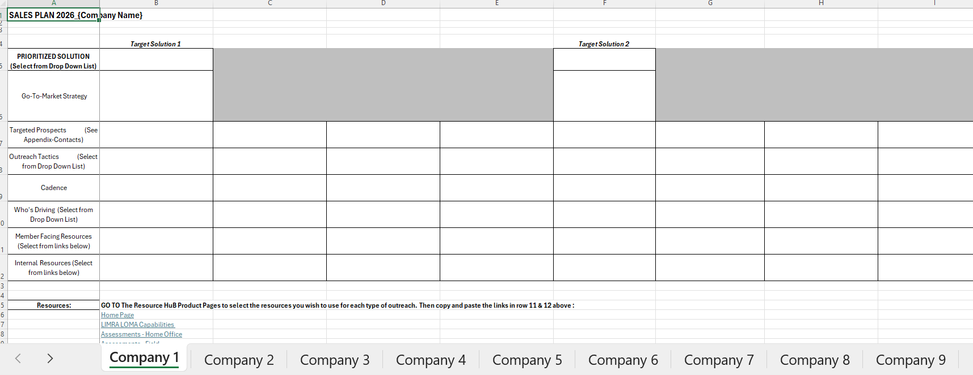
2026 SALES PLAN Template
Right click, then “open link” on the chart below to access the template. Complete your sales plans for each target account.
Upload the completed template (single file) with all companies to the Home Page of the Resource Hub.

Slide 6
APPENDIX – PLANNING TOOLS

Slide 7
CONTACTS – Navigating the Organization
ACCOUNT CONTACTS
(I) "KEY CONTACTS“ by Account
  Segment 1&2 Accounts: "Head of" & "C-Suite".
  All Accounts-Senior Leaders by Division (includes C-Suite and above, and those who report to C-Suite)
  LLG Liaisons
(II) "KEY RELATIONSHIPS" - the buying team for each opportunity opened in the last two years.
(III) "WHO'S WHO"- senior leaders who participate in our Collaboration Groups
  Canada ~ Gr Lakes ~ Northeast ~ South ~ West ~ WPB
(IV) LLG BOARD OF DIRECTORS
  Companies represented
Back to Planning Guide

Slide 8
Member Engagement History
LINKS to TABLEAU & MEMBER BENEFIT REPORTS (MBR)
Combined LIMRA LOMA Member Benefits Report (MBR)
LLG Engagement Analysis Dashboard - Commercial Product Spend
LLG Sales Revenue Dashboard - Revenue by Product Line
Professional Development: Enrollments by Account Team - (Previously called the Business Development Report )
(For Tableau Login credentials: ITSupport@llglobal.org)
LIMRA LOMA Member Benefits Report (MBR)
LLG Engagement Analysis Dashboard - Commercial Product Spend
LLG Sales Revenue Dashboard - Revenue by Product Line
Professional Development: Enrollments by Account Team - (Previously called the Business Development Report )
Back to Planning Guide

Slide 9
Member Company Research
Prior Year Activity: review the CRM for activity feeds and account notes. Review prior year discussions - what were their pain points; what were the challenges and successes in working with them; what LLG solution did they invest in; what was left on the table? Was there any follow-up requested for 2025?
Review their website
  What is their core business?
  What core markets do they serve
  Who is on the leadership team – anyone not currently in our CRM?
Request Info Center Intel
  committee meeting notes
  quick queries
  research briefs
  inquiries received
Review the company’s LI Profile if it exists
  identify any “top of mind” initiatives, recent accolades, promotions, etc.
ACCOUNT LISTS (ASSIGNMENTS by Team)
Accounts by Teams
Teams by Account
Back to Planning Guide

