Slide 1
[Company Name]
Team Member, Team Member, Team Member
Month, Day 2025

Slide 2
Discussion Topics
Life Insurance Sales Trends
Annuity Sales Trends
Company vs. Peers
Membership Benefits & Utilization
Knowledge
Insights
Connections
Solutions

Slide 3
U.S. Life Insurance Sales Trends by Product
Source: U.S. Retail Individual Life Insurance Sales Survey and Industry Estimates — Annualized Premium, LIMRA.

Slide 4
Market Share by Product – 2024
12%
38%
Source: U.S. Retail Individual Life Insurance Sales Survey and Industry Estimates — Annualized Premium, LIMRA.

Slide 5
Annualized Premium Sales by Product
Source: U.S. Retail Individual Life Insurance Sales Survey and Industry Estimates — Annualized Premium, LIMRA.

Slide 6
Placeholder for Member Sales vs. Peers

Slide 7
A Record Year for Annuity Sales…again!
85% higher than avg.
Avg. Annual Sales: $233b
Source: U.S. Individual Annuity Sales Survey, LIMRA. $$ in billions

Slide 8
U.S. Annuity Sales Trend by Product
3%
Source: U.S. Individual Annuity Sales Survey, LIMRA.

Slide 9
Total Annuity Sales Fell 13% from 4Q 2023
Total annuity sales posted $434.1 billion in 2024, up 13% year over year.
$102.1B
Source: U.S. Individual Annuities Sales Survey, LIMRA.

Slide 10
Placeholder for Member Sales vs. Peers

Slide 11
Membership Benefits & Utilization Start Date of Report – End Date of Report

Slide 12
Our Purpose
Advancing the financial services industry
by empowering our members with
Knowledge
Insights
Connections
Solutions

Slide 13
Knowledge

Slide 14
Knowledge: How We Advance the Industry
Highlights
#
Strategic Leadership Experience Program Attendees
#
Designations Taken
#
Designations Earned
#
Facilitated Learning Course Enrollments
Strategic Leadership Experience
Industry
Advantage
Insurance
Immersion
Designations

Slide 15
Designation Programs
Associate,
Life Management Institute™, ALMI™
Fellow,
Life Management Institute™, FLMI™
Associate,
Customer Service™
ACS ®
Associate,
Insurance Regulatory Compliance®, AIRC™
Notes:
Designations Earned (6): 3 ALMI, 2 AIRC, 1 ACS

Slide 16
Insights

Slide 17
Insights: How We Advance the Industry
Highlights
#
Research Downloads
#
Research Benchmarks Participation
#
Survey Participation
#
InfoCenter Requests
#
MarketFacts Subscriptions
#
News2use
Subscriptions
Distribution Benchmarks & Research
Product Benchmarks & Research
Consumer Benchmarks & Research
McKinsey LIMRA 360 Performance Benchmarking Survey
Compass Programs
Thought Leadership
Experience Studies Pro
Notes:
38 people downloaded 207 reports for a total of 403 downloads

Slide 18
NEW! Interactive Infographic: 2024 FY Sales and Forecasts
2024 Life Sales: Trends and Future Outlook
Life insurance premiums reached $15.9 billion in 2024, up 3 percent from 2023. Growth was driven by strong equity markets and innovative product designs. LIMRA’s exclusive forecast anticipates stable sales and no recession; premium growth is expected to stay around 3 percent.

Slide 19
NEW! Interactive Infographic: 2024 FY Sales and Forecasts
Annuity Sales: Strategic Insights and Future Market Trends
In 2024, annuity sales hit $434.1B, up 13% from 2023. Driven by economic conditions, interest rates, and aging population. High demand for protected growth and guaranteed income.

Slide 20
Recently Published
Upcoming
Research
Insights on the Consumer Decision-Making Process for Life Insurance: What Matters Most (for Whom)?
Learn what consumers value most, and the tradeoffs they are willing to make, when choosing a life insurance product.
2025 Insurance Barometer Study
Opportunities in Underserved Markets: Young Consumers
Unlocking Growth in the Life Insurance Industry
The Changing Family: A New Reality for Life Insurance
Over recent decades, numerous fundamental shifts have influenced the structure of the American family. Within the life insurance landscape specifically, these changes present modern and meaningful implications for consumer needs and expectations.

Slide 21
Connections

Slide 22
Connections: How We Advance the Industry
Highlights
Represented on
# Committees
Represented on
# Study Groups
# people attended
# Conferences
#
people attended Webinars
Conferences
Committees
Study Groups
Webinars
Executive Advisory Boards
CXO Groups
Notes:
Webinars:
LIMRA: 53 people attended seminars/webinars
LOMA: 19 attended seminars/webinars
67 total webinars attended
Conferences:
28 people attended 4 conferences:
2024 LIMRA Annual, 2024 Life and Annuity Conference, 2024 Supplemental Health, DI, & LTC, 2025 Life Insurance and Annuity Conference.

Slide 23
LIMRA and LOMA Committees & Study Groups
Committees
Study Groups
Annuity Advisory Board
Board of Directors
Chief Marketing Officers
Direct to Consumer Distribution
FraudShare Governance Council
LL Global Board Audit
LL Global Board Finance
Strategy & Innovation
Advanced Analytics
AI Governance Group
Annuity Leadership Forum
Annuity Research
Customer Experience
Defined Contribution Income Strategies Roundtable
Digital Strategy
Individual Life
Product Development
Retirement Income Strategies
LL Global
Board of Directors:
First/Last Name
Annuity Advisory Board:
First/Last Name
Notes:
LIMRA committees with representation:
Annuity Advisory Board, Board of Directors, Chief Marketing Officers, Direct to Consumer Distribution Committee, Fraudshare Governance Council, LL Global Board Audit Committee, LL Global Board Finance Committee, Strategy & Innovation Committee.
Study Groups:
Advanced Analytics Study Group, AI Governance Group, Annuity Leadership Forum, Annuity Research Study Group, Customer Experience, Defined Contribution Income Strategies Roundtable, Digital Strategy, Individual Life, Product Development, Retirement Income Strategies.

Slide 24
Industry-Leading Conferences
2025 Conferences
Attending
Workplace Benefits Conference
April 23 – 25 | Encore Boston Harbor, Boston, MA
# people attended
# conferences*
Presenting
Supplemental Health, DI & LTC Conference
July 30 – August 1 | Hard Rock Hotel San Diego, San Diego, CA
Download the 2025 Conference Series Brochure
LIMRA Annual Conference
Sept 14 – 16 | Gaylord Palms Resort & Convention Center, Kissimmee, FL

Slide 25
Solutions

Slide 26
Industry Challenges Require Collaborative Solutions
4
Average number of industry solutions utilized by each member

Slide 27
Solutions: How We Advance the Industry
FraudShare
Applied Research Solutions
Anti-Money Laundering Training
Hiring Assessments
Trustworthy Selling
Compensation Resource Center
Customer Assurance Program/Customer Experience
LDEx Standards

Slide 28
Wrap-Up
Next steps from today’s meeting
Next steps for continued engagement

Slide 29
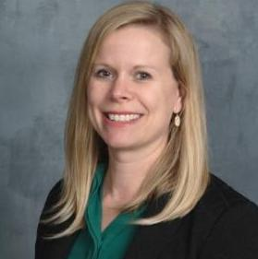
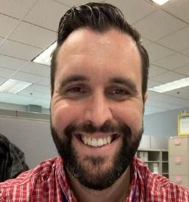
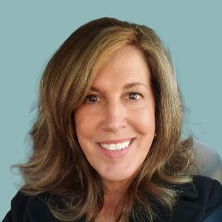
Your Dedicated Partnership Team
Kelly Fehring, FLMI, ACS, CLU
Member Relations Director
kfehring@limra.com
(513) 384-8061
Mike Rand
Member Solutions Director
mrand@limra.com
(860) 285-7871
Barb Kimball
Member Solutions Director
bkimball@limra.com
(860) 214-3350
Notes:
(next slide)

Slide 30
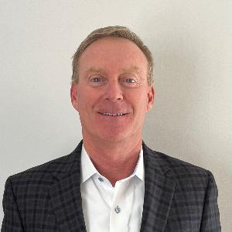
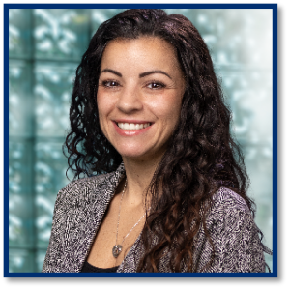
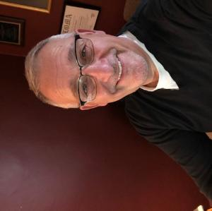
Your Dedicated Partnership Team
Chris J. Callahan
Member Relations Director
ccallahan@limra.com
(908) 873-8818
Angelina Weeks, CLF
Member Solutions Director
aweeks@limra.com
(239) 416-3749
Al Palmeri, FLMI FSRI, ACS, AIRC
Senior Director, Member Solutions
apalmeri@limra.com
(770) 984-3759
Notes:
(next slide)

Slide 31
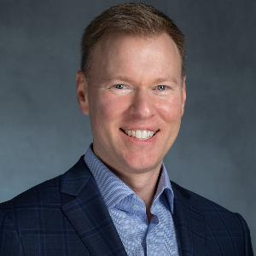
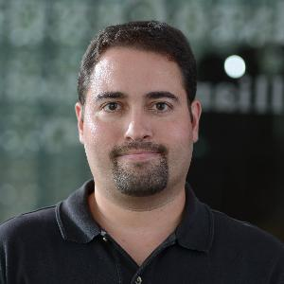
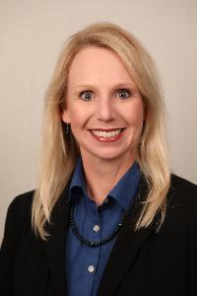
Your Dedicated Partnership Team
Andrew Franks
Member Relations Director
afranks@limra.com
(703) 859-3273
Miguel P. Rodrigues, MBA
Member Solutions Director
mrodrigues@limra.com
(860) 285-7861
Melanie Evans-McHugh
Member Solutions Director
mevans-mchugh@loma.org
(470) 278-6450
Notes:
(next slide)

Slide 32
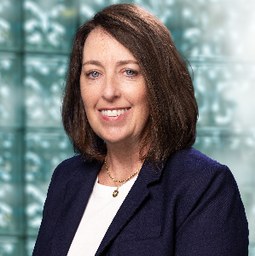
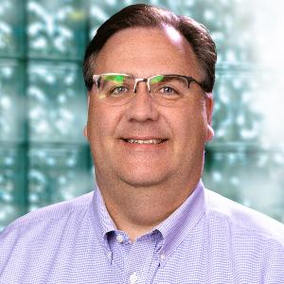
Your Dedicated Partnership Team
Jason Hammen, CFP®, ChFC®, CLU®, FLMI
Member Relations Director
jhammen@limra.com
(309) 706-2369
Nicole Overmeyer, FLMI, ACS, AIAA
Member Solutions Director
overmeyern@loma.org
(770) 984-6450
Chris Atkins, MA, FLMI, ACS, AIRC
Member Solutions Director
catkins@limra.com
(817) 832-4783
Notes:
(next slide)

Slide 33
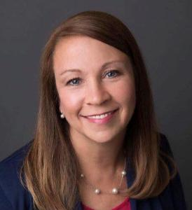
Your Dedicated Partnership Team
Kellie Benson-Bray
Member Relations Director
Kbenson-bray@limra.com
(385) 323-6527
Nicole Overmeyer, FLMI, ACS, AIAA
Member Solutions Director
overmeyern@loma.org
(770) 984-6450
Melanie Evans-McHugh
Member Solutions Director
mevans-mchugh@loma.org
(470) 278-6450
Notes:
(next slide)

Slide 34
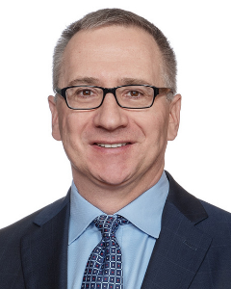
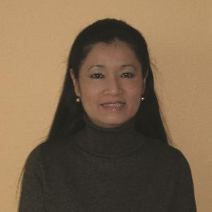
Your Dedicated Partnership Team
Paul Mlodzik
Member Relations Director
pmlodzik@limra.com
(519) 830-3755
Sook Maccarone, ALMI, ACS
Canadian Business
Development Director
maccarones@loma.org
(905) 530-2302
Angelina Weeks, CLF
Member Solutions Director
aweeks@limra.com
(239) 416-3749
Notes:
(next slide)

