Slide 1
Navigate with Confidence: Significant Opportunities Ahead
David Levenson • 2024 Annual Conference
September 16, 2024

Slide 2

Significant Opportunities Ahead
  Life Insurance, Annuity, and Workplace Benefits Sales Trends
  Meaningful Opportunities for Our Industry
  Record Annuity Sales
  Record Life Insurance Demand
  Private Equity Capital
  Differentiating With Expense Management
  New Ways of Working
  Artificial Intelligence

Slide 3

Life Insurance, Annuity, and Workplace Benefits Sales Trends

Slide 4
U.S. Life Insurance Sales Trends by Product
Source: LIMRA’s U.S. Retail Individual Life Insurance Sales Survey and Industry Estimates — Annualized Premium.
*Preliminary data and 1st half of 2024.

Slide 5
U.S. Annuity Sales Trend by Product
3%
*Preliminary data — year to date.
Source: Preliminary U.S. Individual Annuity Sales Survey, Second Quarter 2024, LIMRA.

Slide 6
U.S. Workplace Benefits Sales Trend by Product
$8.3 B
$7.5 B
$7.5 B
$7.7 B
$5.2 B
Workplace Benefits Life Insurance Sales (excludes specialty products).
*Preliminary data — year to date.
Source: LIMRA’s U.S. Workplace Benefits Sales Survey.

Slide 7

Record Annuity Sales

Slide 8
Record First Half of the Year…
…for Spread-Based Annuity Products
Registered Index-Linked | $30.8 B | 41%
Deferred Income | $2.5 B | 30%
Fixed Indexed | $59.3 B | 23%
Fixed-Rate Deferred | $83.7 B | 16%
Fixed Immediate | $7.0 B | 3%
Source: U.S. Individual Annuity Sales Survey, Second Quarter 2024, LIMRA.
Notes:
2024 delivered a record for the first half for all annuity product lines except Trad VA’s which still saw grow over the first half of 2023 up 11% (total of 29.1B for 2024)

Slide 9
With Room to Run…
Rate Difference
2019 | 2020 | 2021 | 2022 | 2023 | 2024
0.5% | 0.9% | 1.1% | 2.7% | 2.5% | 2.2%
Source: Beacon Research and Bank CDs comes from Depositaccounts.com.

Slide 10
And New Channels With Significant Potential for Growth
The workplace is becoming a more meaningful opportunity for annuity products.
$13.6 Trillion
$10.6
Trillion
70%
Defined
Contribution Market
of participants are interested in building lifetime-guaranteed income for retirement by investing all — or part — of their contributions in an investment that is part of a retirement savings plan offered by employers.
IRA Market
14%
of plans offer
in-plan annuities
$2.3 Trillion
26%
of plans are
actively considering
Annuity Market

Slide 11
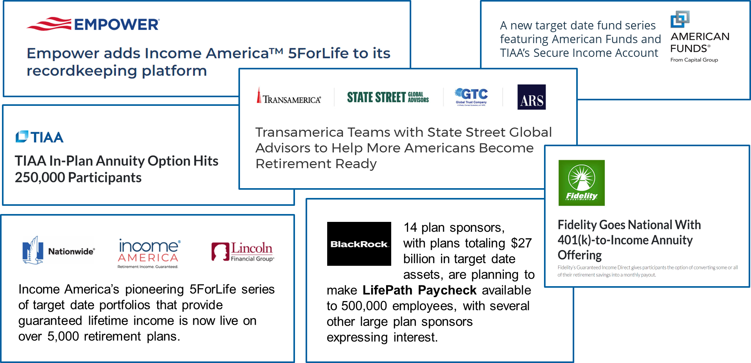
New Solutions for Decumulation Are Coming Quickly

Slide 12

Record Life Insurance Demand

Slide 13
Percent of U.S. Adults With a Life Insurance Need
102 million Americans are
uninsured or
underinsured
Source: 2024 Insurance Barometer Study, LIMRA and Life Happens.

Slide 14
Our Supply Is Not Meeting the Demand
Average Age 62
Average Age 44
Sources: Census of U.S. Sales Personnel (2018 and prior) and LIMRA estimates (2021); FP (Agent) Production & Retention, LIMRA, 2021; Casting Light on the Age of an Independent Insurance Agent, LIMRA, 2018.

Slide 15
And — to Date — the Direct Channel Has Not Increased
Source: U.S. Retail Individual Life Insurance Sales, LIMRA 2017 – Q2 2022 (Direct includes direct to consumer and internet direct).
Notes:
And, to date, the Direct Channel has not Increased to Accommodate the Demand

Slide 16

Private Equity Capital

Slide 17



















Private Equity Influence Across the Industry
Annuity
Independent Distribution
Reinsurance/M&A
--
--
--
--
--
--

Slide 18

Differentiating With Expense Management

Slide 19
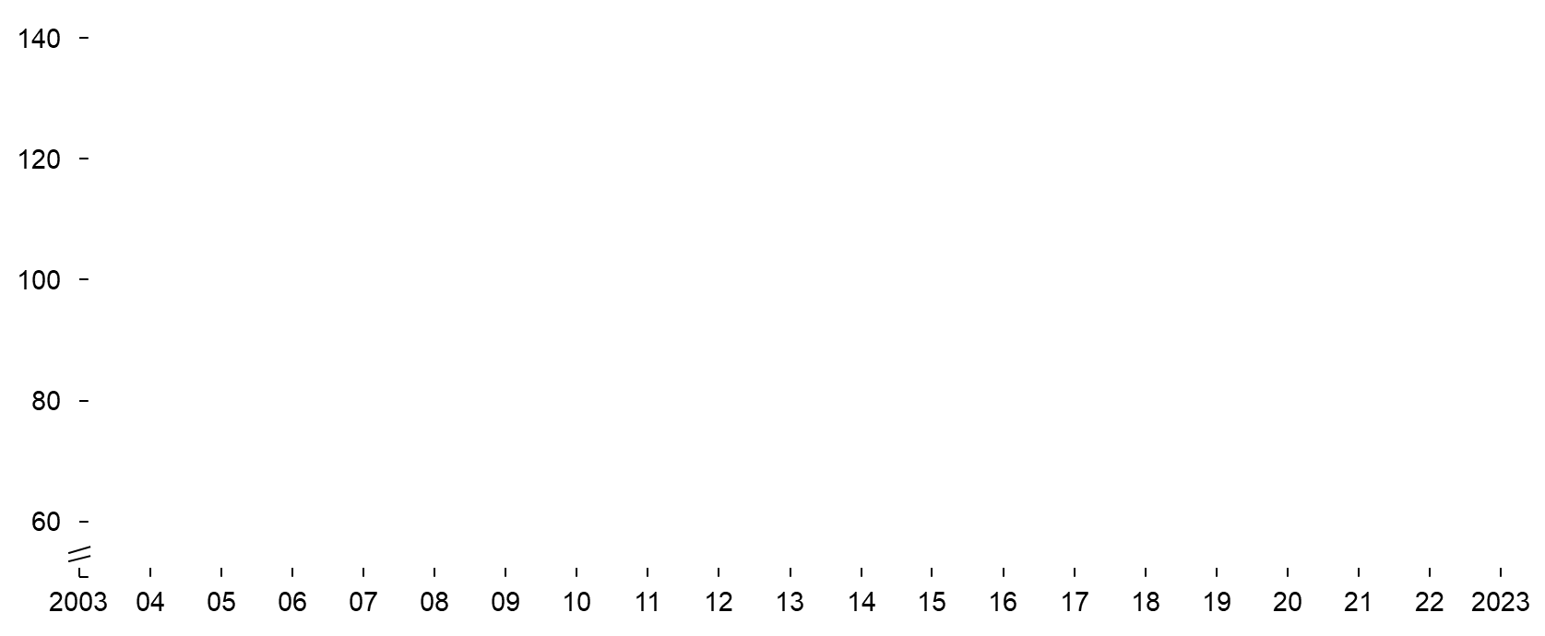
U.S. Insurance Industry Continues to Lag on Productivity
Cost Efficiency Evolution by Industry¹
Change 2003–2023
U.S. Life Insurance +26%
U.S. Property and Casualty -3%
U.S. Asset Managers -4%
Automotive -29%
Telecommunication -29%
¹ Indexed; Expressed as “SG&A expenses as % of Revenue.”
Source: S&P Capital IQ, Team analysis, McKinsey NA Life & Annuities 360 Performance Benchmarking Survey, LIMRA.
Notes:
Life carrier’s operating costs have increased by 26% over the last two decades
% Total SG&A Expenses / Revenues, Normalized at 100 in 2003

Slide 20
Efficiency Disparity Among Carriers
Individual Life Cost Ratio
Individual Annuities Cost Ratio
 |  | Delta |  | Delta
Product Development and Marketing |  | 2.3x |  | 2.8x
Sales Distribution¹ |  | 1.7x |  | 2.2x
Sales Support |  | 2.2x |  | 3.4x
Operations: New Business³ |  | 1.9x |  | 3.0x
Operations: In Force |  | 2.3x |  | 2.8x
IT |  | 2.0x |  | 2.4x
Corporate Functions |  | 1.8x |  | 2.4x
Investment Office |  | 3.1x |  | 2.9x
Total |  | 1.7x |  | 2.4x
Top Quartile Bottom Quartile
^{1.} Includes agent commissions, salaries and benefits, and all other agent costs including allowances, 3p strategic distribution payments, and agent lease expenses, etc.
^{2.} New business contact center costs included in Operations: New business (excluded from Operations: In Force).
Source: McKinsey-LIMRA 2024 Individual L&A Benchmark Survey. NOTE: Total based on reported total cost/GPW for each participant.
Notes:
Individual Life and Annuities – 2023, Expenses as a % of Gross Written Premiums
Update footnotes

Slide 21
Efficiency Disparity Among Carriers
Workplace Benefits Cost Ratio
 |  | Delta
Product Development and Marketing |  | 2.3X
External Sales Agent Distribution |  | 1.7X
Internal Sales Distribution Support |  | 1.9X
Pricing and Underwriting |  | 3.4X
Operations: New Case Implementation |  | 4.2X
Operations: Servicing |  | 3.3X
Claims and Benefits |  | 4.5X
IT |  | 2.5X
Corporate Functions |  | 2.0X
Total including External Sales Agent Commissions |  | 2.1X
10.6
17.5
21.7
46.1
Top Quartile Bottom Quartile
Source: McKinsey-LIMRA 2023 Workforce Benefits Benchmark Survey. NOTE: Total based on reported total cost/GPW for each participant.
Notes:
2023, Expenses as a % of GPW + Fees; categorized by function

Slide 22
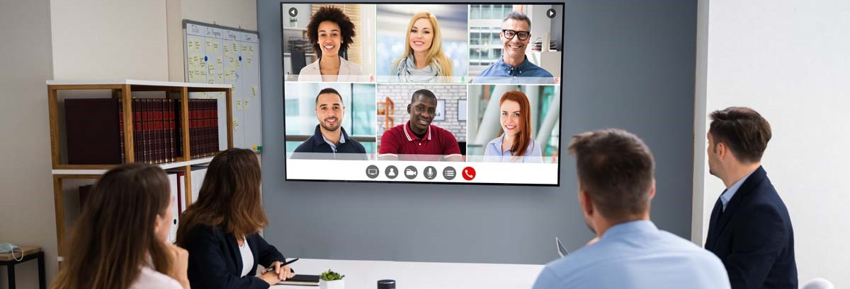
New Ways of Working

Slide 23
Work Arrangements
Based on 38 responses.
Source: Adapting to Alternative Work Models: An Update on Current Human Resources Trends, LIMRA, 2024.

Slide 24
Work Model Impact on Voluntary Turnover
Under the hybrid model,
voluntary turnover
decreased the most…
…followed by full-time remote
work models.
Based on 37 responses.
Source: Adapting to Alternative Work Models: An Update on Current Human Resources Trends, LIMRA, 2024.

Slide 25
Leadership Through Work Model Changes
Based on 34 responses.
Source: Adapting to Alternative Work Models: An Update on Current Human Resources Trends, LIMRA, 2024.
Notes:
Middle Management: 2% as poor

Slide 26
Employees Hired Within the Last 5 Years
Based on 33 responses.
Source: Adapting to Alternative Work Models: An Update on Current Human Resources Trends, LIMRA, 2024.
Notes:
Employees hired between January 2020 and August 2024

Slide 27

Artificial Intelligence

Slide 28

Artificial Intelligence Governance Group (AIGG)
Developed to identify and share industry trends, develop best practices and frameworks, and share knowledge
Nearly 80 executives representing over 40 U.S. insurance companies
Released first study, Navigating the AI Landscape: Current State of the Industry
Notes:
The group aims to create a foundation for sustainable and inclusive AI practices to improve the life insurance industry.
Intent:
Educate members about the current state of AI in the industry
Provide a forum for open and collaborative discussion
Create industry standard frameworks
Establish industry benchmarks
Enhance customer’s experience while improving productivity and profitability

Slide 29
AI Spend
When comparing this year
to last year:
29% of companies had a flat
AI spend last year while
24% of companies increased
their AI spend by over 50%
Source: AIGG AI Survey, Third Quarter 2024, LIMRA.

Slide 30
AI Spend
When comparing next year
to this year:
71% of companies will increase
their spend by less than 30% while
Only 12% will increase
spend by over 50%
Source: AIGG AI Survey, Third Quarter 2024, LIMRA.

Slide 31
AI Employee Use
Source: AIGG AI Survey, Third Quarter 2024, LIMRA.

Slide 32
AI Industry Impact
47% of technology executives believe AI will have a significant impact to our industry in the next 3 years but…
  48% don’t have a training program yet
  and no company in the survey has more than 25 use cases.
Source: AIGG AI Survey, Third Quarter 2024, LIMRA.

Slide 33
Our Organization and Brands

