Slide 1
Elevating Tomorrow: Advancing Life Insurance, Annuities, and Workplace Benefits
September 2025

Slide 2

Compass 2025 Key Milestones and Achievements
Success Metrics
Alliance for Lifetime Income by LIMRA
Empowering Our Members
Knowledge, Insights, Connections and Solutions
Infrastructure
Notes:
Compass 2025 has been our strategic North Star for the past five years, guiding LIMRA and LOMA through a period of profound industry transformation. From navigating the COVID-19 pandemic to embracing innovation and forging new partnerships, our members have demonstrated resilience and adaptability. Today, we reflect on the key accomplishments that have shaped our journey and positioned us for future success.

Slide 3
Success Metrics
Notes:
Our success is reflected in consistent year-over-year growth. The Net Promoter Score (NPS), based on member surveys, has risen from 34 in 2020 to 58 in 2024—clear evidence that our members recognize and value the support we provide. As a not-for-profit organization, our mission is to serve the industry. The steady revenue growth underscores the increasing adoption of our solutions across the sector.

Slide 4
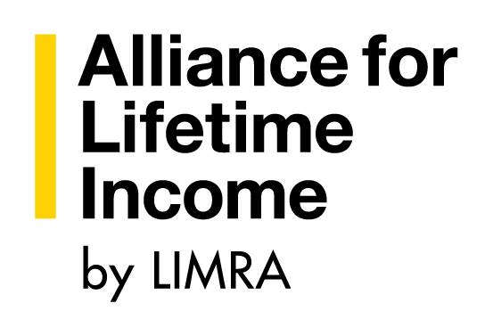
Alliance for Lifetime Income by LIMRA
Notes:
The Alliance for Lifetime Income is now under LIMRA and LOMA’s management, rebranded as “Alliance for Lifetime Income by LIMRA.” This transition reinforces our commitment to retirement security and consumer education. With 11,000 Americans turning 65 daily, our work to promote protected lifetime income is more critical than ever. An advisory board of industry leaders has been established to guide the next chapter.

Slide 5




Empowering Our Members
Advancing the
financial services industry
by empowering our members with:
KNOWLEDGE
INSIGHTS
CONNECTIONS
SOLUTIONS
Notes:
Empowering our members is central to our mission. Through Compass 2025, we’ve focused on delivering solutions, knowledge, insights, and connections—the pillars that advance the financial services industry. These elements are embedded in everything we do to support our members’ success.

Slide 6
Knowledge: Compass 2025
Finance for Insurance Leaders
Industry Advantage
Insurance Immersion
Strategic Leadership Experience
Designations
  Associate, Life Management Institute™, ALMI™
  Fellow, Life Management Institute™, FLMI™
  Associate, Customer Service™, ACS®
  Associate, Insurance Regulatory Compliance®, AIRC™
Certificate Programs
  Insurance Fundamentals
  Retirement Essentials
  Customer Experience Essentials
  Regulatory Compliance Essentials
Notes:
Over the past five years, we’ve expanded our educational offerings to meet evolving member needs:
Finance for Insurance Leaders: A two-day, in-person program for non-financial managers, with nearly 10 sessions planned this year.
Industry Advantage: A growing library of short, LMS-compatible courses—232 courses and 17 learning paths, with 40 new additions in 2024. Currently adopted by 29 carriers.
Strategic Leadership Experience (SLE): Our executive development program with Wharton has engaged over 80 companies. The fourth cohort (Class of 2027) is underway, and we’re launching an alumni network to foster continued peer engagement.

Slide 7

Insights: Compass 2025
Consumer Discovery Research
Distribution Benchmarks and Research
Product Benchmarks and Research
Experience Studies Pro
LifeCompass and AnnuityCompass
McKinsey LIMRA 360 Performance Benchmarking Survey
Thought Leadership
Notes:
We’ve delivered powerful insights through new and enhanced research platforms:
Experience Studies Pro: In partnership with SOA, now subscription-based with 5 studies planned for 2025 and 34 subscribing companies.
LifeCompass and AnnuityCompass: Real-time data tools covering 88% of life premium and 87% of annuity market. New dashboards are in development.
McKinsey LIMRA 360 Survey: Now in its fifth year, covering a significant portion of the U.S. and Canadian markets. It remains the most comprehensive expense benchmark in the industry.

Slide 8
Connections: Compass 2025
Committees
Conferences
CxO Groups
Executive Advisory Boards
LIMRA and LOMA Liaisons
Study Groups
Webinars
Notes:
We’ve strengthened member engagement through expanded collaboration platforms:
Annual Conference: Attendance up 25% since 2019; sponsorships up 205%.
CxO Groups: Now 22 groups, with new forums for Annuity Leadership and Broker-Dealers.
Advisory Boards: Five boards with 110+ executives from 78 companies.
Liaisons: Nearly 80 liaisons serve as key connectors between LIMRA/LOMA and member companies.

Slide 9

Solutions: Compass 2025
Applied Research Solutions
Compensation Resources
Compliance Education Platform
Customer Assurance Program/Customer Experience
FraudShare
Hiring and Selection Assessments
LIMRA Data Exchange (LDEx)
Trustworthy Selling
Notes:
We’ve introduced impactful solutions to meet evolving member needs:
Applied Research Solutions: Delivered three consortia studies and several in progress, addressing niche and emerging topics.
FraudShare 2.0: In partnership with Verisk, this next-gen platform offers real-time fraud detection. Early adopters are shaping its development.
LDEx Standards: Adopted by 52 companies, with growing traction in Canada through a dedicated standards committee.

Slide 10
Infrastructure: Compass 2025
Benchmark Data Optimization
Compliance Education Platform Enhancement
Customer Relationship Management
Exam Platform
Human Capital Management Platform
Learning Content Management System
Learning Management Systems
NetSuite
Notes:
Our infrastructure investments over the past five years have enhanced our ability to serve members and employees. These include upgrades to CRM, exam platforms, HCM systems, LMS, and data optimization tools—all designed to support scalable, efficient operations.

Slide 11

Vision for the Future
Life Insurance
Annuities
Workplace Benefits
Artificial Intelligence
  Key Insights
  Industry Resources
Compass 2030 Strategy: Focus Areas

Slide 12





Life Insurance
Shrinking Advisor Base
Operational Efficiency Gains
Simplified Point-of-Sale Experience
Strategic In-Force Management for Capital Efficiency
Artificial Intelligence
Notes:
Key challenges and opportunities for life insurance include:
Addressing the shrinking advisor base.
Improving operational efficiency.
Enhancing the point-of-sale experience.
Accelerating strategic in-force management.
Leveraging AI to drive innovation and efficiency.

Slide 13




Annuities
Peak65 Demographic Opportunity
Greater Integration of Decumulation Strategies Into Financial Planning
Growth in Fee-Based Platforms
Simplified Point-of-Sale Experience
In-Plan Annuities
Artificial Intelligence
Notes:
Annuities are poised for growth, driven by:
The Peak65 demographic shift.
Better integration of decumulation strategies.
Expansion of fee-based platforms.
Simplified point-of-sale processes.
Growth in in-plan annuities.
AI adoption to support an aging advisor workforce while preserving human connection.

Slide 14




Workplace Benefits
Continued Pressure on Fiduciaries
Growth in Nontraditional Voluntary Benefits for New Customers
Increase in Personalized Benefit Solutions
Enhanced Absence and Leave Management Programs
Artificial Intelligence
Notes:
Workplace benefits will evolve through:
Increased fiduciary pressure.
Growth in nontraditional voluntary benefits.
Personalized benefit solutions.
Complex leave management programs.
AI-driven digital experiences that streamline enrollment, education, and claims.

Slide 15
Artificial Intelligence: Key Industry Insights
The life insurance industry is lagging other industries in spend and implementation
Carriers are distributing human and financial resources across multiple functions, slowing down and complicating scaling efforts
Carrier spend remains modest: 87% spend under $10M annually, and 78% are increasing spend by no more than 20% per year
Use cases take 1 to 2 ½ years to scale
Only 5% of use cases are at scale
Notes:
AI adoption in our industry faces several hurdles:
Fragmented resource allocation slows scaling.
Modest spending: 87% of carriers spend under $10M annually.
Long timelines: Use cases take 1–2.5 years to scale.
Only 5% of use cases are fully scaled.
The industry lags behind others in implementation and investment.

Slide 16
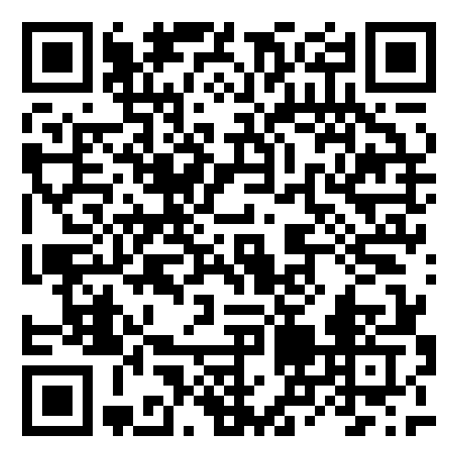
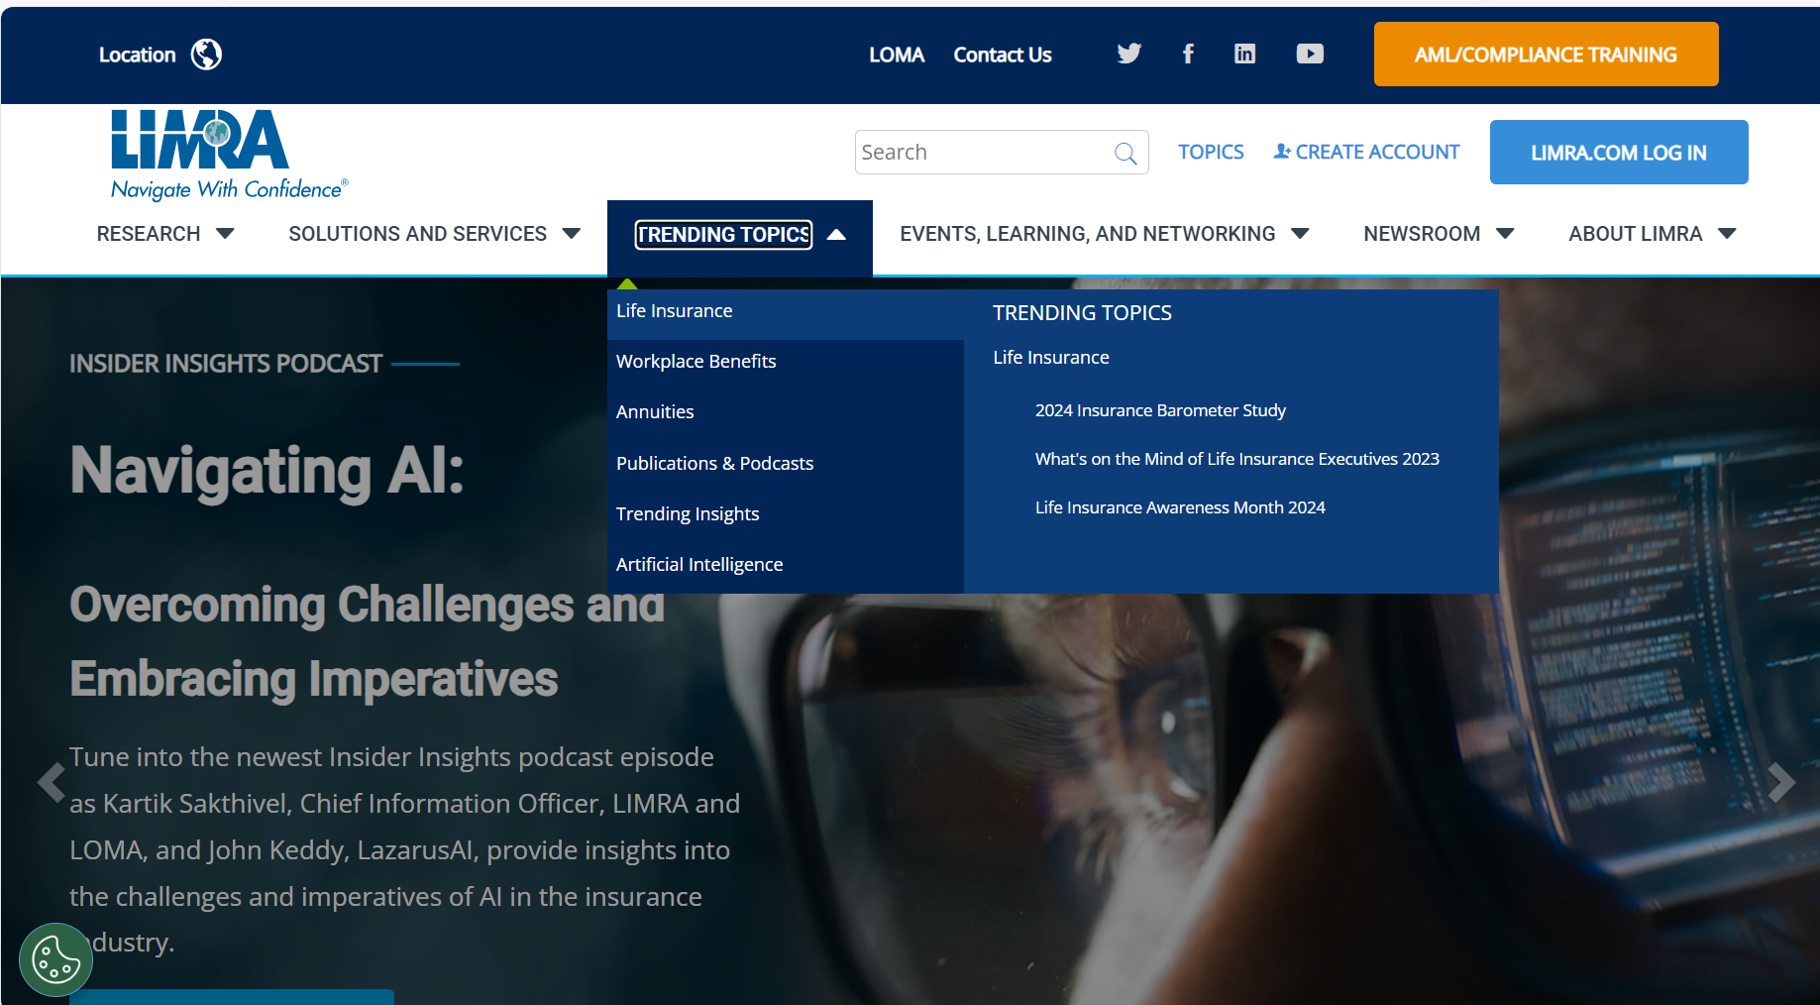
Explore LIMRA and LOMA’s AI Resources
Notes:
Visit https://www.limra.com/en/trending-topics/artificial-intelligence/ to explore our latest AI resources, including research, tools, and thought leadership to support your organization’s digital transformation.

Slide 17
Compass 2030 Strategy: Focus Areas
Empowering Members With Data and Knowledge
Expand Industry Engagement
Alliance for Lifetime Income
By LIMRA
Artificial Intelligence
Notes:
Focus areas of the Compass 2030 Strategy – where the Association will focus on over the next five years

Slide 18
Notes:
We remain committed to advancing the financial services industry by empowering our members with knowledge, insights, connections, and solutions—the foundation of our shared success.

