Slide 1
Individual Life Forecast
Bryan Hodgens• Karen Terry
February 11, 2025
Notes:
Bryan kick off and introduce me.

Slide 2
New Annualized Premium Jumped in the second half of 2024
New premium up 4% year-to-date
Source: LIMRA’s U.S. Individual Life Insurance Sales Survey and LIMRA estimates
* Preliminary results
++ Less than ½ of negative one percent
Notes:
It’s been a rollercoaster ride, although it’s settled down for some products
moderate declines during the early days of the pandemic sales soared in 2021 due to increased consumer demand, the regulatory impacts of IRS Section 7702 changes, and the Washington Cares Act.
Sales began to decline again in the second half of 2022 as the regulatory impacts receded. Declines continued through the first half of 2023, but sales began to recover mid-year.
Returned to a pattern of slow growth – except for a few outlier products

Slide 3
Total Individual Life Policy Sales Level with 2023
Source: LIMRA’s U.S. Individual Life Insurance Sales Survey
* Preliminary results
+ Less than ½ of one percent
++ Less than ½ of negative one percent
Notes:
Policy sales are a different story. Increased consumer demand during the pandemic drove the first extended increase that we’d seen in decades.
Dropped off in 2022 – front loaded sales
Demand was still elevated in 2023 but now we’re settling back down – to flat sales as opposed to declines at least.
Some of the increases are driven by a new focus on lower face sales – final expense and simplified/guaranteed issue

Slide 4
Market Share by Product – 2024*
12%
38%
Source: LIMRA’s U.S. Individual Life Insurance Sales Survey and LIMRA estimates
*Preliminary results
Notes:
This is a look at product share on a premium and policy basis. We will be focusing on premium today, specifically on flexible products because that’s where the action is.
The majority of policies (customers) focus on term and whole life
Pause: Bryan question – tee up 4th quarter growth

Slide 5
VUL Premium Sales 56% Higher Than 4Q 2023
Variable universal life premium up 27% year-to-date
Source: LIMRA’s U.S. Individual Life Insurance Sales Survey and LIMRA estimates
* Preliminary results
Notes:
We’ve seen VUL double it’s market share from 7% to 14% of premium – first through protection focused products and then through accumulation products. All types of VUL are up this year, but the majority of premium is cash accumulation
Extreme growth has been very concentrated among a few carriers however
the stock market is doing better than fixed investments now. Heightened tax uncertainty and a need for alternative investments for high net worth clients has increased interest as well.
Also seeing some good sales from mutual companies that you might not expect

Slide 6
IUL New Premium Up 10% in 4Q 2024 From 2023
IUL new premium up 4% year-to-date
Source: LIMRA’s U.S. Individual Life Insurance Sales Survey and LIMRA estimates
* Preliminary results
Notes:
IUL was hit hard by the pandemic. Similar to variable UL, Indexed UL experienced strong sales during the first half of 2022, driven by tax law changes, and then began a decline in the second half of the year. IUL premium was down in the first half of 2023 relative to the strong growth in the prior year period.
IUL premium was impacted by interest rate increases, which put pressure on sales. At the same time we saw an increase in sales by carriers that typically sell in a lower face market. Some of this was driven by new final expense/simplified issue products in the brokerage channel.
We’re seeing an increase in IUL premium from traditional carriers again. Interest rates were coming back down – and also continued growth in the lower face market.

Slide 7
Fixed UL Premium Sales Down 1% in 4Q 2024 From 2023
Fixed universal life new premium up 7%year-to-date
WA Cares
260
Source: LIMRA’s U.S. Individual Life Insurance Sales Survey and LIMRA estimates
* Preliminary results
Notes:
Fixed UL was down in Q4 after 5 consecutive increases.
Combination products have an outsized impact on this product.
WA cares in 2021
Increases due to two successful new combo products/rates beginning in Q4 2023
Declines: some carriers shifting focus towards accumulation products and comparisons to strong 4Q2023 sales

Slide 8
Universal Life Crediting Rates
Maximum l Medium Minimum
Source: LIMRA’s U.S. Individual Life Insurance Sales Survey
Notes:
Unlike the annuity market, we haven’t seen much movement in fixed crediting rates.

Slide 9
UL Product Sales Shift
Annualized Premium ($Billions)
Tax Law Change
(IRC 7702)
Secondary Guarantee Products
Market Increase
Market Decline
Great Recession
Low Interest Rates
Source: LIMRA’s U.S. Individual Life Insurance Sales Survey and LIMRA estimates
Notes:
Product popularity tends to shift over time driven by economic factors such as stock market returns and interest rates, and regulatory changes. This shows the market share changes for the three flexible products. You’ll note sales for all three combined are just back to pre 2009 levels in the past few years.

Slide 10
Term Life Up 2% in 4Q 2024 From 2023
Term new life annualized premium sales up 1% year-to-date
Source: LIMRA’s U.S. Individual Life Insurance Sales Survey and LIMRA estimates
* Preliminary results
Notes:
Term sales are pretty steady over time.
After falling 5 percent in 2022, term sales quickly rebounded in 2023, although gains strongly reflect the experience of the top writers. Digital platform expansions and more competitive pricing drove much of the growth. Sales slowed in 2024, although remaining positive and with a nice uptick projected in Q4.
As a middle market product term is impacted by unemployment and inflation, which impact ability to pay premium in middle and upper middle income households

Slide 11
Whole Life Annualized Premium Up 2% in 4Q 2024 From 2023
Whole life down 4% year-to-date
IRS 7702
Source: LIMRA’s U.S. Individual Life Insurance Sales Survey and LIMRA estimates
* Preliminary results
Notes:
Note: Bryan question
Sales in the first half of 2022 were fueled by continued consumer interest in life insurance, impacts to some carriers from Section 7702 interest rate changes, and a strong increase in LTC combination product sales due to the Washington Cares Act. Whole life premium fell during the second half of 2022 and ended the year with flat growth following a 16 percent increase in 2021.
Rising interest rates shifted buyers to longer payment periods. Falling interest rates should help, but they put pressure on dividends. Increases recently have been in lower face, guaranteed and simplified issue and final expense products.

Slide 12
Growth Products Concentrated In Independent Channels
Annualized Premium Share 3Q2024 YTD
Source: LIMRA’s U.S. Individual Life Insurance Sales Survey
Notes:
Where there is growth – much is focused in independent channels.
IUL is almost exclusively independent and the majority of FUL and VUL premium is in independent channels as well.
Affiliated share has increased for FUL and VUL recently – something to watch

Slide 13
Where’s The Growth
Annualized Premium Growth 3Q2024 YTD
Source: LIMRA’s U.S. Individual Life Insurance Sales Survey
Notes:
Bryan question:
Here’s the detail behind growth in 2024
As you see all independent. Full service BD is a handful of carriers but sales are up almost across the board. A lot of this business goes through BGAs and IMOs
MLEA sales are down after a very good 2023
Again these channels tend to focus on the more volatile flexible premium products. At this time last year most of these channels were flat to down.

Slide 14
Market Share by Product
Total “UL” share of premium has remained fairly steady, but the mix between the products has shifted.
Whole life and term dominate policy sales, accounting for 9 in 10 policies sold
Source: LIMRA’s U.S. Retail Life Insurance Sales Survey and LIMRA estimates
*Preliminary results
Notes:
Bryan question – lot of change happening now how will that impact the forecast
Some pretty big swings over the past years.
Reality check: Term and whole life sales are flat to slightly down. And we see that UL sales have just returned to prepandemic levels – although some products have been more successful than others over the years.
Policy share also hasn’t shifted much – although you can see the jump in IUL in 2024 related to the continued increases in the new market.
Popularity of specific products swings over time driven by regulation, economic factors, and product innovation. What’s popular today likely won’t be in 5 years.

Slide 15

Forecast 2025 - 2027
Notes:
Now we’re going to look ahead at what we expect over the next few years.

Slide 16

Forecast Assumptions
Interest rate cuts: Fewer than originally expected
Inflation: originally hovering around 2% now projected to jump in 2026
Unemployment: has been low, some uncertainty
Tax cuts and jobs act extension of estate tax minimums and deductions for pass through entities (survivorship and small business sales)
Consumer demand continues to soften
Notes:
First, we take many different factors into account when building our surveys, from recent trends to some of the assumptions you see on the screen.
Interest rates impact many products
FYI despite the fed cuts and decision to hold in January interest rates are creeping back up on increased inflation expectations. Inflation and unemployment impact available cash flow
Of course all of this is in flux at the moment and the insurance market hates uncertainty
Bryan question
Consumer demand decline was expected – reset the baseline.

Slide 17
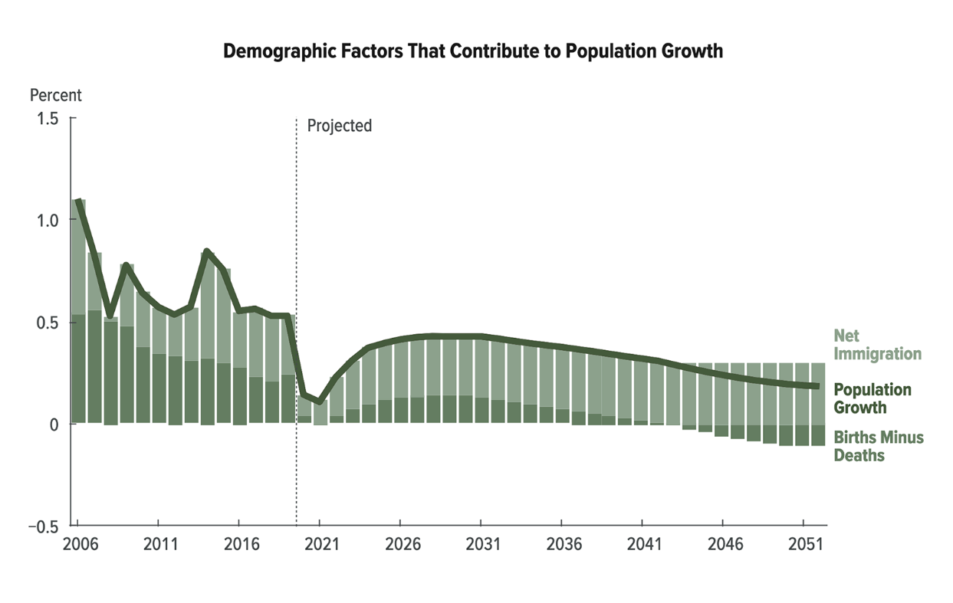
Demographics Contribute To Population Growth
Population growth is slowing
U.S. population will grow from 335 million people in 2022 to 369 million people in 2052
Population growth increasingly driven by net immigration
Source: Congressional Business Office, July 27, 2022
Notes:
Population growth has been increasingly driven by net immigration, which accounts for all population growth after 2042.
These were the forecast assumptions in 2022. Based on recent actions by the new administration Moody’s is forecasting a significant decline in net migration and much slower population growth

Slide 18
Individual Life Forecast
Source: LIMRA’s U.S. Life Insurance Sales Forecast
Notes:
In non-recession years life premium grows about 3% on average
VUL – up every year from 2025 – 2027, but less so than in 2023 and 2024. Currently the S&P is forecast to decline in 1Q20026
IUL – low to moderate growth as interest rates were expected to remain close to current levels if not a little lower. We may need to adjust if they continue to rise
FUL – this was a surprise for us in 2024. It had a strong year – driven by combination products. The growth associated with two new products introduced is expected to level off so we are projecting low to moderate growth in 2025 and a return to declines after that
Whole life – low to moderate growth. Probably closer to the low end of our projections given changes in interest rate projections
Term – also low to moderate growth (around that 3% mark) as usual

Slide 19

What We Are Watching
Economic environment
Tax cuts and jobs act extension of estate tax minimums and deductions for pass through entities (survivorship and small business sales)
Shifts in product focus
Consumer demand
Regulation
Notes:
A story of growth over the next couple of years
IUL and VUL continue to drive growth.

