Slide 1
Five Insights Into The Evolution of Distribution
Faye Williamson • Member Relations Director
Date

Slide 2
Insights Into The Evolution Of Distribution
Demographics is Destiny
Families and needs are changing; are you?

Slide 3
Insights Into The Evolution Of Distribution
Demographics is Destiny
Families and needs are changing; are you?
It’s all about the experience
Customers have high expectations – can you deliver?

Slide 4
Insights Into The Evolution Of Distribution
Demographics is Destiny
Families and needs are changing; are you?
It’s all about the experience
Customers have high expectations – can you deliver?
It’s all about the experience
A happy advisor means a happy end customer

Slide 5
Insights Into The Evolution Of Distribution
Demographics is Destiny
Families and needs are changing; are you?
It’s all about the experience
Customers have high expectations – can you deliver?
It’s all about the experience
A happy advisor means a happy end customer
Easy integration enables future innovation
Easier said than done, of course

Slide 6
Insights Into The Evolution Of Distribution
Demographics is Destiny
Families and needs are changing; are you?
It’s all about the experience
Customers have high expectations – can you deliver?
It’s all about the experience
A happy advisor means a happy end customer
Easy integration enables future innovation
Easier said than done, of course
There is no one answer…
… but you need to be experimenting to reach new markets

Slide 7
Demographics: Who Will You Be Selling To?
Little population growth
More diverse population
Fewer marriages
Fewer children
Aging population

Slide 8
Demographics Contribute To Population Growth
Population growth is slowing
U.S. population will grow from 335 million people in 2022 to 369 million people in 2052
Population growth increasingly driven by net immigration
Source: Congressional Business Office, July 27, 2022
Notes:
Population growth increasingly driven by net immigration, which accounts for all population growth after 2042

Slide 9
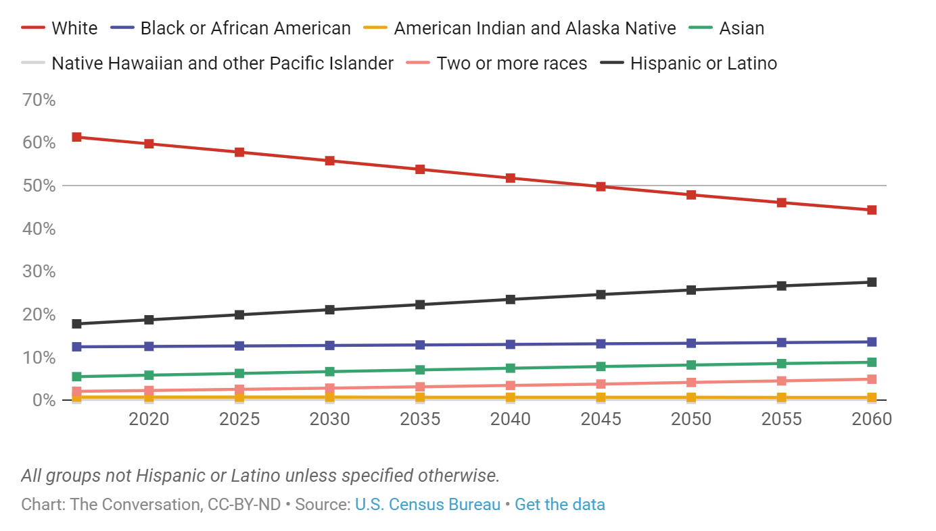
The Changing Face Of The United States
After 2045, non-Hispanic whites will likely
make up less than half of all Americans
Multilingual advisors growing their business at twice the
rate of monolingual advisors and have more clients with
incomes over $1 million.
Source: LIMRA EY Study of Experienced Advisors, 2023.
Notes:
on the first day of 2020, whites under age 18 were already in the minority. Among all the young people now in the U.S., there are more minority young people than there are white young people.
Among old people age 65 and over, whites are still in the majority. Indeed white old people, compared to minority old people, will continue to be in the majority until some years after 2060.

Slide 10
Fewer Marriages, More Divorces
% saying, by 2050, they expect people will be ____ likely than they are now
Source: Pew Research, Looking to the Future, Public sees an American Decline on Many Fronts.

Slide 11
Female Advisor Growth
Female advisors are growing their client base 22% more than their male counterparts.
Source: LIMRA EY Study of Experienced Advisors, 2023.

Slide 12
Age Brings Opportunity
The number of Americans ages 65 and older will more than double over the next 40 years
Statista, 2023
Share of population 65 and older, 1950-2025

Slide 13
Need Growing, but Sales Aren’t (mostly)
 | U.S. Individual Life Insurance Annualized Premium Growth
2021 | 18%
2022 | 1%
2023 (Forecast) | -3 to +1%
2024 (Forecast) | +1 to +5%
Gap Between Own Insurance and Need Insurance
Industry premium declined 13% in the last three months of 2022 and continued into 2023, with annualized new premiums dropping 7 percent compared with first quarter 2022.
After dropping throughout 2022, policy sales stabilized, increasing by 4 percent in the first quarter 2023.
Intermediaries are most bullish on indexed universal life products and most bearish on fixed universal life.
Source: LIMRA- NAILBA BGA IMO Survey, 2023

Slide 14
Consider…
Are products that worked for Boomers what the market really wants?
Do your products reflect the reality of the market? (Delayed family formation, high debt, different family structures and markets)
What does the future financial professional look like? What will they expect and what will they need to manage large books of business?
Notes:
Wellness services

Slide 15
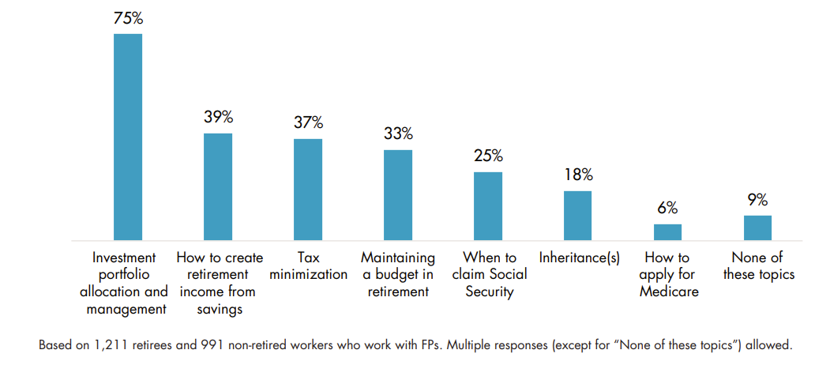
Consumers Have Other Things On Their Minds
Topics Discussed With Financial Professional in Past Two Years
19% have a very or somewhat favorable view of the economy
66% say inflation is a major concern for them
32% say they have somewhat or high stress levels around their household finances
LIMRA Retirement Investors Survey 2022
Source: LIMRA Consumer Sentiment Survey, January 2023

Slide 16
What Clients Don’t Understand About Life Insurance…
Sample: All FP’s selling life insurance
Source: Reimagining Growth: LIMRA-EY Experienced Financial Professional Study, 2023

Slide 17
…Differs By Advisor Type
What Clients Don’t Understand About Life Insurance
Sample: All FP’s selling life insurance
Source: Reimagining Growth: LIMRA-EY Experienced Financial Professional Study, 2023

Slide 18
Trust Matters…
Consumers With an “Extreme Amount” or “Quite a Bit” of Confidence in…
Formal financial plans drive trust in advisors, satisfaction with advisors, loyalty to advisors, and increase cross sales.
Base: Consumers involved in their households’ financial decisions. *July ‘08 represents October-surveyed consumer responses regarding “3 months ago.”
Notes:
Twenty-seven percent of Americans have high levels of confidence in insurance companies today, down 6 percentage points from January 2022 and 5 points below its pre-pandemic levels (January 2020).

Slide 19
Facts and Figures: Food for Thought
3
Number of carriers advisors place business with
Source: Reimagining Growth: LIMRA-EY Experienced Financial Professional Study, 2023

Slide 20
Facts and Figures: Food for Thought
57%
Percent of life business given to top carrier
Source: Reimagining Growth: LIMRA-EY Experienced Financial Professional Study, 2023

Slide 21
Facts and Figures: Food for Thought
31%
Percent who added/replaced carrier
Source: Reimagining Growth: LIMRA-EY Experienced Financial Professional Study, 2023

Slide 22
Facts and Figures: Food for Thought
19%
Percent who dropped carrier
Source: Reimagining Growth: LIMRA-EY Experienced Financial Professional Study, 2023

Slide 23
Experience is the Most Important…
Primary Reasons Financial Professionals
Place Business with their top Life Carrier
* Including things like integration with financial professional platforms and illustrations
** Including things like faster, easier, consistent application and underwriting process
Source: Reimagining Growth: LIMRA-EY Experienced Financial Professional Study, 2023

Slide 24
…for Placement and for Stopping Placement
Source: Reimagining Growth: LIMRA-EY Experienced Financial Professional Study, 2023

Slide 25
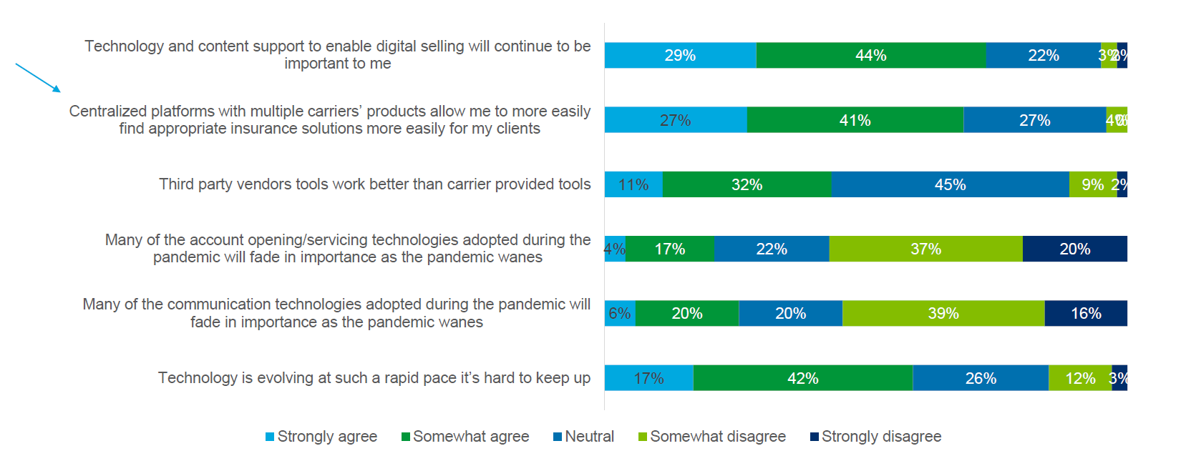
Centralized Platforms Improve Experience
FP’s are forced to use a fragmented set of tools and platforms to support clients
Source: Reimagining Growth: LIMRA-EY Experienced Financial Professional Study, 2023

Slide 26
Technology: Easy Integration Enables Innovation
Technology is not fully optimized
Address legacy systems; don’t create “bolt ons” that provide a slick front end that short circuits and is not integrated across the customer experience.
Create a simple way to connect to insurtechs. You don’t need to build everything yourself. And you don’t really want to.
Ensure digital transformation across the value chain
Clean up data – GIGO. This is necessary to leverage the potential of AI and automation

Slide 27
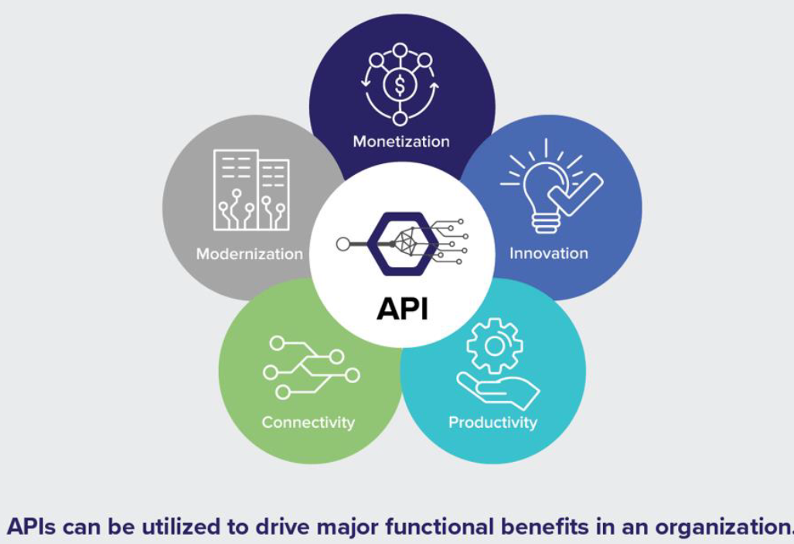
The API Economy is Driving Change
An application programming interface(API) establishes an online connection between a data provider and an end-user. This allows IT to simplify and automate tasks, and speed development.

Slide 28
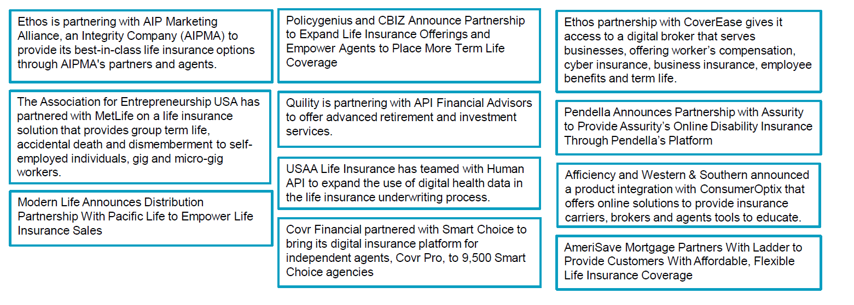
Solutions Offer a Potential Competitive Advantage
We are seeing a steady increase in partnerships within the insurance industry

Slide 29
There is No One Answer…
But you need to be experimenting…

Slide 30
Our Mission
Advancing the financial services industry
by empowering our members with
Knowledge
Insights
Connections
Solutions
Notes:
Now that you know a little bit more about us and our membership let’s now focus on what exactly we do.
Our purpose is to advance the industry by empowering our members through insights, connections, knowledge and solutions. I’m going to talk about each one of these and the products and services we offer to live up to that purpose and support our membership.

Slide 31
Our Organization and Brands

