Slide 1
2025 Insurance Barometer Study
Report 1
LIMRA and Life Happens

Slide 2
Key Insights
Understanding Life Insurance
The Cost of Life Insurance
Life Insurance Ownership
The Need Gap
Life Insurance Perceptions
The Influence of Social Media
Seeking Financial Professionals

Slide 3
Understanding Life Insurance

Slide 4
Understanding Life Insurance
41% overall say they are only somewhat or not at all knowledgeable about life insurance.
Source: 2025 Insurance Barometer Study, LIMRA and Life Happens.
Notes:
Talk about the panoply of options out there these days. “Not like it was back in the day. “
These are self-assessments, and I think they’re overestimating as it is – men vs. women, younger generations, c’mon.
Maggie
–the crux of why we do this study: to find out what it is that they don’t know (or think they don’t know
--why LH continues it’s mission to educate consumers
--always a new “crop” of people coming into the market who do not know

Slide 5
Understanding Life Insurance
1966
“I feel there should be more education on life insurance. I found that most people are not aware of how important [life] insurance is and at what price it can be bought by young people.”
2025
“I would expect life insurance to be around the same price or a little more that my other insurances like car/medical insurance.”
Source: 2025 Insurance Barometer Study, LIMRA and Life Happens.
Notes:
These quotes are from 2 different LIMRA focus group studies. Both are from Millennial-aged women. The 2nd one is from a recent Young Consumers study conducted a few months ago. The first one is from a 1966 LIMRA study on recently widowed beneficiaries. Almost 60 years
Maggie: Life Happens 1994; 30 years

Slide 6
The Cost of Life Insurance

Slide 7
The Cost of Life Insurance
Historically, about three quarters of Americans overestimate the actual
cost of life insurance.
Source: 2025 Insurance Barometer Study, LIMRA and Life Happens.
Notes:
One of the most attention grabbing metrics Maggie and I share in presentations is regarding what the average consumer thinks a middle of the road life insurance policy’s annual premium is. We asked everyone what a 250K level-term 20 year policy for a healthy male would be for several years and consistently found that 75 % overestimated the cost, ____ at 3x or more. Last year we added a follow-up that found that over 50% were basing their estimate on gut feeling or wild guess. But we – and you and your companies- wanted to know more. Maggie
--critical info for us at LH and for you (even if you are in the HIE or advanced markets)
--mantra: they are not going to buy what they don’t understand (education) and think they can’t afford (overestimate price)

Slide 8
The Cost of Life Insurance
Adults 35 and under who say they are healthiest are overestimating the price of life insurance by 7–10x
Source: 2025 Insurance Barometer Study, LIMRA and Life Happens.
Notes:
It has always been a little unfair expecting people to accurately estimate what 30 year old healthy male would pay for something that is priced based on things like gender, age, and overall health. So this year we tightened up the question a bit, asking respondents to price the same product for themselves. We know their gender, age, and asked them to rate their own health on a 11 point scale. On first glance, it does look like people have a slightly better idea of what a policy would cost for themselves, but honestly not really. We asked the same policy (250K 20 yr level term) and explained what we were asking (how much you’d pay a yr to pay out 250k to beneficiary if you die.)
Maggie
--what else do we buy that costs us several hundred dollars that people think is 7 to 10 times more than it is … meaning is hundreds but we think costs thousands

Slide 9
The Cost of Life Insurance
Of those who say it’s too expensive…
the majority overestimate the cost
53%
76%
Millennials
Gen Z
Source: 2025 Insurance Barometer Study, LIMRA and Life Happens.
Notes:
We really tried to drill down this year, asking respondents to rate their health and then we were able to take those numbers, their age, their gender and ask them what they think THEY would pay. Interestingly, those who would pay the least – healthy younger adults – over estimate the cost the MOST.
AND they are also likely to cite cost as a reason not to buy. “Too good to be true” – as P&C costs rise with labor, materials, tariffs, environmental events, etc., life more or less stays stable, really only responding to inflationary reasons. It’s kind of amazing. They don’t believe it.

Slide 10
Financial Concerns
Source: 2025 Insurance Barometer Study, LIMRA and Life Happens.
Notes:
Comfy retirement # 1 for all except Z
Hisp, Black, LGBTQ more concerned generally
Asian significantly more concerned about losing $ on investments – ties into Asian view of life as more of an investment than others.
Z and Mill more concerned than X across the board
Mill most concerned in 10 of 15
Z most concerned in 5 of 15 – (Paying my monthly bills Paying my mortgage or rent Losing money on my investments Paying off or reducing student loan debt Job security/maintaining a steady income )

Slide 11
Financial Security of Families
How long would it be before your household would feel the financial impact if the primary wage earner were to pass away?
Source: 2025 Insurance Barometer Study, LIMRA and Life Happens.
Notes:
Almost half (47%) under 6 months.

Slide 12
Life Insurance Ownership

Slide 13
Life Insurance Ownership
37% say they have an individual policy
51% of adults say they have some type of life insurance.
23% say they have a group/workplace policy
Source: 2025 Insurance Barometer Study, LIMRA and Life Happens.
Notes:
51% is the consumer reported # and when we look at the breakdown of that a bit – click –
We can know where the disconnect it. Ind – know, group/worksite do not. We estimate it much higher in the high 30% range, so why? “drowning in information”… Are we connecting with our customers? How to better communicate these days with employees who DO have our benefit, even if their employer is paying100%. We know it’s eroded since 2010 and have the data to back that up. Why? IF they knew more about their life benefit, would that prompt them to look into other more personalized life coverages?
an educated consumer is a more likely consumer.

Slide 14
Life Insurance Ownership
Total life insurance ownership: 51%
Source: 2025 Insurance Barometer Study, LIMRA and Life Happens.
Notes:
Demographic ownership.
Hispanic – things in Spanish …

Slide 15
The Need Gap

Slide 16
Life Insurance Need Gap
Uninsured and underinsured need gap:
30%
need
life insurance
10%
need more life insurance
plus
Source: 2025 Insurance Barometer Study, LIMRA and Life Happens.
Notes:
Explain what Life Ins Need Gap is and why it’s important

Slide 17
Life Insurance Need Gap
Uninsured and underinsured need gap:
74 million Americans
25 million Americans
plus
Source: 2025 Insurance Barometer Study, LIMRA and Life Happens.

Slide 18
Life Insurance Need Gap Over Time
Source: 2025 Insurance Barometer Study, LIMRA and Life Happens.
Notes:
Pandemic effect, starting to return? But that long period of increase is still interesting

Slide 19
Life Insurance Perceptions

Slide 20
Life Insurance Perceptions
% who agree with these statements
 | Gen Z | Millennial | Gen X
Life insurance is only for final expenses | 30% | 32% | 20%
I can’t personally benefit from life insurance | 34% | 39% | 30%
Certain types of life insurance provide the benefit of some income in retirement | 51% | 55% | 50%
Life insurance companies prefer I live a long and healthy life | 52% | 61% | 61%
Source: 2025 Insurance Barometer Study, LIMRA and Life Happens.
Notes:
Catch/note difference in last line
--content around living benefits

Slide 21
Reasons They Don’t Own Life Insurance — or More of It
Source: 2025 Insurance Barometer Study, LIMRA and Life Happens.
Notes:
#2 are
The other three are things we can address

Slide 22
The Influence of Social Media

Slide 23
Reaching People Where They Are
62% use social media when seeking information on financial or insurance products
Source: 2025 Insurance Barometer Study, LIMRA and Life Happens.
Notes:
Mention that it’s tough to separate these platforms now – since Meta owns FB & Insta, Google owns YT, and its very common to post tiktoks on Insta,FB Reels, YT Shorts and vice versa etc. “social media IS the Internet for so many now, incl people in this room.” tiktoks but not on tiktok
Maggie
--not overly skewed young
--we may not like it, but that is where they are

Slide 24
Influencers
Millennials and Gen Z, who use social media for financial information, follow …
Source: 2025 Insurance Barometer Study, LIMRA and Life Happens.
Notes:
Its tough out there. There is some bad information – how do stodgy companies cut through that noise AND impart trust and education in the face of flashy, young, hip person ?

Slide 25
Influencers
About half of Millennials and Gen Z (49%) think recommendations from experts, influencers, or spokespeople are extremely or very important.
Source: 2025 Insurance Barometer Study, LIMRA and Life Happens.
Notes:
Again, WHO? Podcasts are important now – story from YC study

Slide 26
Advertising on Social Media
63% of Millennials and Gen Z say they would pursue life insurance advertising
Source: 2025 Insurance Barometer Study, LIMRA and Life Happens.

Slide 27
Seeking Financial Professionals

Slide 28
What People Seek When Looking for Advisors
Source: 2025 Insurance Barometer Study, LIMRA and Life Happens.
Notes:
Experience is always paramount and will never change, no matter how many bells and whistles. Can’t know what people mean by “special focus” but it’s interesting nonetheless. (We did ask if wanting same gender/race/etc. but that rates very low, so this should be something different)
Recommendations – but for many, GenZ, Black Americans, lower incomes, empathy & Kindness slotted in behind the top 2. All should be aware of situations, being cognizant of language and culture, different cultures and backgrounds view death very differently. BE AWARE. TRAIN.
Northwestern Mutual says it plans to hire more than 5,000 financial professionals this year, citing a "financial insecurity epidemic" and a looming generational shift among advisors.
The new employees will include an unspecified number of financial advisors, representatives and interns, the firm announced this month.
"Financial insecurity continues to be an epidemic in America, and many people are looking for an advisor to guide them down a path toward greater financial security," said chief field officer John Roberts.
The firm's own survey data suggests robo-advisors and artificial intelligence-based advisory services have only limited appeal, with respondents trusting human advisors over AI and robos by a margin of 54% to 15%.

Slide 29
Financial Professionals Versus AI
51% would use AI to research
55% would use AI to shop
Source: 2025 Insurance Barometer Study, LIMRA and Life Happens.
Notes:
Humans are still relevant – and look to be for the foreseeable future!
Northwestern Mutual says it plans to hire more than 5,000 financial professionals this year, citing a "financial insecurity epidemic" and a looming generational shift among advisors.
The new employees will include an unspecified number of financial advisors, representatives and interns, the firm announced this month.
"Financial insecurity continues to be an epidemic in America, and many people are looking for an advisor to guide them down a path toward greater financial security," said chief field officer John Roberts.
The firm's own survey data suggests robo-advisors and artificial intelligence-based advisory services have only limited appeal, with respondents trusting human advisors over AI and robos by a margin of 54% to 15%.

Slide 30
What Does It All Mean — What Can You Do?
Lean into the stability of the industry during uncertainty
Educate to overcome knowledge gap; misconceptions
Believe them when they tell you why they are not buying
Use social media and influencers to educate, convert
Keep an eye on AI and how your company can leverage it
Notes:
Life pays no matter what as long as paying premiums.

Slide 31
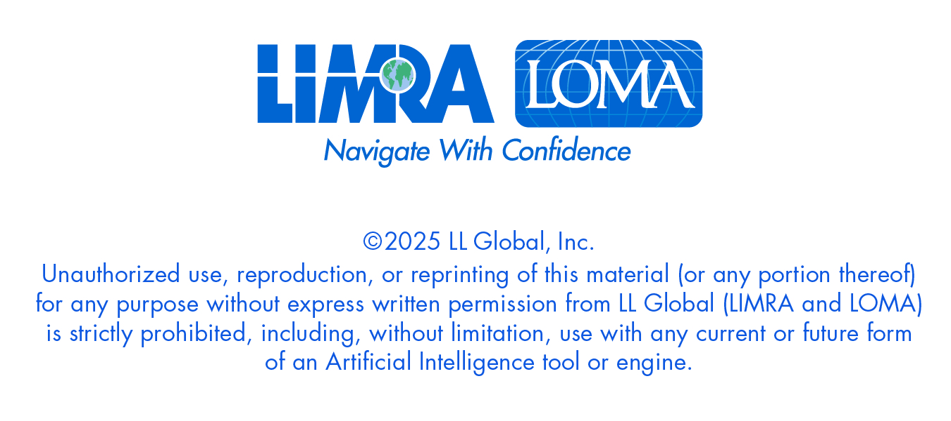
0414-2025

