Slide 1
A World of Opportunities: The Future of Life Insurance and Annuities
April 2025

Slide 2
Key Trends Shaping Actuarial Demand

Slide 3
Key Trends Shaping Actuarial Demand
Technology and Artificial Intelligence
Skillset Evolution
Non-Credentialed Staff
Offshoring/Nearshoring
Notes:
Some Trends Shaping Actuarial Demand that the SOA is watching
Technology
The adoption of AI tools by insurers is getting a lot of investment and attention but in the next several years, actuaries and actuarial work are still likely to be impacted more by the ongoing rapid adoption and refinement of data, large databases, and predictive analytic tools.
Actuarial leaders report that they expect AI to have a major impact over time on actuarial work (and they expect it to largely be positive for the profession), but they’re not seeing it much yet in their day-to-day work and it isn’t yet impacting their hiring decisions.
They do believe more skill development and investment aimed at developing AI-relevant skills and AI tools is needed.
Skillset evolution
Actuarial leaders (and the managements above them) expect senior actuaries to bring regulatory expertise, strategic insight, and strong communication skills on top of a foundation of strong math and analytical skills.
They don’t expect the SOA to provide the necessary education for these higher-level skills but instead to ensure that a really strong technical foundation is laid.
Use of non-credentialed staff
We’ve seen in some market segments a rise in the use of non-credentialed or partially-credentialed staff for certain actuarial functions. But our demand research suggests this trend is limited mostly to entry-level and highly repeatable tasks and is centered on the benefits administration industry.
The good news for experienced actuaries is that the demand for highly-skilled talent is expected to remain strong in the market segments that are expected to grow the fastest over the next few years, for example in reinsurance and private equity engagement in insurance markets.
Offshoring and near-shoring
This is a phenomenon we’ve seen in recent years as a cost containment effort centered mostly in the benefits administration industry and the large multi-national life insurance industry.
It is not seen as a growing trend in either the reinsurance or health segments, which are expected to be the fastest growing market segments overall.
For health, there are significant limits on this practice arising from country-specific regulations on data privacy and market players in health tell us it’s not an approach they expect to use.

Slide 4
The Future of Life Insurance and Annuities
Notes:
ACLI is tracking the same trends as LIMRA and LOMA

Slide 5
Key Trends
Record Annuity Results
…but Variable Annuities Are Declining
Record Life Results
…but Policy Counts Are Falling
Record Life Insurance Demand
…but Supply Is Challenged
Record Industry Revenue
…but Expenses Are Also Growing
Continued Consolidation of the Independent Channel
Capital in the Industry Is at Record Levels
Notes:
ACLI is tracking the same trends as LIMRA and LOMA

Slide 6
Record Annuity Results
More than two times 2020 results
Dollars in billions.
Source: U.S. Individual Annuity Sales Survey, LIMRA.
Notes:
2024 Sales by Product
Deferred Income: $4.95 (1%)
Fixed Immediate: $3.6 (3%)
Fixed-Rate Deferred:$153.2 (36%)
Indexed Deferred: $126.9 (29%)
Traditional Variable: $60.9 (14%)
Structured Settlements: $8.9 (2%)
Registered Index-Linked Annuities: $65.6 (15%)
Total: $434.1

Slide 7
…but Variable Annuities Are Declining
Dollars in billions.
Source: U.S. Individual Annuity Sales Survey, LIMRA.
Notes:
RILAs launched 4Q 2010, these products are still in the teenage years, it took a long time for manufacturers to buy into them.

Slide 8
…but Variable Annuities Are Declining
Dollars in billions.
Source: U.S. Individual Annuity Sales Survey, LIMRA.
Notes:
RILAs launched 4Q 2010, these products are still in the teenage years, it took a long time for manufacturers to buy into them.

Slide 9
…but Variable Annuities Are Declining
Dollars in billions.
Source: U.S. Individual Annuity Sales Survey, LIMRA.
Notes:
RILAs launched 4Q 2010, these products are still in the teenage years, it took a long time for manufacturers to buy into them.

Slide 10
Record Life Results
Source: U.S. Retail Individual Life Insurance Sales Survey and Industry
Estimates — Annualized Premium, LIMRA.
Notes:
2024 Sales by Product
Indexed Universal Life: $3.8 (24%)
Fixed Universal Life: $1.1 (7%)
Variable Universal Life: $2.2 (14%)
Term: $3.0 (19%)
Whole Life: $5.8 (36%)
Total: $15.9

Slide 11
…but Policy Counts Are Falling
Source: U.S. Retail Individual Life Insurance Sales Survey and
Industry Estimates — Annualized Premium, LIMRA; Life Insurers Fact Book, ACLI, 2024.

Slide 12
Record Life Insurance Demand
About 100 million Americans are uninsured or underinsured.
Source: 2025 Insurance Barometer Study (unpublished), LIMRA and Life Happens.

Slide 13
…but Supply Is Challenged
Affiliated: Agency-building, MLEA, home service channels.
Independent: Independent insurance agents focused on life insurance sales.
Sources: U.S. Sales Capacity — A Census of Affiliated FPs, LIMRA and LIMRA estimates, 2023; FP (Agent) Production and Retention, LIMRA, 2023; Casting Light on the Age of an Independent Insurance Agent, LIMRA, 2018.

Slide 14
…but Supply Is Challenged
Average Age 62
Average Age 46
Affiliated: Agency-building, MLEA, home service channels.
Independent: Independent insurance agents focused on life insurance sales.
Sources: U.S. Sales Capacity — A Census of Affiliated FPs, LIMRA and LIMRA estimates, 2023; FP (Agent) Production and Retention, LIMRA, 2023; Casting Light on the Age of an Independent Insurance Agent, LIMRA, 2018.

Slide 15
Record Industry Revenue
Data compiled March 10, 2025.
Based on annual total direct premiums and considerations contained within the Exhibit-1 Part-1 premiums and annuity considerations for life, annuity, and accident and health contracts. U.S. life filers only.
* The 2024 annual premiums and considerations for select companies is sourced manually or based on proprietary projections.
Source: S&P Global Market Intelligence.
© 2025 S&P Global.
Notes:
2024 sees highest premiums and consideration growth in US life industry in last 20 years
It estimates industry income at 14.2% and says it is the industry’s best income in 20 years. They use annual statement data and projections for that since all the statements probably haven’t been publicly released yet.

Slide 16
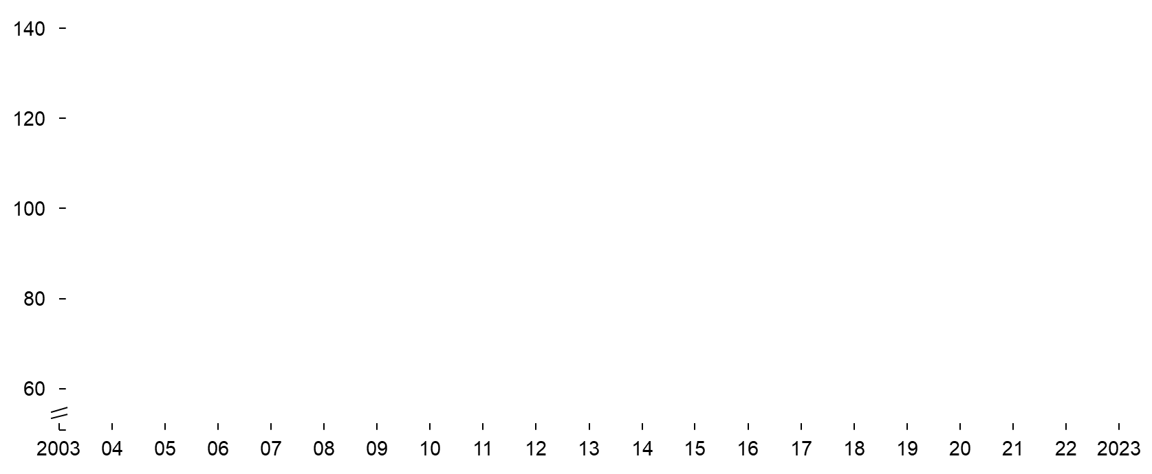
…but Expenses Are Also Growing
Cost Efficiency Evolution by Industry¹
Change 2003–2023
U.S. Life Insurance +26%
U.S. Property and Casualty -3%
U.S. Asset Managers -4%
Automotive -29%
Telecommunication -29%
¹ Indexed; Expressed as “SG&A expenses as % of revenue.”
Source: S&P Capital IQ, Team analysis, McKinsey NA Life & Annuities 360 Performance Benchmarking Survey, LIMRA, 2023.
Notes:
U.S. Insurance Industry Continues to Lag on Productivity
% Total SG&A Expenses / Revenues, Normalized at 100 in 2003

Slide 17
…but Expenses Are Also Growing
Individual Life Cost Ratio
Individual Annuities Cost Ratio
 |  | Delta |  | Delta
Product Development and Marketing |  | 2.3x |  | 2.8x
Sales Distribution² |  | 1.7x |  | 2.2x
Sales Support |  | 2.2x |  | 3.4x
Operations: New Business³ |  | 1.9x |  | 3.0x
Operations: In Force |  | 2.3x |  | 2.8x
IT |  | 2.0x |  | 2.4x
Corporate Functions |  | 1.8x |  | 2.4x
Investment Office |  | 3.1x |  | 2.9x
Total |  | 1.7x |  | 2.4x
Top Quartile Bottom Quartile
² Includes agent commissions, salaries and benefits, and all other agent costs including allowances, 3p strategic distribution payments, and agent lease expenses, etc. ³ New business contact center costs included in Operations: New Business (excluded from Operations: In Force).
Source: McKinsey-LIMRA 2024 Individual L&A Benchmark Survey. NOTE: Total based on reported total cost/GPW for each participant.
Notes:
Individual Life and Annuities – 2023, Expenses as a % of Gross Written Premiums
Efficiency Disparity Among Carriers

Slide 18
Capital in the Industry Is at Record Levels
Reinsurance/M&A
Notes:
There were 30 distribution acquisitions in the life-annuity sector in 2024. This decreased from 65 life-annuity distribution acquisitions in 2023. Of those 30 transactions, 23 were acquired by two companies: Integrity Marketing Group, backed by Silverlake, Harvest Partners, and Carlyle, acquired 18 distributors. Simplicity Group, backed by Lee Equity Partners, acquired five distributors.

Slide 19
Capital in the Industry Is at Record Levels
Carriers
Asset Managers
Reinsurers
Private Equity Firms
Foreign Insurers
Notes:
https://www.wealthmanagementoutcomes.com/post/private-equity-investing-in-the-life-annuity-industry
As private-capital firms have gained market share in the insurance sector, they have injected more than $31 billion of net new private capital into the life and annuities industry worldwide since 2014. To put that in perspective, over the same period, publicly traded insurers have returned about $175 billion to shareholders, representing 74% of their collective current market capitalization.
Private-capital firms account for 35% of new sales in fixed and fixed-indexed annuities in the United States, up from 7% in 2011.
https://www.mckinsey.com/industries/financial-services/our-insights/private-capital-in-insurance-2-point-0-building-the-flywheel
In 2021, private investors announced deals to acquire or reinsure more than $200 billion of liabilities in the United States. Such investors now own over $900 billion of life and annuity assets in Western Europe and North America. Assuming the pending deals close successfully, private investors will own 12 percent of life and annuity assets in the United States, totaling $620 billion, and represent more than a third of US net written premiums of indexed annuities. All five of the largest private equity (PE) firms by assets have holdings in life insurance, representing 15 to 50 percent of their total assets under management.
https://www.mckinsey.com/industries/private-capital/our-insights/why-private-equity-sees-life-and-annuities-as-an-enticing-form-of-permanent-capital

