Slide 1
The Upsides: Segment Marketing Plan
Lisa Rabuse, Integrated Marketing
November 2, 2023

Slide 2
Segmentation Strategy
Variable
Weight
2x2 Segmentation Framework
Total Revenue: Dues & Commercial
50%
3 | 1
4 | 2
Engagement
Account Penetration >$10k
30%
Net Membership Value
20%
Revenue
Scope: Includes LL Members; LIMRA Members (75% of domestic total revenue)
Excludes Affiliate, Associate & LOMA Only

Slide 3
Member Segmentation Profiles
The Opportunistics
The Cornerstones
39 member companies
21% in top focus list
8% of domestic revenue
11% of LL/LIMRA revenue
32 member companies
100% in top focus list
43% of domestic revenue
58% of LL/LIMRA revenue
57% of LLG board companies
Engagement
The Self-Reliants
The Upsides
27 member companies
1 company in top focus list
2% of domestic revenue
3% of LL/LIMRA revenue
43 member companies
70% in top focus list
22% of domestic revenue
29% of LL/LIMRA revenue
43% of LLG board companies
Revenue
Total domestic revenue percentages are based on $64 million base; LL/LIMRA revenue includes members in this project only.

Slide 4
The Upsides: Segment Snapshot
Member Relations
Net Membership Value Avg | $339k
Life Advisory Board (7 ) | 16% of segment
Annuity Advisory Board (10) | 23% of segment
Workplace Advisory Board (12) | 28% of segment
LLG Board | 43% of board companies
Segment Profile
Mid to large organization; life insurance is not primary business (WPB, P&C, annuity, re-insurers). If life insurance is a large part of the business, then they are Canadian firms or fraternals Moderate engagement with Member Relations Mid to high revenue mix Low to mid commercial revenue Low product utilization 2/3 Modest engagement with research and convening
Objective
Increase awareness & engagement Maximize member benefits (research, convening) to demonstrate value Increase commercial sales
Sales
Total Revenue | $0.9 – 0.1 million 22% of total revenue
Brand and Reputation
NPS | 52
Indispensable | 72%
Sentiment | 71%
Strategy
Relevancy is going to drive our engagement Build authentic and long-lasting relationships with functional leaders (Executive, LoB, Distribution, Product, Marketing, etc.) Keep connected including personal engagement; build strong liaison relationship Leverage member engagement dashboards to have that line of sight about how much they use us Create awareness and demand for commercial products & solutions Build reputation as a reliable and trusted industry expert

Slide 5
The Upsides: Engagement & Data Collection Summary
Engagement Data Collected
Member Engagement Snapshots: Ran snapshots for the Upsides relative to the top focus firm (top75) peer group. (70% of this segment is included in that list) Contact List in salesforce LIMRA.com Accounts Publications Active Subscriptions Pardot average engagement scores ( (email, web forms, landing page engagement)
Target Audience
16,102 mailable contacts – All levels & functions 7,800 middle managers or above
Member Engagement Snapshot Key Findings*
Product/Solutions: The majority are ranked 4th quartile (28/30) for professional development enrollments The majority have used Commercial research as a solution (26/30) Majority do not use Home office (5/30) or Field (8/30) assessments. Some correlation with use of field assessment & TWS Research: Majority rank low on research downloads - 3rd or 4th quartile Convening: Almost all are 4th quartile for conference attendance (28/30)
Engagement Metrics
5,175 have active limra.com accounts (32%) 2,420 N2U subscribers (15%) 6,784 MarketFacts subscribers (42%) Average account engagement score is 20
*Detailed heat map in appendix, slide 10

Slide 6
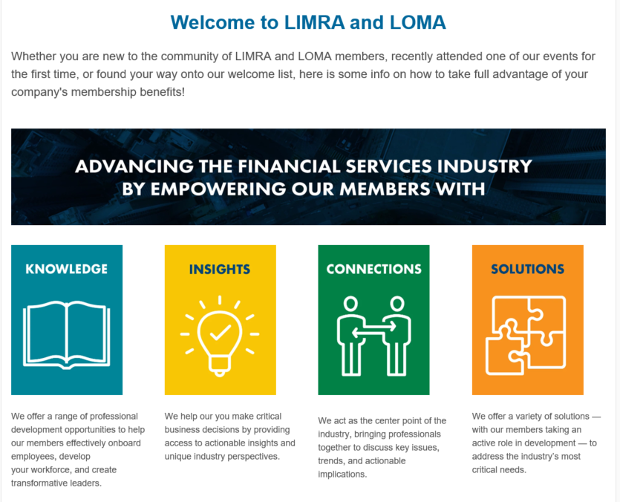
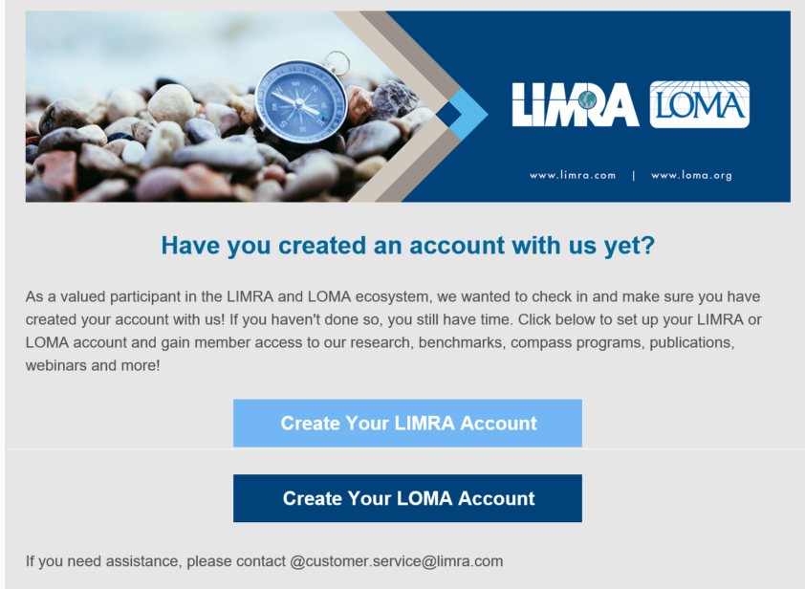
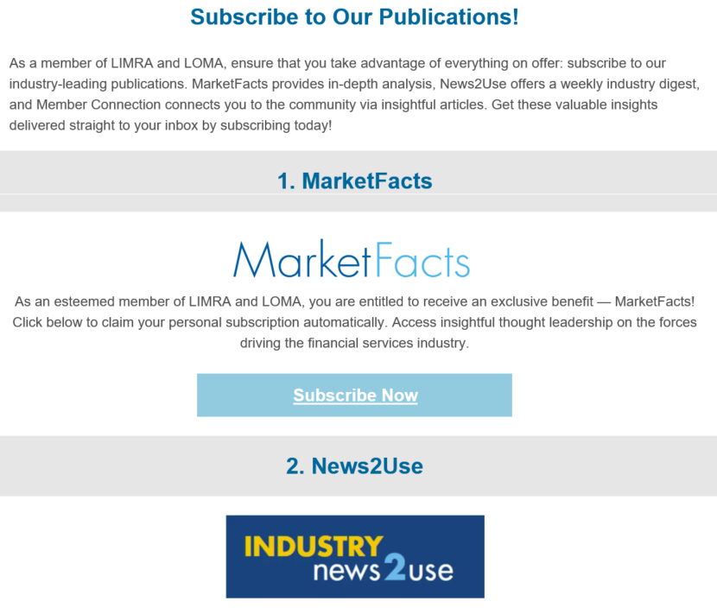

The Upsides: Q4 Tactical Journey Map
Build contact list
Awareness & Engagement Email Campaign
Maximize Member Benefits
Oct
[Nov 15 Kick-off]
Dec
Jan’24
The Upsides
TBD
Targeted Research/Conferences
42 Companies
16 k Contacts
1. Intro to LIMRA/LOMA
2. Create an Account
3. Subscribe to Publications
4. 2024 Conference Schedule
5. Leverage InfoCenter
6. Life
Talent WP
Gen Z
Millennials
Deeper Dive – IUL
Forecast
Quarterly Sales Infographics
BGA/IMO
6. Annuity
Talent WP
Deep Dive – VA
Quarterly Sales
Forecast
Wholesaler Study
6. WPB
Talent WP
Harnessing Growth
EE Insights
Forecast
Qtrly Sales
Q1 2024
Q2 2024
Q3 2024
Q4 2024
Maximize Member Benefits: Targeted Research/Conferences Monthly Email
Increase Commercial Sales: Targeted Prioritized Solutions Campaign

Slide 7
The Upsides: 2023-2024 Marketing Dashboard
 |  |  | 2023 | 2024
Objective | Campaign | Measure of Success | Q4 | Q1 | Q2 | Q3 | Q4
Increase awareness & engagement | Welcome campaign Empowering Our Members Register for the website, MF and News2use Highlight the InfoCenter as a resource | •5,175 have active limra.com accounts (32%) •2,420 N2U subscribers (15%) •6,784 MarketFacts subscribers (42%) [10% Increase TBD]
Maximize member benefits to demonstrate value | Max My Benefits campaign Tailored by LoB &triggered based on engagement Highlight relevant research & conferences | Increase Pardot account engagement score from 20 Email opens, page views & downloads Movement up from 4th quartile of research & convening
Increase commercial sales | Prioritized Solutions Targeted campaigns to drive awareness Tailored landing page with curated content | Sf.com pipeline improvement for PD, IS and ARS TBD TLP page views and click through rates
Monthly email to new SF.com users; max 3 emails per member
Monthly email based on LoB
AC campaign launch
Trigger based email to stagnant members
Pilot ABM
Refine ABM

Slide 8

Next Steps
Finalize email content and build in Pardot
Plan and align 2024 marketing content with Sales goals & objectives (i.e. monthly curated email by LOB)
Identify target companies for ABM pilot in 2024
Execute Email Campaign

Slide 9

Appendix

Slide 10
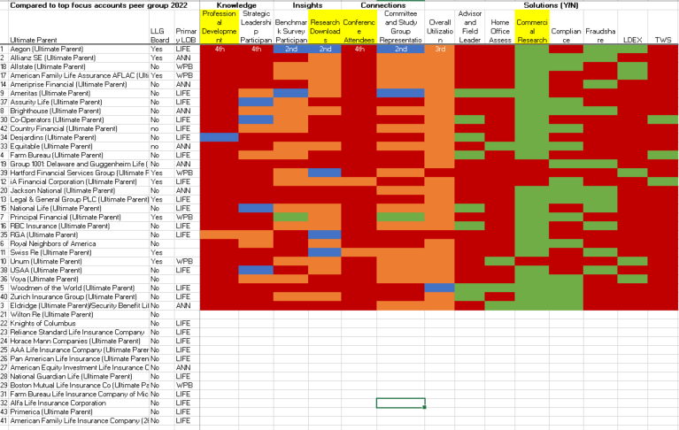
The Upsides: Penetration Heat Map

Slide 11
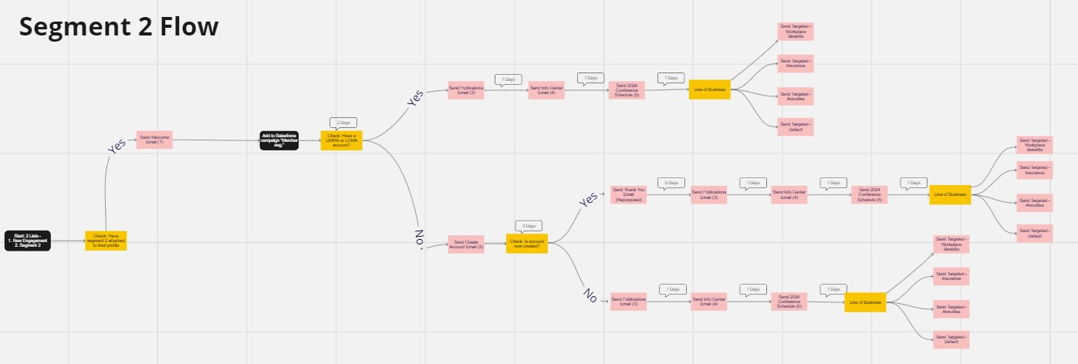
Email Journey Map

Slide 12
Companies by Quadrant
2. THE UPSIDES
Aegon/Transamerica
Allianz SE
Security Benefit Life
Farm Bureau
Woodmen of the World
Royal Neighbors of Ameri
Principal Financial
Brighthouse
Ameritas
Unum
Swiss Re
iA Financial Corporation
Legal & General Group PLC
Ameriprise Financial
National Life
RBC Insurance
American Family Life Assurance AFLAC
Allstate
Group 1001: Delaware and Guggenheim
Jackson National
Wilton Re
Knights of Columbus
Reliance Standard Life Insurance Company
Horace Mann Companies
AAA Life Insurance Company
Pan American Life Insurance
American Equity Investment Life Insurance Company
National Guardian Life
Boston Mutual Life Insurance Co
Co-Operators
Farm Bureau Life Insurance Company of Michigan
Alfa Life Insurance Corporation
Equitable
Desjardins
RGA
Voya
Assurity Life
USAA
Hartford Financial Services Group
Zurich Insurance Group
American Family Life Insurance Company
Country Financial
Primerica
Southern Farm Bureau added Nov 8
Board companies in bold; Missing board members: NFP
Meiji Yasuda Life Insurance Company changed to The Standard
Notes:
Work on segment names for appropriation. Refine.
High Revenue, High Engagement:
Do not move Manulife
Protective is highly engaged
Mutual of Omaha – best member, leave as is
Allianz – not engaged, move to mid revenue/low engagement
Sunlife – Canada they are big, US not so much, leave as is
Aegon – big dues but not a lot of engagement (historical), under new management, move to mid revenue/low engagement
The Standard – formerly Meiji Yasuda, bought Securian pension business, workplace benefits firm
Mid Revenue, Low Engagement
1.

