Slide 1

Lunch & Learn: Taking the Mystery Out of "LIMRA Research“
12/12/23

Slide 2
Our Purpose
LIMRA and LOMA Purpose:
Advancing the financial services industry by empowering our members with knowledge, insights, connections, and solutions
Member benefits purpose:
Be the go-to source for actionable market intelligence for products, markets, and distribution in the insurance, annuities and workplace benefits businesses

Slide 3
Our Purpose
LIMRA and LOMA Purpose:
Advancing the financial services industry by empowering our members with knowledge, insights, connections, and solutions
Member benefits purpose:
Be the go-to source for actionable market intelligence for products, markets, and distribution in the insurance, annuities and workplace benefits businesses

Slide 4
Research Program – Focus
Workplace
Benefits
Insurance
Annuities
Product
Distribution
Markets

Slide 5

Research Program - Focus
Workplace
Benefits
Insurance
Annuities
Product
+
Distribution
Additional Priority Issues
Markets

Slide 6

Research Program – Types of Research
Benchmarking studies
Discovery research
Compilations
White papers
marketScans
Custom research

Slide 7


Setting the Research Agenda
“Discretionary”
“Benchmark and Anchor”
Strive to Understand the Needs of Our Members

Slide 8

The Research Process
1
2
3
4
5
6
Design
Collection
Editing
Analysis
Reporting
Inquiries

Slide 9
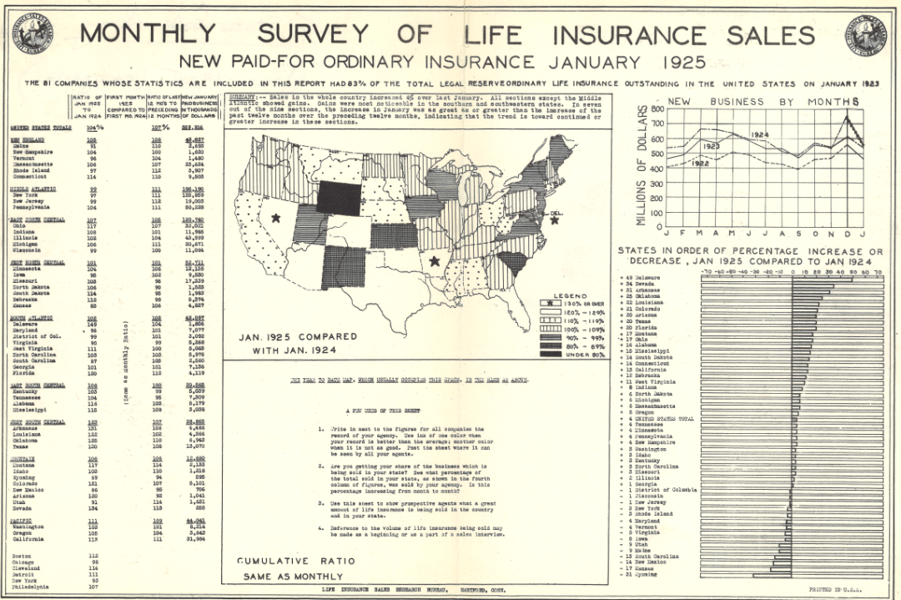
Benchmarking Studies
Benchmarks are ongoing studies that allow companies to compare their data to one or many others.
Source of data: Participating carriers (typically)
Product Sales/Inforce Studies
Product Experience Studies
Recruiting Trends Studies
Agent Retention Studies
Compensation Studies
Other

Slide 10







Discovery Research
Topical studies addressing current business issues. Can be recurring or one-time efforts.
Source of data: Dependent on study (consumers, investors, employees, employers, financial professionals or carriers)

Slide 11

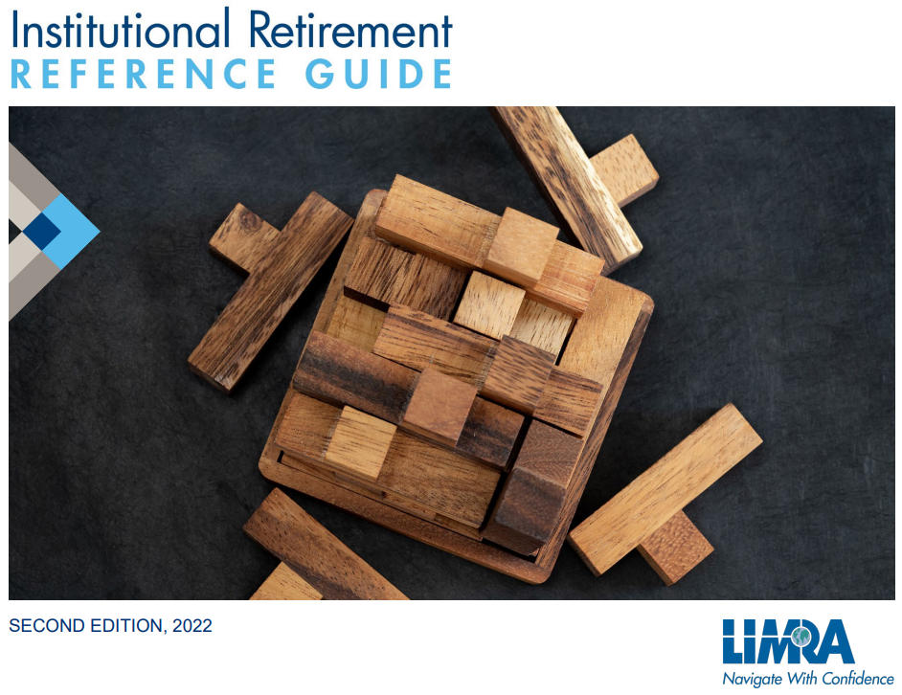

Compilations
Aggregations of statistics and information including Yearbooks, Fact Books, and Reference Guides
Source of data: Various secondary sources (LIMRA and other)

Slide 12


White Papers
Deliverables intended to provide thought leadership, showcase expertise, and address industry challenges.
Source of data: Dependent on study, may reflect on trends across studies or focus on subject matter expertise

Slide 13



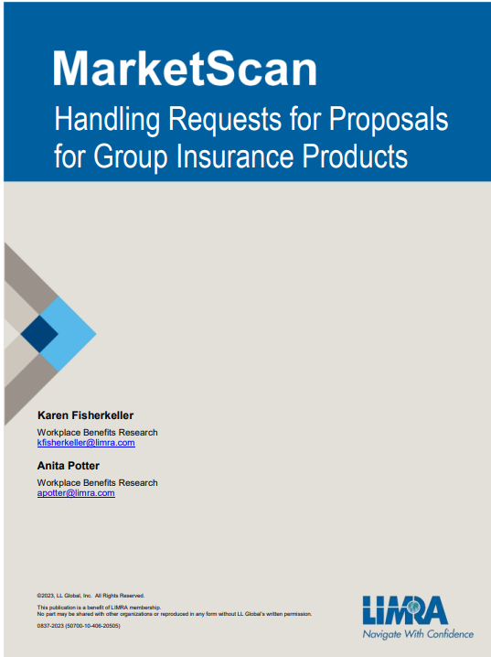
MarketScans
Source of data: Participating carriers

Slide 14
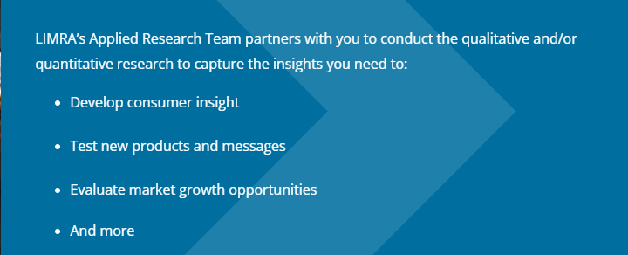
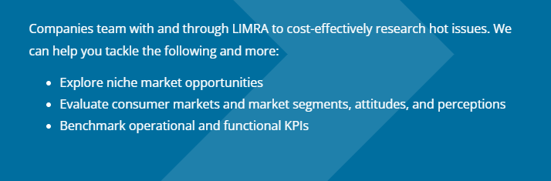

Applied Research Solutions
Custom Research
Consortia Research
.

Slide 15
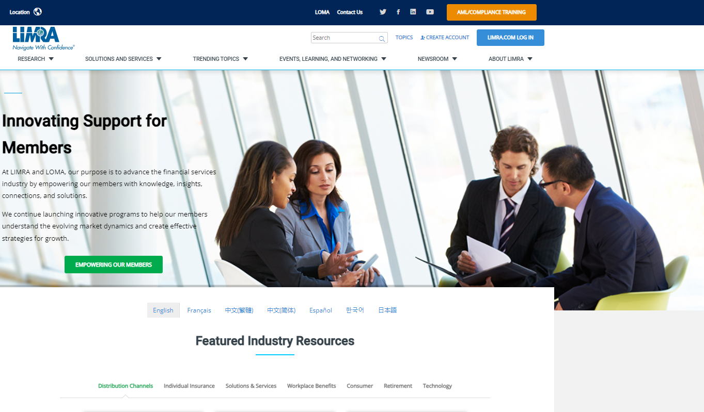
Do You have a LIMRA.COM account?

Slide 16
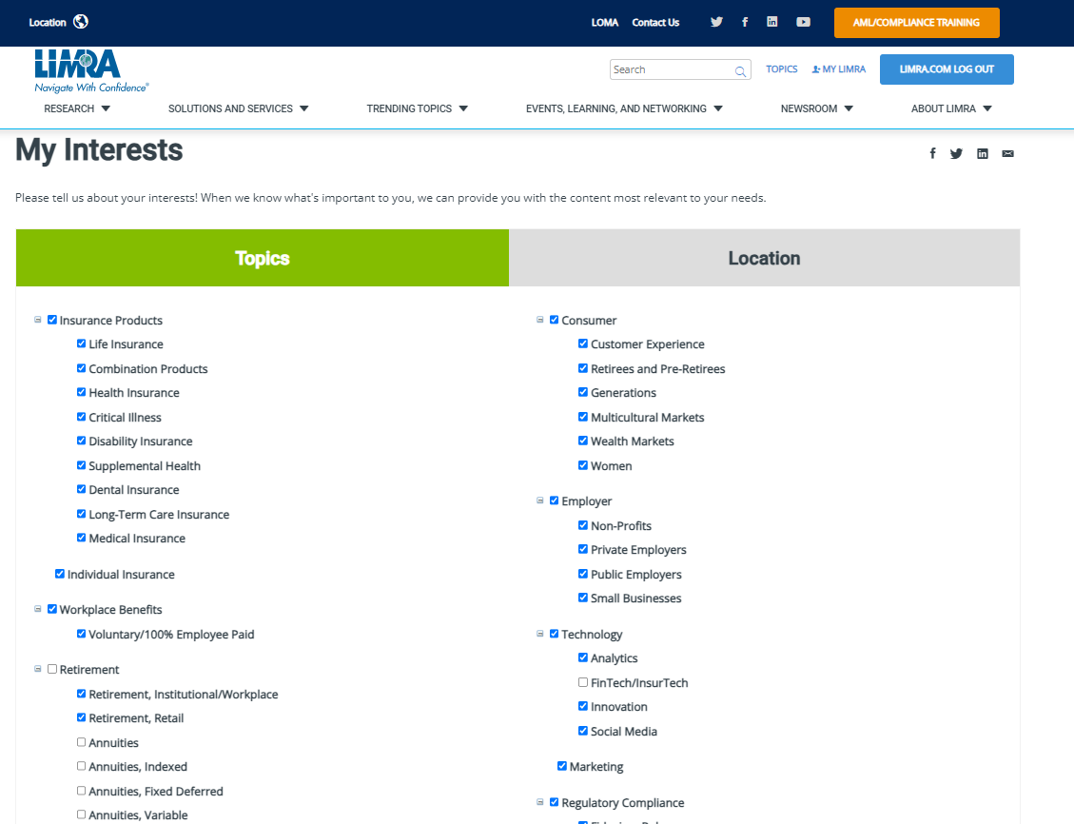
Have you signed up for “My Interests”

Slide 17
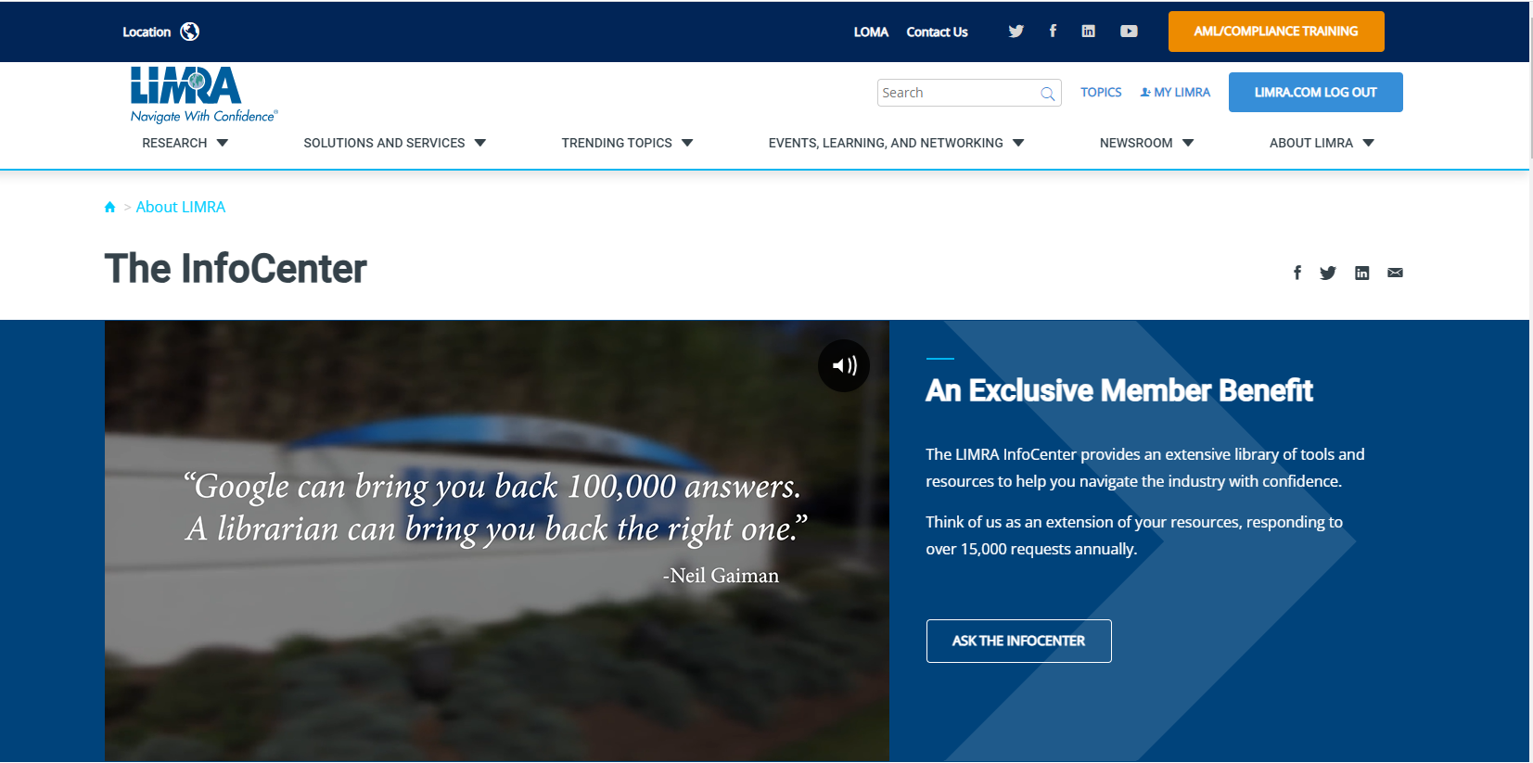
Ask the InfoCenter

Slide 18

Who Does What in Research
Click here for list of LIMRA Research Contacts

