Slide 1
Sample Presentation
This is a deck that can be modified for members who are interested in an overview of our producer assessments. It can be modified to include those pieces that are most important for the conversation.
For more information, contact Kathy Reid.

Slide 2

Kathy Reid
March 11, 2025
Member Company A:
A Guide to Making the RightChoice

Slide 3

Our Agenda…
LIMRA’s Philosophy
Impact of our Assessments
Overview of RightChoice and Key Components
Next Steps

Slide 4


Story of our Assessments: Our Philosophy
We understand the hiring and onboarding challenges unique to our industry and draw on historically broad and deep data sources in support of our assessments.
Expertise
Data
80+ years of continued refinement and dynamic development of assessment methodologies
Extensively validated and updated assessment solutions specifically for our industry
Broad and deep data sources enable us to anticipate needs and develop timely solutions with a research-based approach
60 million candidates assessed
200+ companies use our assessment solutions worldwide
Notes:
Differentiates us from our competition

Slide 5
LIMRA’s Philosophy
Initial Interview
Application
Screening Tests
Selection Tests
Review Process
In-Depth Interview
Closing Interview
Hire
Notes:
Through its modular approach, the RightChoice System provides the flexibility to assess candidates on certain elements at the time in the selection process that is most appropriate for your sales culture or the information you are trying to gather.
Hiring managers receive straightforward, graphical results that they can easily interpret to make informed decisions. They get the right information at the points in time they can use it most.
At each step, it provides an engaging candidate experience that encourages potential hires to explore more about the career.

Slide 6

LIMRA’s Philosophy
Can they?
Will they?
Will they fit in your sales organization/culture?

Slide 7
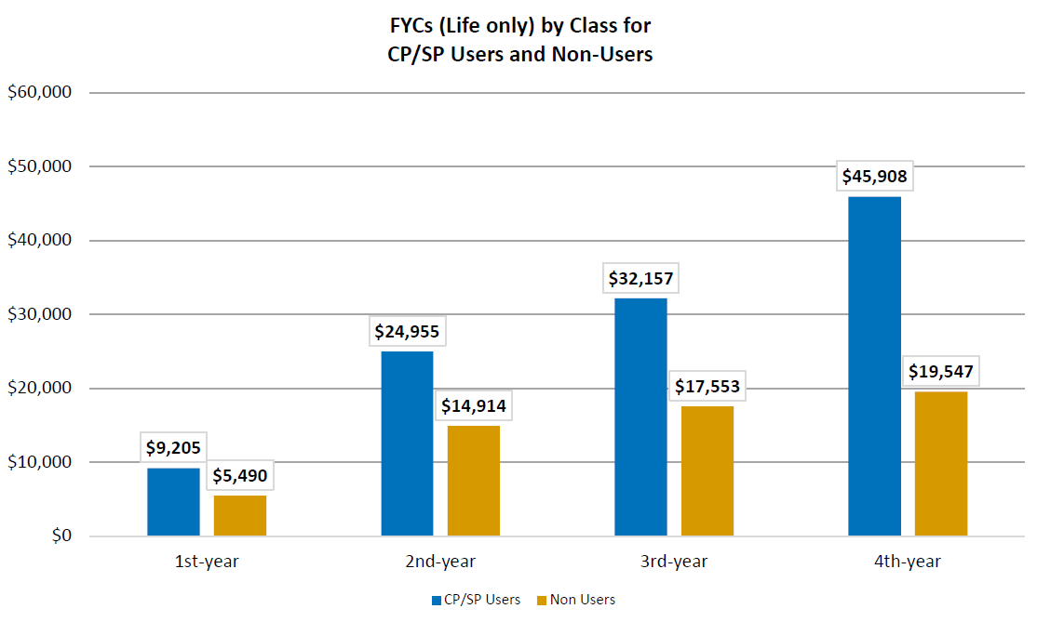
LIMRA’s Philosophy
First Year Commissions by Class

Slide 8
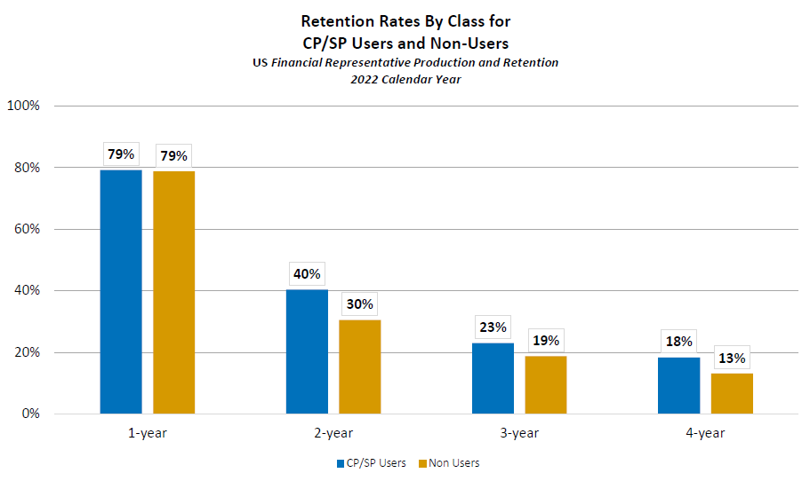
LIMRA’s Philosophy
Retention Rates by Class
The first year typically doesn’t show a difference because new agents are supported through the onboarding process, coaching, training, and leadership.
The second year, commonly referred to as the “cliff” is where you see a bigger difference with companies that use our assessments. Agents are on their own, without much of the support provided during the first year.
The remaining years continue to demonstrate an impact, especially as agents settle in on their own. It is here where the cumulative impact of retained agents is greatest, especially for a company's bottom line.

Slide 9
LIMRA’s Philosophy
Sales Effectiveness Rating | Top 25% Production
High | 34%
Moderate | 29%
Low | 17%
High scoring candidates out-produce Low scoring candidates by
100%
*PSP Validity Study
Notes:
PSP is another proven assessment tool that has had impact on the companies that use it. Here is an example from a company’s study. Candidates who scored “high” on the sales effectiveness rating out-produced candidates who scored “low” by 100%.

Slide 10

The RightChoice System
RightChoice is the toolbox that houses assessment tools that help our industry make the right decisions when looking for new agents. These tools are designed to help recruit the best candidates for the role of agent. You design your RightChoice system based on your existing selection process, and where your needs and gaps are.

Slide 11
All Six RightChoice Components
SuccessPredictor:
  Identify candidates’ success potential through bio-data validity
SalesPersona:
  Reveal candidates’ sales personality makeup and unique motivators
CareerView:
  Uncover candidates’ work style preferences, motivators, concerns and expectations
LearningStyles:
  Understand and leverage each candidates’ primary learning style
CollaboRate:
  Identify candidates’ preference for collaborative work
LeaderPersona:
  Evaluates candidate's likely effectiveness in functions such as recruiting, selecting, training, coaching, and managing producers and staff.
Notes:
We evaluated the competencies for “the next generation of sales talent” and infused those insights plus direct member feedback into the components of the system.
SuccessPredictor – identifies the candidates success potential through bio-data validity. We know the best way to predict future success is by looking at past success through their personal history and experiences. Success is defined as someone who is likely to survive their 12 months under contract and produce in the top 50% of all first year surviving agents.
SalesPersona – reveals candidates’ sales personality makeup by evaluating three dimensions revealed in Agent of the Future research – Drive, Openness and Authenticity
Depending on your sales culture, this is all the kind of information you want to know right away in the selection process.

Slide 12
RightChoice Components for Focus Today (most commonly used for agent recruiting)
SuccessPredictor:
  Identify candidates’ success potential through bio-data validity
**SalesPersona:
  Reveal candidates’ sales personality makeup and unique motivators
CareerView:
  Uncover candidates’ work style preferences, motivators, concerns and expectations
Candidates likely to survive 12 months under contract
Produce in the top 50% of all first year surviving agents
Evaluates the latest competencies from Agent of the Future Research:
Drive, Adaptability and Self-Awareness
Made up of four optional components:
WorkStyles
Motivators
Concerns
Expectations
**We’ll also review Personality Styles Profile (PSP)
Notes:
We evaluated the competencies for “the next generation of sales talent” and infused those insights plus direct member feedback into the components of the system.
SuccessPredictor – identifies the candidates success potential through bio-data validity. We know the best way to predict future success is by looking at past success through their personal history and experiences. Success is defined as someone who is likely to survive their 12 months under contract and produce in the top 50% of all first year surviving agents.
SalesPersona – reveals candidates’ sales personality makeup by evaluating three dimensions revealed in Agent of the Future research – Drive, Openness and Authenticity
Depending on your sales culture, this is all the kind of information you want to know right away in the selection process.

Slide 13
RightChoice Components for Focus Today
LeaderPersona:
  Evaluates candidate's likely effectiveness in functions such as recruiting, selecting, training, coaching, and managing producers and staff.
Measures:
Belief in Self
Interpersonal Orientation
Leadership Ability
Innovative
Focused
Amiable
Flexible
Organized
Notes:
LeaderPersona will help you evaluation managerial type functions such as recruiting, selecting, training, coaching and managing producers and staff.
Selection tool to initial screen field managers, LeaderPersona can help.

Slide 14

SuccessPredictor
SuccessPredictor tells you how likely it is that your candidate will be a success in this industry at this point in time
It is the single most predictive piece of an overall selection process
The rating determines whether you move forward with your candidate
If they receive an acceptable rating, you should move forward to collect additional information to help make an informed decision

Slide 15
SuccessPredictor
The Rating
(Can they do the job?)
Is based on objective historical experiences in the candidate’s life, some of which can change over time
Indicates how similar a candidate’s background is to that of successful agents “like them” (opportunity groups)
Notes:
39 Questions
Opportunity groups – clumping people together to compare success potential with others like them, similar experiences

Slide 16
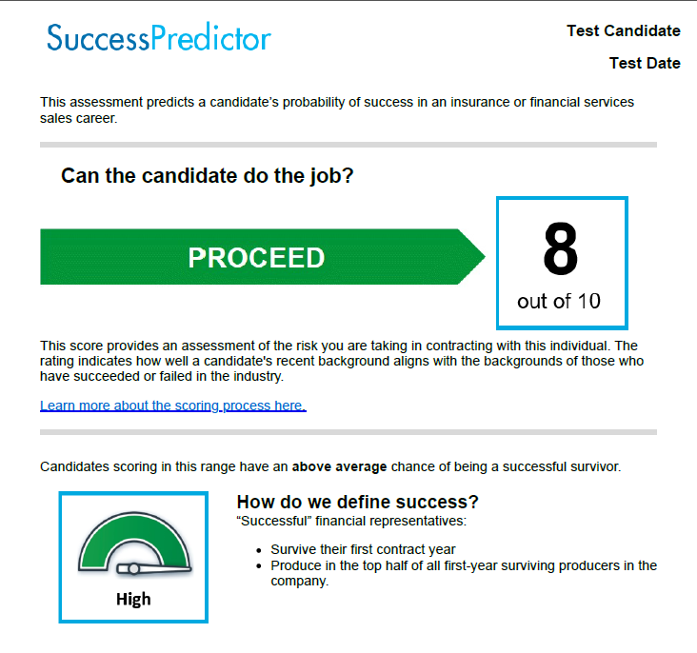
SuccessPredictor
Ratings:
1 – 3 “Not at this time”
4 – 6 “Proceed with Caution”
7 – 10 “Proceed”

Slide 17

SalesPersona
A personality assessment that rates a candidate on three personality dimensions that are calibrated for financial sales
Personality is what “makes” an individual who they are (individuals describe themselves)
Personality helps inform your decision making regarding the candidate
How will the candidate apply their success potential?
Notes:
50 questions

Slide 18
SalesPersona
Personality measures pertinent to today’s insurance
sales environment:
(Will they do the job?)
Drive – focused on goals and successes, motivated
Adaptability – creative, flexible, willing to try, brainstormers
Self-Awareness – true to self, accountable, trustworthy

Slide 19
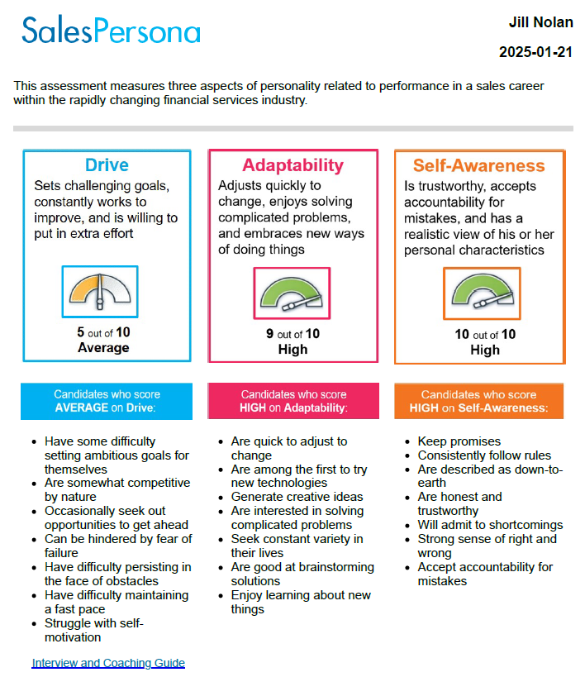
SalesPersona
SalesPersona
Ratings:
Low
Average
High

Slide 20

CareerView
How the candidate views the role of an agent, and how they prefer to work
(Do they fit?)
Candidate’s view of today’s reality including things like remote selling and virtual learning
Provides exact candidate responses to questions to assess how well they match your specific environment and culture and realities of the job
Notes:
47 questions
8 Traditional Work Styles
14 Motivators
14 Concerns
10 Expectations

Slide 21
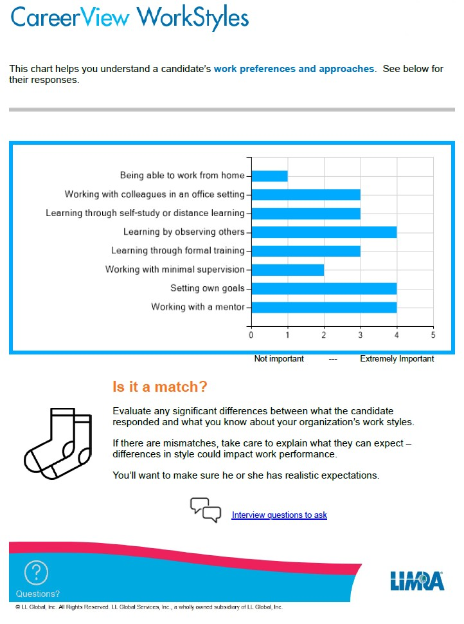
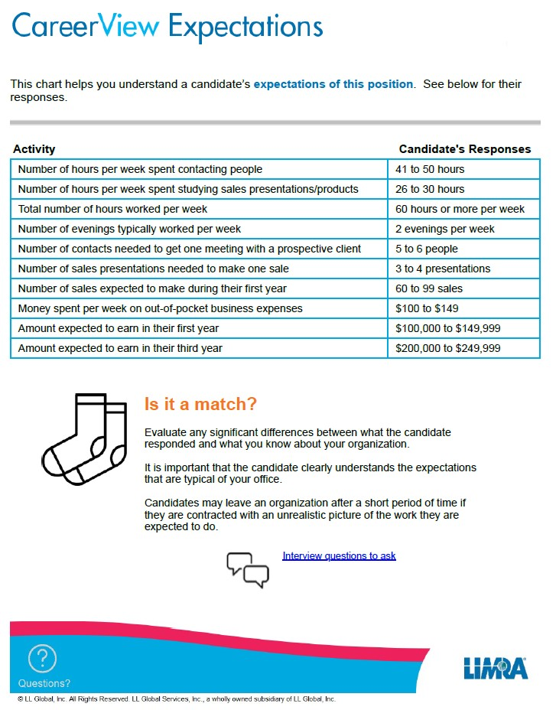
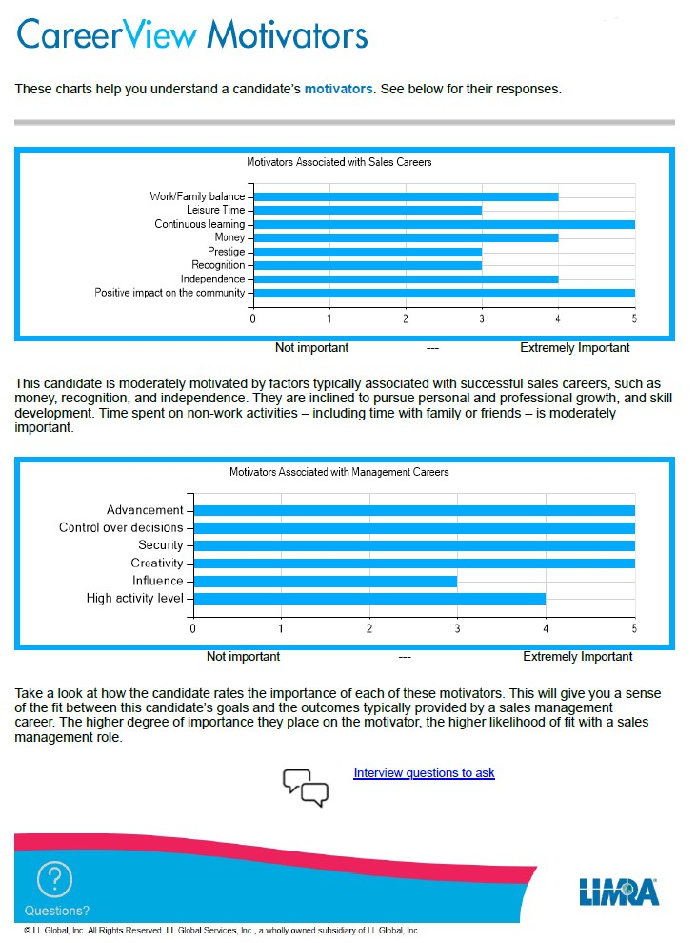
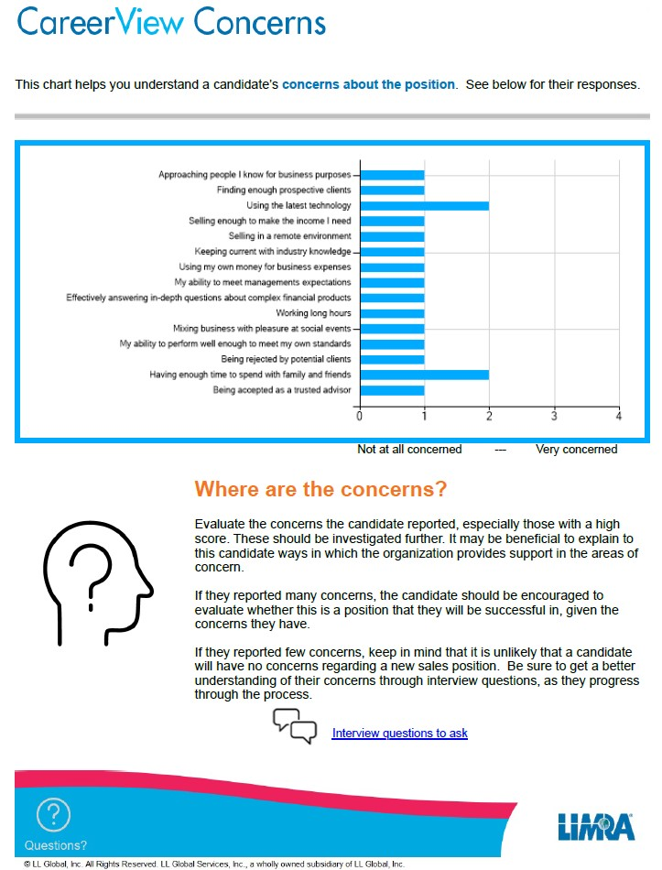
CareerView
Uncover a candidates’ work style preferences, motivators, concerns, and expectations

Slide 22

LeaderPersona
How effective will a candidate be with specific leader-related activities and behaviors?
(Will they?)
Measures eight leadership-oriented activities and tasks to see how effective a candidate would be
Helps identify where to focus coaching and training for upcoming leaders tied to bench strength

Slide 23
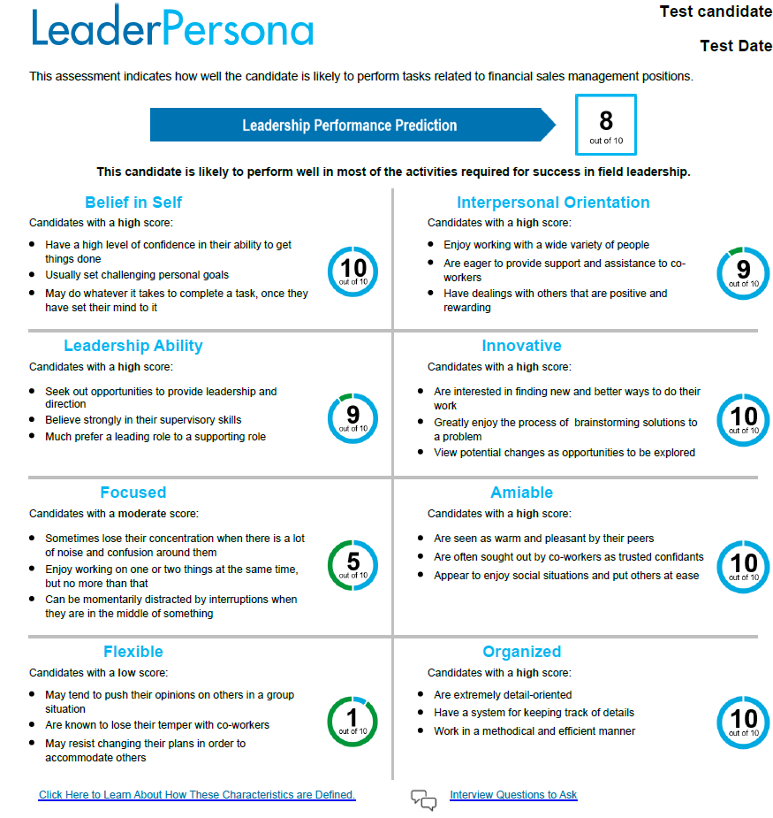
LeaderPersona
Ratings:
1-10 for low, moderate and high leadership potential

Slide 24

Interpreting results to make an informed decision
SuccessPredictor
SalesPersona
CareerView
LeaderPersona

Slide 25
Personality Styles Profile
PSP
Personality assessment
(will they?)
Measures an individual’s communication style during the sales process – their “selling style”
Provides individualized recruiting approach by identifying candidate’s drivers
Helps develop an individualized training program that builds on the strengths of the candidate's selling style
Validated specifically for the financial services sales industry - appropriate for all sales positions
Notes:
PSP is designed to measure the candidate’s communication style during the sales process – what we call their “selling style”.
Based on the individual’s “selling style”, PSP provides the recruiting manager with specific information about the candidate that allows the recruiting manager to “individualize” their approach with the candidate when it comes to:
Recruiting the candidate
Coaching and developing the candidate

Slide 26
Personality Styles Profile
120 questions
14 Personality Characteristics
3 Primary Selling Styles
9 Key Sales Behaviors
Notes:
Here is how PSP works:
The PSP measures key personality components related to sales performance by collecting the candidate’s responses to 120 questions.
It takes most candidates 20-30 minutes to complete the PSP questionnaire
Those 120 questions measure information that are related to 14 personality characteristics that are proven to be important in sales
Those answers are used to describe the candidate in terms of 3 primary selling styles
Based on the individual’s primary selling style, PSP provides information on how an individuals with that selling style typically behaves across 9 key sales activities

Slide 27
9 Key Sales Behaviors
Planning
Prospecting
Needs Analysis
Presentations
Closing
Handling Objections
Follow-up/Service
Cross-selling
Compliance
Each “selling style” approaches these sales behaviors differently
For some they are strengths
For others they are opportunities for development
Notes:
One of the most important benefits of PSP is that it provides the recruiting manager with information on how these selling styles play out across these nine key sales behaviors. What you find is that each selling style approaches these sales behaviors differently. For some of these sales behaviors, they are strengths for certain selling styles. While for others, they are opportunities for development.
For example, I mentioned the Dynamic selling style. Certainly, prospecting would be a strength of the Dynamic selling style. Closing would be a strength of the Dynamic selling style. Compliance could be an opportunity for development for a Dynamic selling style. So that gives you an example of how for some they are strengths, and for others they are development opportunities.

Slide 28
The RightChoice System: Key take-aways
SuccessPredictor – can they?
SalesPersona/PSP – will they?
CareerView – do they fit in our culture?
LeaderPersona – where do they need development to become an effective leader?
The assessments do not make the decision to contract – they inform the decision to contract an agent

Slide 29
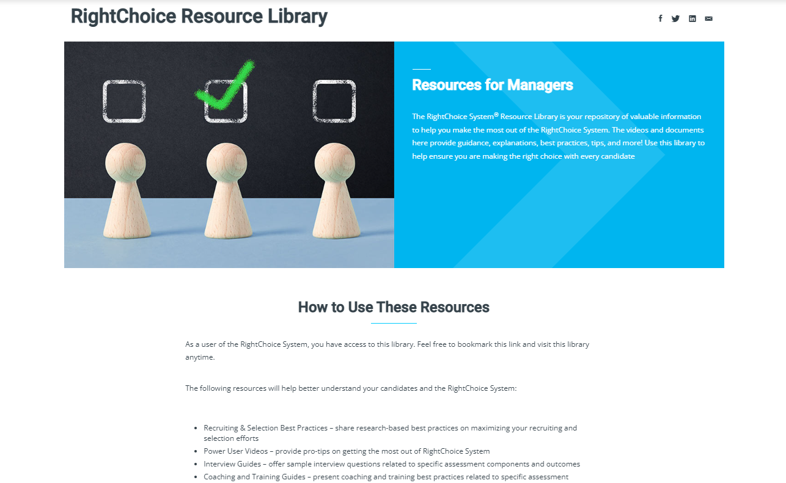
Resource Library – One-Stop Shop
Explainer Videos – describe how the different assessment components or parts of the system works
Recruiting & Selection Best Practices – share research-based best practices on maximizing your recruiting and selection efforts
Power User Videos – provide pro-tips on getting the most out of RightChoice System
Interview Guides – offer sample interview questions related to specific assessment components and outcomes
Coaching and Training Guides – present coaching and training best practices related to specific assessment outcomes
FAQ's – answer questions you have about the RightChoice System and its components

Slide 30
Pricing for Members
Solution | Candidates | Price
Any 3 assessments within RightChoice* | Up to 1,500 | $35 per candidate
Personality Styles Profile (PSP) | Up to 1,500 | $35 per candidate
*SuccessPredictor, SalesPersona, CareerView, LeaderPersona

Slide 31
Kathy Reid * kreid@limra.com and Ben Pharr* overmeyern@loma.org

