Slide 1
AML
Carolyn Clement • MSD Training Day
January 15. 2025

Slide 2
MSD Compliance Update Agenda
Let’s start with you! What questions do you have?
Review of tools and resources
Tableau report
Resource hub on Salesforce
Trends and upcoming enhancements
Opportunities for outreach strategies
We are here to help you!

Slide 3
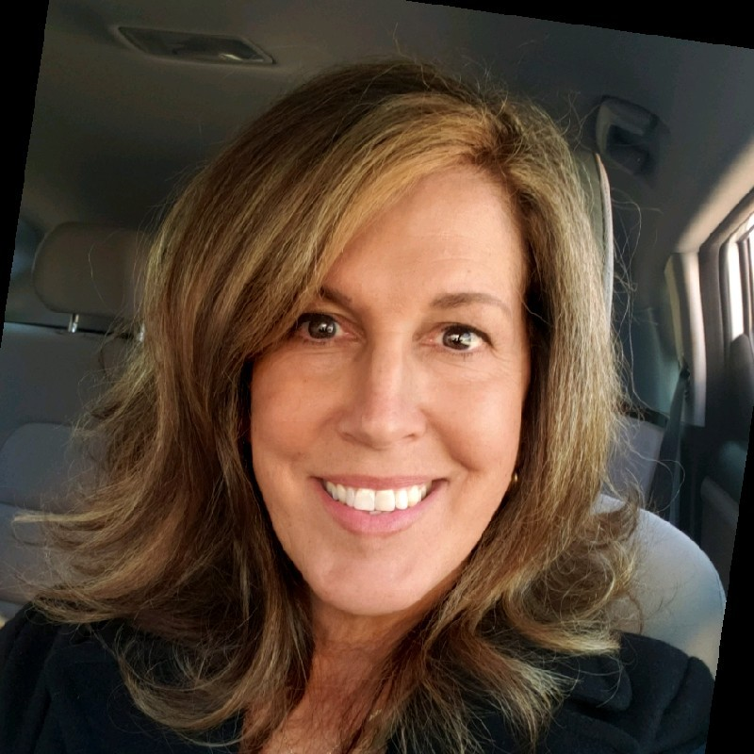
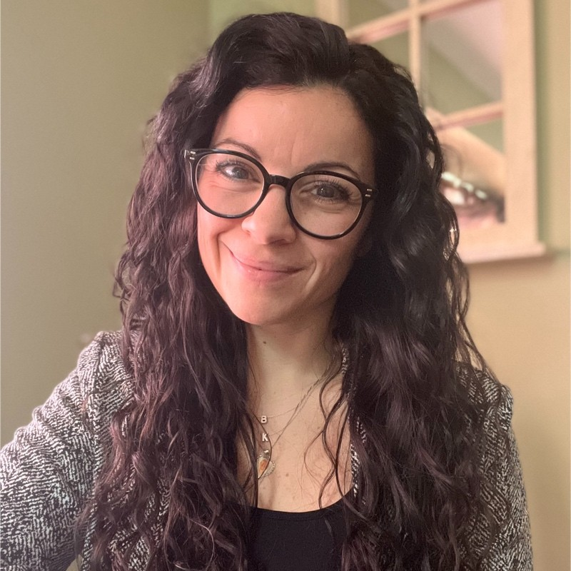
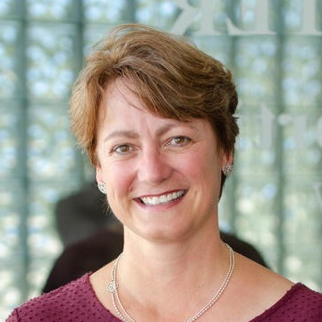
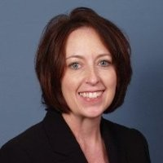
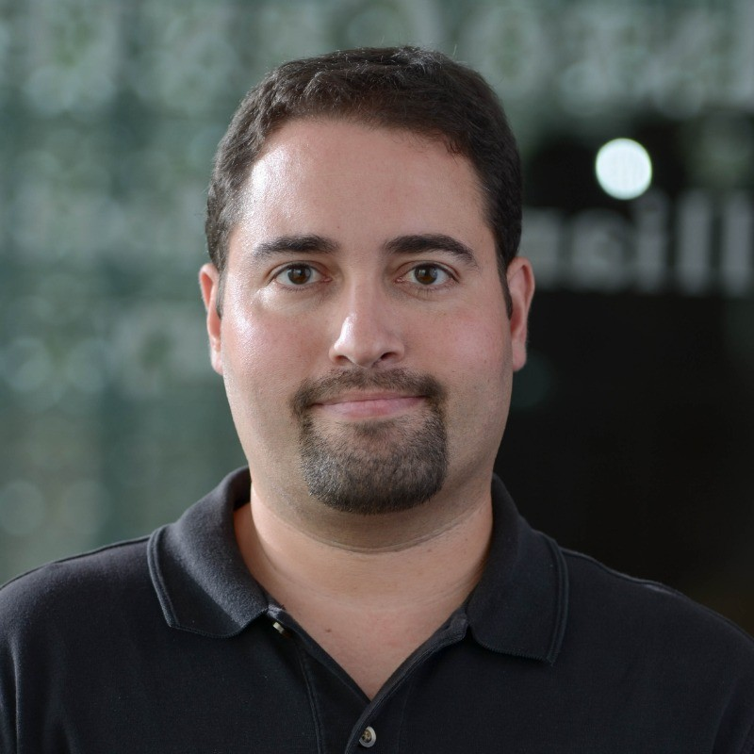
It’s all about YOU – choose one statement to complete below.
Today, I learned …
Because of the session today, I can now …
Today was really a success because …

Slide 4
Tool Talk
Salesforce Compliance Resource hub
CEP Tableau Dashboard - Business Intelligence
Website
Team members

Slide 5
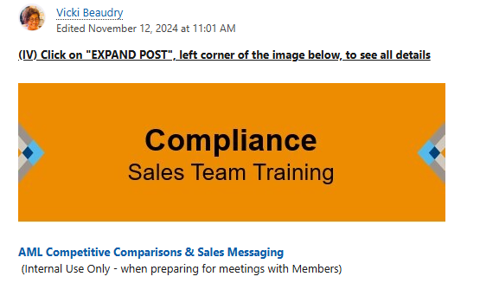
Tool Talk 1. Salesforce Resource Hub - Compliance
Links – tableau and website
Battlecards
Presentations
Social Media Posts
Competitive Analysis and talking points

Slide 6
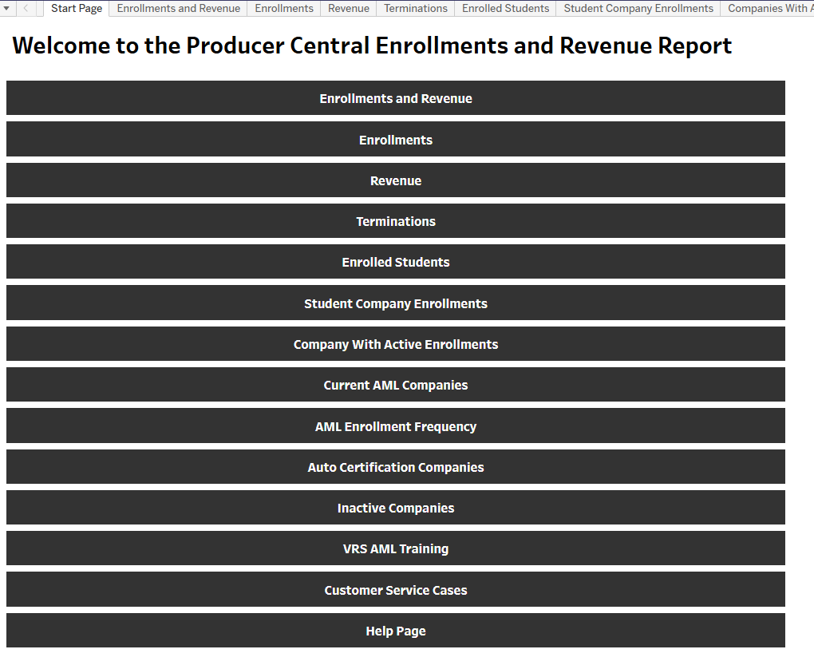
Tool Talk – 2. CEP Tableau Dashboard
Enrollments and revenue
Company-specific info
Current users
Frequency of use
Inactive companies
VRS
And more!
http://analytics.llg.corp/views/ProducerCentralEnrollmentsandRevenueReport/StartPage?%3Aembed=y&%3Aiid=1&%3AisGuestRedirectFromVizportal=y

Slide 7
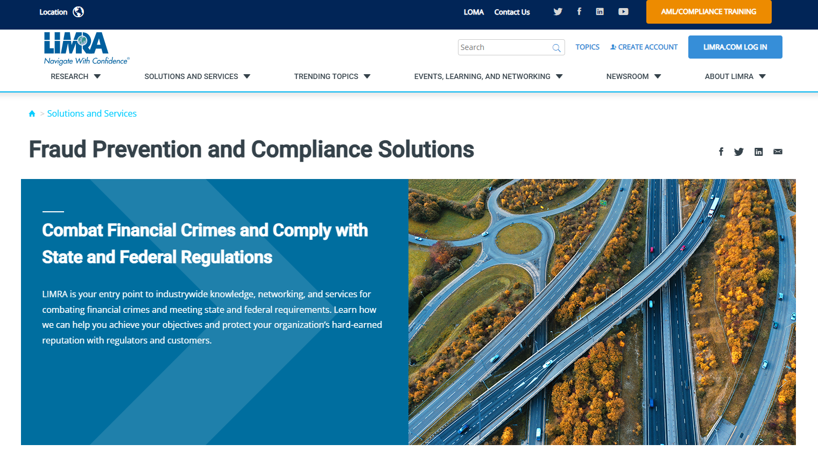
Tool Talk – 3. Website
AML capabilities
Testimonial images
Downloadable awareness posters
https://www.limra.com/en/solutions-and-services/onboarding-and-development/compliance-education-platform/u.s2.-anti-money-laundering-aml-training/

Slide 8
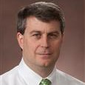
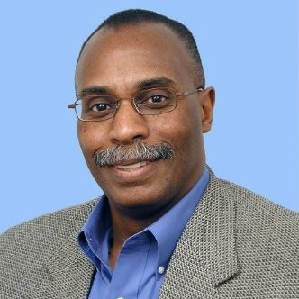
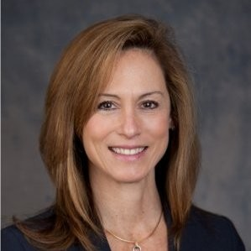
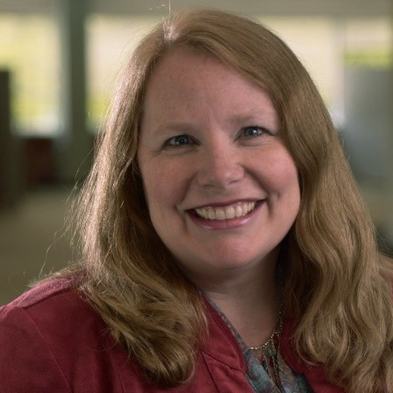
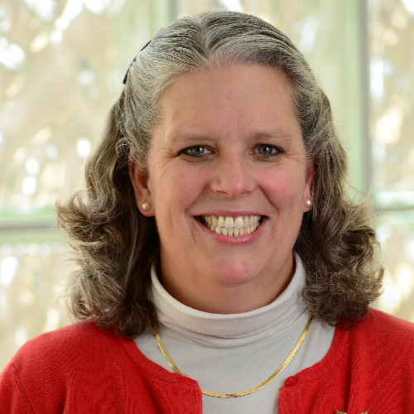
Tool Talk – 4. Team members!
Russ Anderson
Vince Peterson
Sharyn Kessler
Carolyn Clement
JoAnne Kallenbach
Joseph Jordan

Slide 9
MSD Compliance Update Agenda
Let’s start with you! What questions do you have?
Review of tools and resources
Tableau report
Resource hub on Salesforce
Trends and upcoming enhancements
Opportunities for outreach strategies
We are here to help you!

Slide 10
Who needs AML training?
All those who sell Life Insurance and Annuities.
Many home office employees of companies that sell life and annuities.

Slide 11
Who needs us?
Carriers who need to train and verify employees and Financial Professionals have been trained to combat money laundering
Carriers who need to verify that Financial Professionals have been trained to combat money laundering
Distributors who need to train and verify employees and Financial Professionals have been trained to combat money laundering
Distributors who need to verify that Financial Professionals have been trained to combat money laundering

Slide 12
Who ELSE needs us?
Producers, who find our training easy to use and useful, and MUST complete training to sell.

Slide 13
New to the scene - who ELSE needs us?
Third Party Vendors who are managing the licensing and appointment process for carriers and distributors

Slide 14
Trends and Coming Attractions
Third Party Solution Providers
Legal, Technology, Payment
“Discovery” – top users & other key customers
Emails for more access to FPs – convenience & connection
Online Payment capabilities
Industry Advantage Compliance & Fraud Learning Path
Exploring Registered Advisors course for 2026
Expand offering. Get closer to customers/users.
Offer where and how customer needs the service.

Slide 15
MSD Compliance Update Agenda
Let’s start with you! What questions do you have?
Review of tools and resources
Tableau report
Resource hub on Salesforce
Trends and upcoming enhancements
Opportunities for outreach strategies
We are here to help you!

Slide 16
10 reasons for outreach
We want to learn from our top customers. Q1 - Top customer discovery outreach
New Refresher course is out!
Data-driven outreach - Tableau info (last enrolled, usual enrollment, courses used)
Customer service issues (talk to us first!)
Compare and learn. Here’s what we’re seeing from similar companies – how are you managing?
Upcoming conference
User Group meeting invitation and follow-up - May, September, November 2025
Trends and news from subject experts (subscribe to the ICI newsletter)
Committees & Study Groups
Have an important customer – ask us!

Slide 17
Tool Talk – team members!
Russ Anderson
Vince Peterson
Sharyn Kessler
Carolyn Clement
JoAnne Kallenbach
Joseph Jordan

Slide 18
About Us
18

