Slide 1
LIMRA AML Product Differentiator Slides
Name • Department
Notes:
Let’s get started. I’m delighted to be here to share with you a little about the LIMRA AML program.​
​
Before I get started, I’m curious to know how you’re currently managing the AML training requirement for home office employees and financial professionals?​
​
-We use __________ vendor​
-We let our producers take whatever course they want​
-We offer training in-house​
​
(Make notes of how they’re managing AML training and send over to the product team after the call)​
​
Great! Thanks for helping me to understand that. There are a number of ways that the LIMRA AML program can help make your current process quicker and more secure, either using the LIMRA program exclusively OR using it to enhance your current program.​
​
First I want to tell you a little bit about our program.

Slide 2
Built by the Industry, For the Industry
As a trade organization, we have relationships with many industry experts.
Member and volume discounts, with competitive pricing compared to other AML trainings. 25% discount for LIMRA and LOMA Members.
Our focus is you! Course content focused on life insurance, annuities, and workplace benefits, with a Resource Library available 24/7.
Course format showcases reading, knowledge quizzes, digital interactions and scenarios throughout to keep learners engaged.
Notes:
We think LIMRA AML training is the best around and can help solve for some of the issues your team may encounter – and much of the industry thinks that too. ​
​
First are sheer numbers. According to US Bureau of Labor Statistics, there were more than 432,000 Insurance Sales Agents in the USA in 2023. In that same year, just under 300,000 financial professionals were enrolled in our AML training. Almost 70% of financial professionals took LIMRA AML courses that year. 70%. Chances are the person who wants to sell your product has already taken our AML course.​
​
Next is the power of the community algorithm. Google thinks we’re the top, too. If you search for “AML training”, you’ll find the LIMRA AML Program right after the sponsored links. People are using and talking about our AML program.​
​
The program is built just for our industry. Being a trusted central spot for our members, we have access to many industry experts and we focus on exactly what they need. We hear from LIMRA AML users that they like us for many reasons, including that our training is built specifically for those selling life and annuities. The scenarios in the training are taken from real-life examples and focus on just what they need to know.​
​
Price is a factor too. While we can’t know exactly what other AML training providers charge, we consistently hear that the LIMRA AML price is something our participants appreciate about our program when compared against other programs. Membership provides a 25% discount.​
​
User Feedback supports our work as well. We get emails and feedback every single day from the financial professionals who take our AML training, saying the LIMRA AML course is – and these are direct quotes – “I have relied on LIMRA in my 40 years as an agent!” “Course presented in an easy to understand way and was very interesting.” “Very informative and not boring.” High praise for a required compliance course.

Slide 3
LIMRA’s AML Courses Focus on Your Needs
As the largest trade association serving life insurance, annuities, and workplace benefits, our focus is on YOU. We partner with the industry through our members to solve industry problems.
Real-Life Industry Examples
Courses for Financial Professionals and Home Office Staff
100% Verifiable
Notes:
As I said before, one of the things people like about the LIMRA AML course is we target our content specifically to the life and annuity industry. ​
​
Our examples are taken from events that are happening today in the industry. We offer training for both home office and financial professionals that includes information specific to their roles.​
​
Those who participate in our AML program can get verified, digital, immutable course records in close to real time, without having to review copies of certificates or require attestations, which can be unreliable and difficult to prove. Regulators trust the LIMRA AML program.

Slide 4
Compliment Current Compliance Courses with LIMRA’s Options
Appoint producers faster
Easily integrate our compliance solutions into your current setup
LIMRA offers a variety of compliance content to meet the needs of your talent
Notes:
Things move fast. Many companies use just-in-time appointments, and many are also using third party vendors to get to the appointment as quickly as possible, both to facilitate the sale and to accommodate busy sales professionals. ​
​
Here’s where the numbers are in our favor. Because so many financial professionals are taking the LIMRA course – around 70%, companies that participate in our program can get near real time AML completion data, and can verify that requirements have been met. ​
​
We have worked to build out our integrations with whatever systems and third-party administrators you are using for licensing and appointing. We make it easy, quick and accurate for you to ensure your producers are ready to sell. ​
​
Additionally, we offer other compliance training content on the same platform – training to recognize elder financial exploitation (a growing problem today), Reg 187 Best Interest Training for NY, and an option for financial professionals to get CE credit for the AML course. Some companies even put their own product training on our platform, to align with their compliance training. And we have courses available in Spanish too.

Slide 5
See How LIMRA Stands Out
Updated, relevant content
Satisfy Regulatory Requirements
Accessible and customizable
Internal and external experts, and member companies involved in development.
Meets AML/CTF training requirements. CE and CFP eligible.
Easy to access. Access our Resource Library at any time.
New courses developed annually on trending industry topics
Variety of compliance course offerings available for different regulations.
Customized reporting. Check completion status through your customer portal.
Notes:
One thing LIMRA AML users love about our program and sets us apart from others, is the fact the we produce a new course every year on a highly relevant topic. For 2025, our topic is Artificial Intelligence and the impact on money laundering. We have received many kudos from producers who have found the course enlightening and helped them to better understand AI. ​
​
Course topics in the past few years have included perpetual KYC, fraud schemes and scams, cybersecurity and money laundering and more.​
​
Our courses AND our completion data are easy to get to and easy to access, for both the financial professional and the firms that participate in our program. From huge carriers and distributors to small fraternals and agencies, any company that needs to verify AML training can use our program with ease. ​
​
Do you use another vendor for AML training? No problem – you can supplement that with a secure verification of LIMRA course completion to accommodate your producers who have already completed the LIMRA training and you’ll be their hero for not requiring them to take yet another compliance course.​
​
If you’re not currently participating in the LIMRA program now – I encourage you to investigate how much time and money your team is spending going back and forth with producers for attestations, reviewing PDFs and screen shots for accuracy and how does this delay time to appointment? Time is money. Being a part of the LIMRA AML program means you can get that data at the push of a button, and participate in the ONLY VERIFIABLE SOURCE for LIMRA compliance course completion data, so its reliability will withstand regulatory scrutiny too. Unfortunately, we have seen in the industry falsified “screen shots” supposedly from LIMRA courses that were not real – we can get you the verified information quickly and at a low cost through our program.​
​
We also get rave reviews for our customer service. As a member organization – we’re here to serve you and to integrate with whatever you bring to the table to make the LIMRA AML program work for you – whether that’s a completely automated four times a day data feed - to individual look-ups in real time. ​
​
Whether you need to enroll agents or employees in training OR you just need to verify their LIMRA completion, we can help you do that. ​ ​
We can also seamlessly integrate with your company’s LMS. ​
​
And because we aim to make a difference in ending money laundering in the industry – we offer a Resource Library on the training site that is available to all who have been enrolled in LIMRA AML that can be used as a refresher for key information 24/7. It even includes resources like sharable AML awareness posters that can be used to keep money laundering top of mind in the workplace.

Slide 6
Strong User Experience Leads to Broad Adoption
Consistently ranked #1 in Google searches for compliance training.
We incorporate member expertise and learner feedback into course development.
Access industry peer groups, webinars, conferences, and the LIMRA AML Insiders group.
The Market Chooses LIMRA
Unique Industry Networking Opportunities
Our Content Gets Rave Reviews
Notes:
As we’ve talked about, “The LIMRA” is a strong and powerful choice for AML training in our industry. You can tap into the trust that producers already have in our AML program to train your financial professionals and employees, or participate in the program just to get that golden verification you need, to get to the sale. ​
​
We work on continuous customer feedback to drive improvements, and our courses go through rigorous industry review to ensure they meet the life insurance and annuity industry needs. ​
​
Convening, networking, and sharing is at the heart of what we do a LIMRA and LOMA. Companies that participate in our AML program have access to that valuable asset through webinars, the AML Insiders virtual group, conferences, and more. Participants can hear what other companies are doing, what’s happening in the industry, and ensure that they are keeping up with regulators’ expectations as a result.

Slide 7
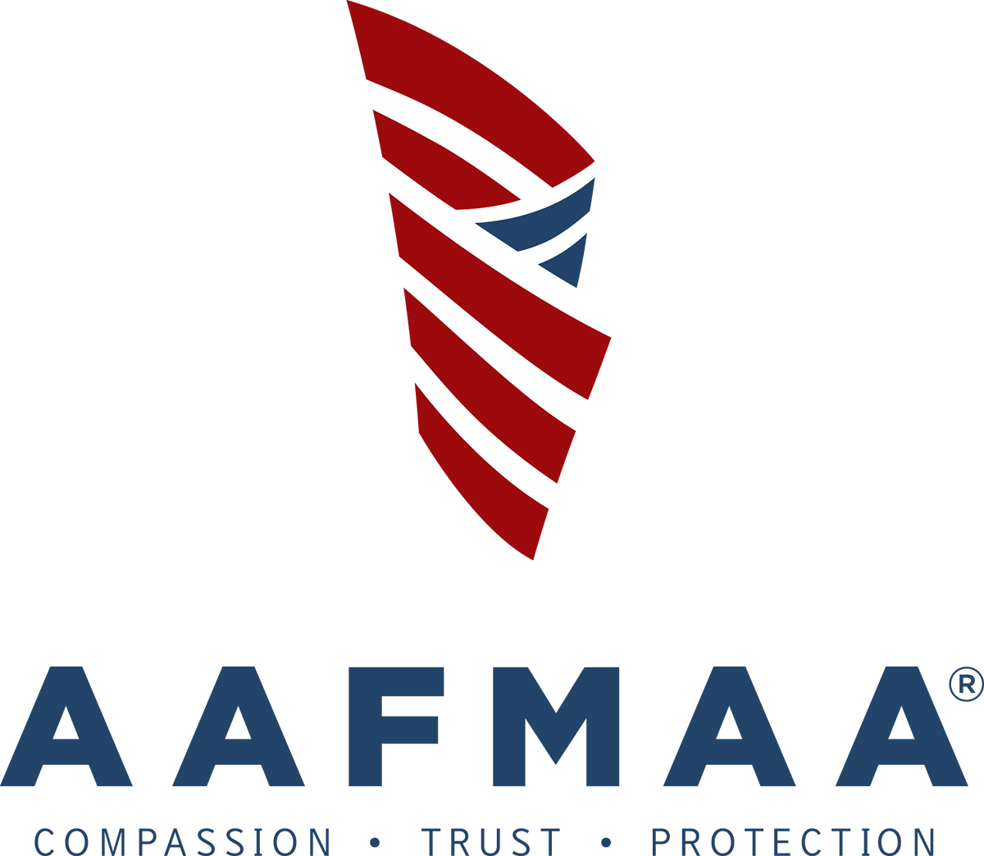
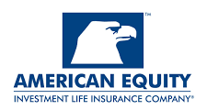
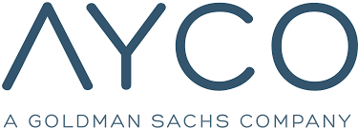
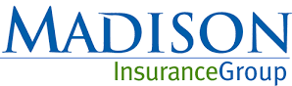
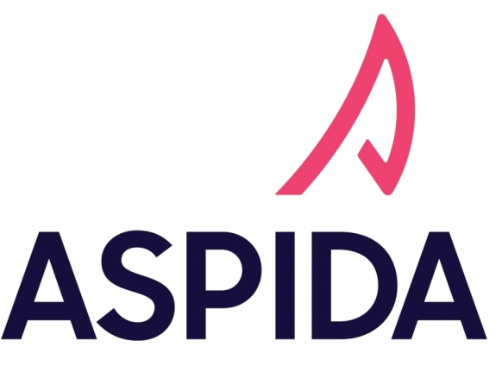
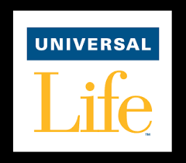
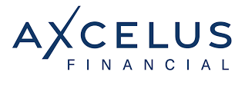
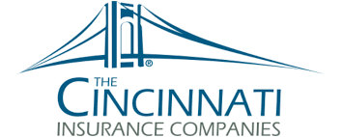
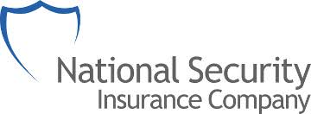
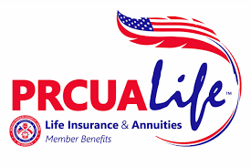
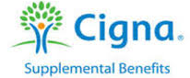
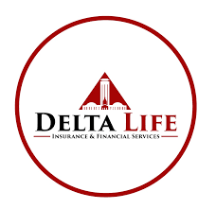
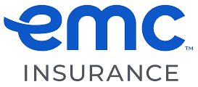
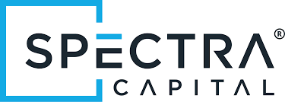
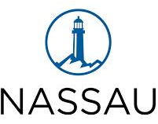
Companies Choose LIMRA to Meet AML Training Needs
Notes:
Here’s a sampling of organizations that participate in our LIMRA AML program. It’s a busy slide, but there’s room for you.

Slide 8
Voice of Customer
Notes:
Just to close, we wanted to share some of that feedback we receive on our courses. Every person who completes a LIMRA course on the Compliance Education Platform is invited to take a short survey and our product and service teams read every comment. ​
​
99% of those who took the survey in 2024 said they’d recommend the LIMRA AML course to a colleague. ​
​
100% said the course prepared them to recognize and report money laundering activities. ​
​
We could go on and on, but let’s stop and see what questions you have.

