Slide 1

AML Training for Home Office Employees
Industry Solutions

Slide 2
About Us
trade association in the world serving financial services
LARGEST
LIMRA
LOMA
Premier financial services industry research organization
Flagship for industry professional development
Serving members for over 100 years
Over 700 member companies in 66 countries
2
Notes:
A fun fact you may not know is that LIMRA and LOMA represent the largest trade association serving the financial services industry. LIMRA is widely known for providing industry benchmarking and research. And, LOMA is known for providing professional development and education. For more than a century, we’ve served as the largest trade association supporting the financial services industry. Today, we’re working with over 700 member companies, in 66 countries, to help them confidently navigate the changing industry by helping them understand trends, inform their strategies, develop their talent, and create solutions that advance the life insurance, annuity, and workplace benefits industries.

Slide 3




Empowering Our Members
Advancing the
financial services industry
by empowering our members with:
KNOWLEDGE
INSIGHTS
CONNECTIONS
SOLUTIONS
Notes:
Now that you know a little bit more about us and our membership let’s now focus on what exactly we do.
Our purpose is to advance the industry by empowering our members through insights, connections, knowledge and solutions. I’m going to talk about each one of these and the products and services we offer to live up to that purpose and support our membership.

Slide 4
Collaborative Industry Solutions
FraudShare®
Compliance
Combated over 570 account takeover incidents targeting over $170 million in account values.
Meet training requirements quickly and protect your customers, financial professionals and company.
+3.5 million
Course Completions
1
Applying analytics to identify fraud and generate alerts
2
Anti-Money Laundering
(AML) Training
Compliance Education Platform
Enabling preventive actions
3
Benchmark fraud experiences versus peers
100%
Financial professionals surveyed said they would recommend the AML course, and it prepared them to recognize and report money laundering.
Notes:
Our experience with insights, connections, and knowledge enables us to help our members in additional ways, specifically through the development of industry solutions. Today, we’re reviewing the AML Home Office course, and what I’d like to note is that we work with our members to understand key issues and then develop solutions that effectively address the issue, minimize disruption, and provide a cost advantage for our membership.
One of our latest industry solutions, FraudShare, was also created using this proven model.
FraudShare was developed to specifically address account takeover fraud. Think of it as an industry-wide neighborhood watch for detecting and preventing fraud attempts. We have recently announced a partnership with The SPARK Institute, designed to enhance fraud prevention measures within the retirement services industry. We continue to look at strategic alliances including another one we established about a year ago with Verisk that will enable us to enhance fraud prevention across our industry.
Similarly, our Compliance Solutions, which include AML Courses for Home Office Employees and Financial Professionals, Recognizing Financial Education Training, a Course covering New York’s Reg 187 Best Interest requirements, Annuity Training, and background checks, were created using this same model. The industry identifies a need, LIMRA convenes broad perspectives from members and others, and builds a solution to meet those needs in a cost-effective way.
Additionally, each year we bring together over 10,000 industry professionals – through conferences, study groups, committees, executive forums and webinars. These interactive opportunities provide members with the ability to exchange ideas; discuss common issues; and network with peers and colleagues from across the industry.
To highlight just a few examples, we have over 100 committees and study groups that not only focus on products, markets and distribution, but go beyond that to explore topics of interest around compliance, technology, HR and training, strategy and innovation, marketing, and finance.
We’d be happy to work with you to see if there are some compliance or learning and development groups that might be a good fit for someone in your company.

Slide 5
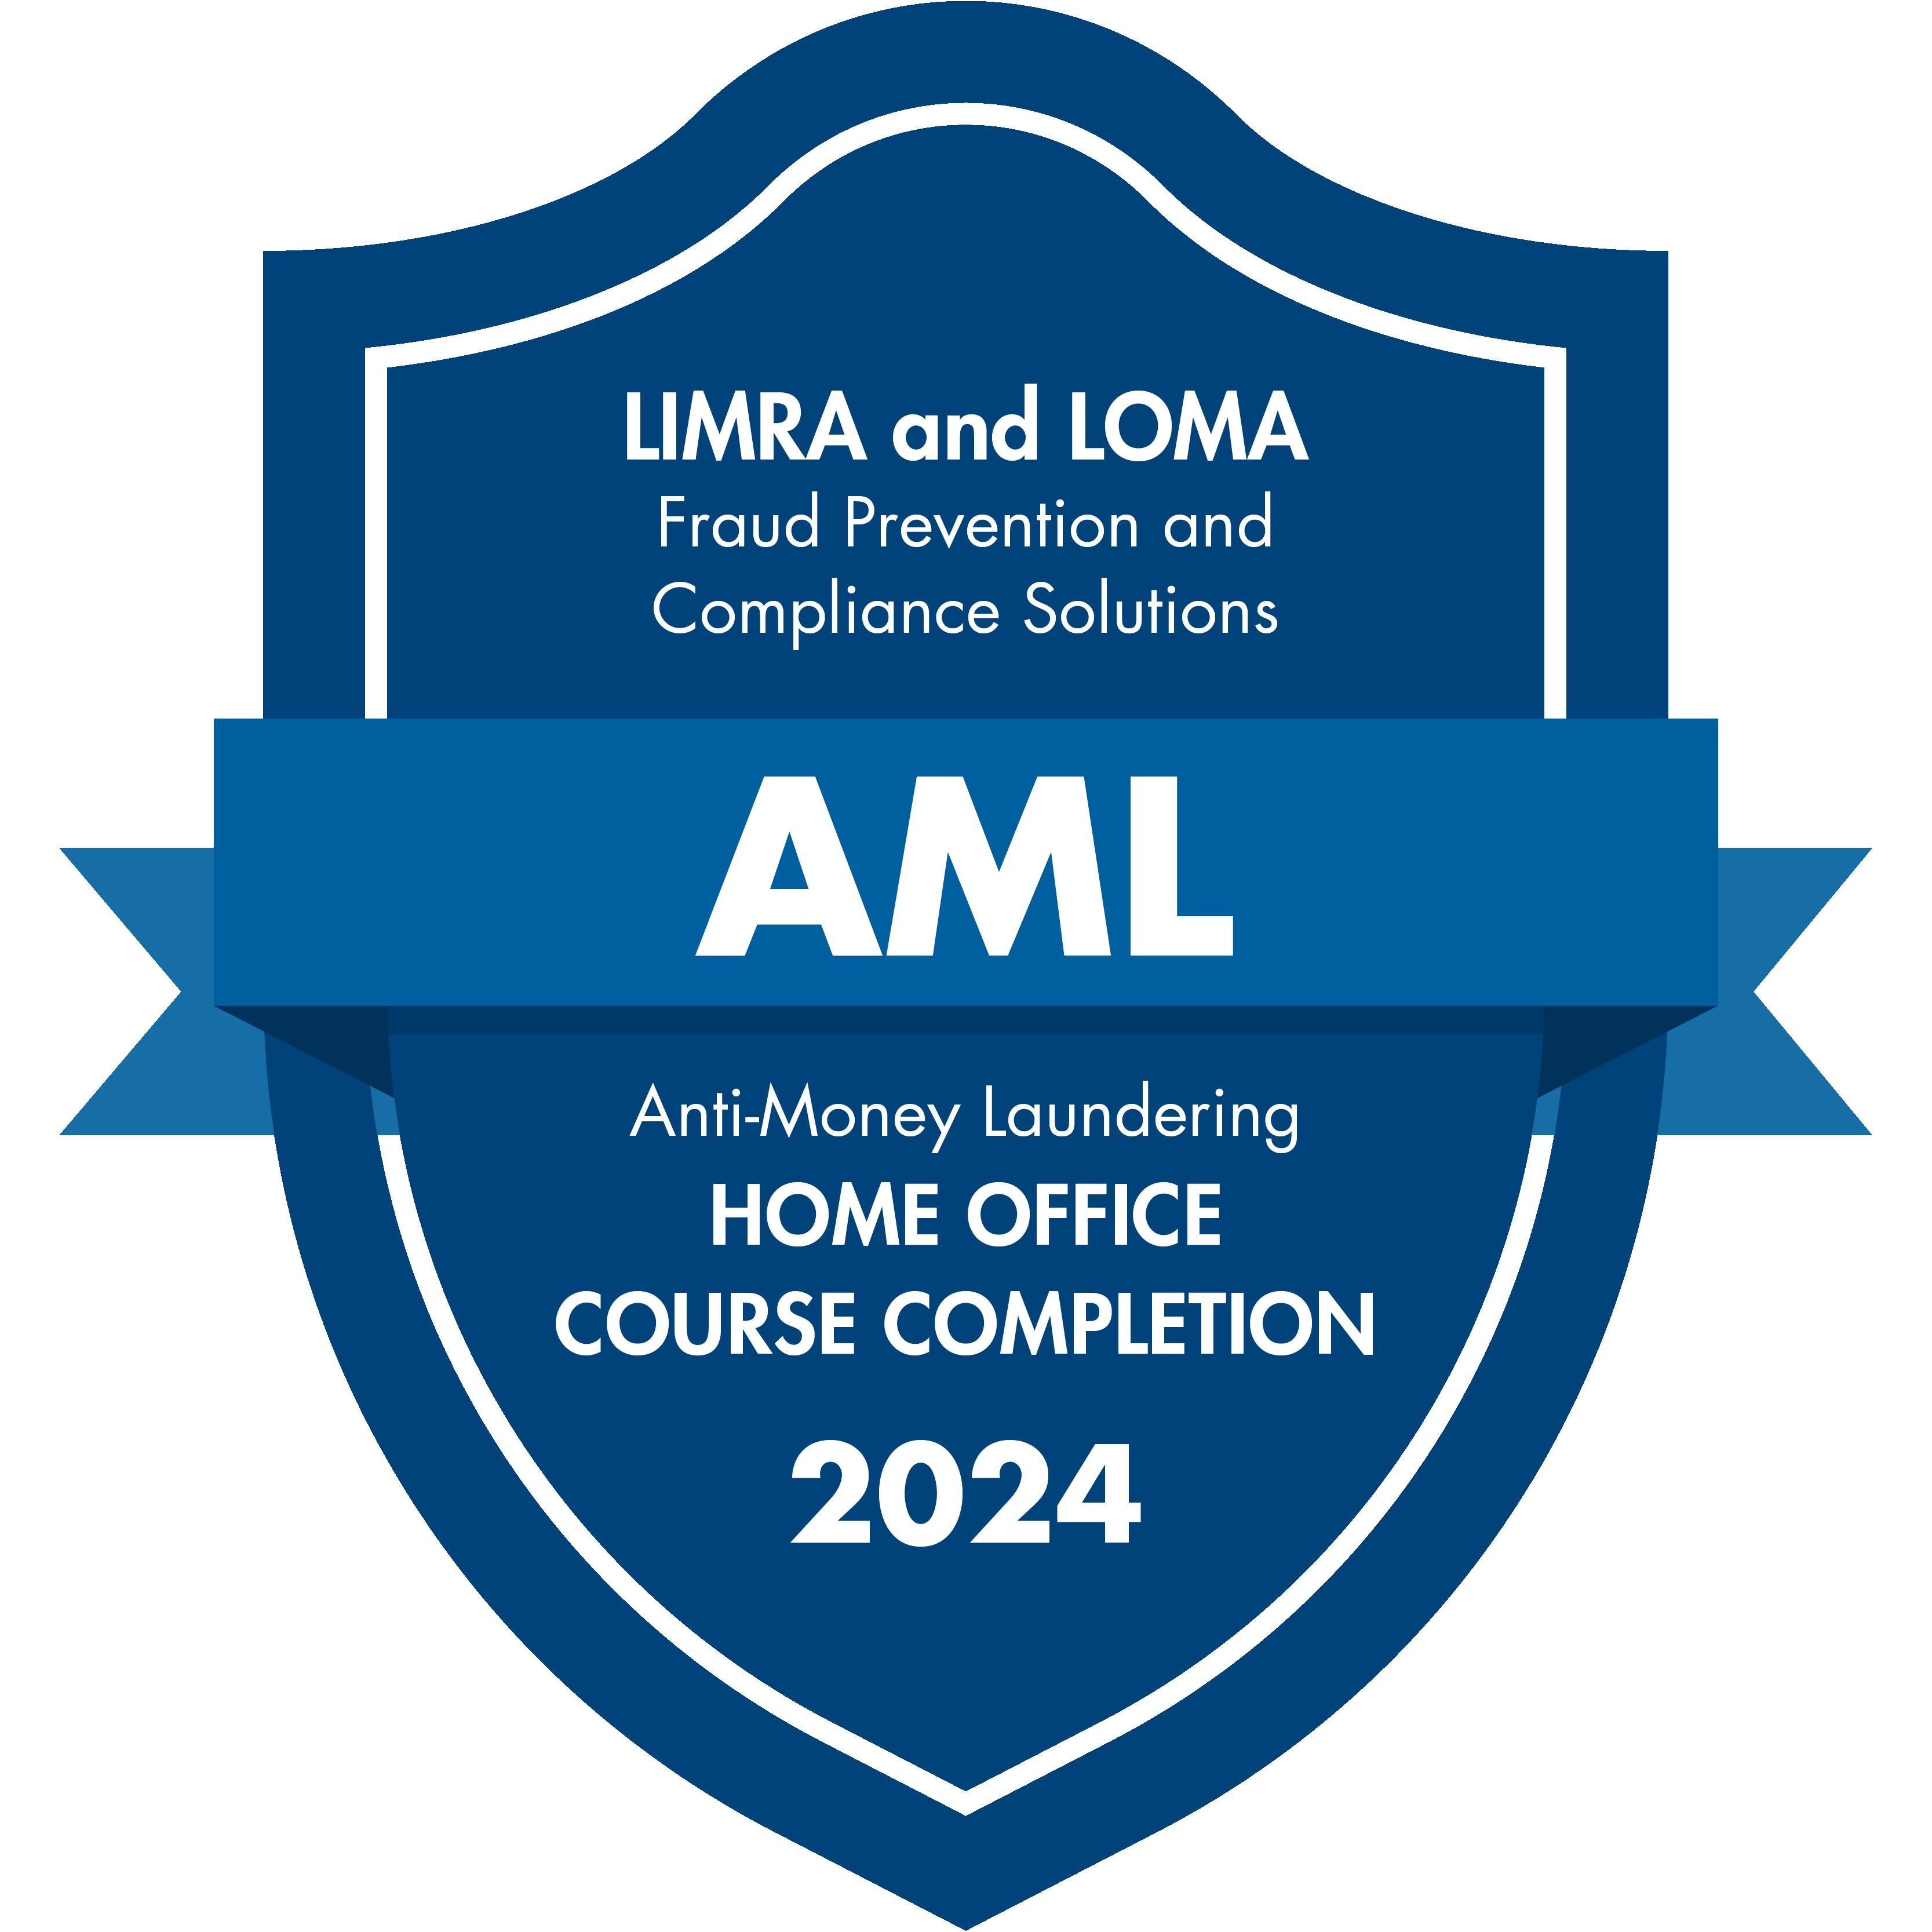
Home Office Badge of Completion
Notes:
Now, let’s talk about the LIMRA AML course. As we mentioned on an earlier slide, we brought together the industry to create our AML training program in a way that makes it cost-effective and easy for companies to administer, meets regulatory requirements, protects your company and customers, and simplifies the process for those taking the course.

Slide 6

USA PATRIOT ACT – Protect your customers and stop terrorist financing
Section 32: Anti-Money Laundering Programs:
Requires financial institutions to establish anti-money laundering programs, which at a minimum must include: the development of internal policies, procedures and controls; designation of a compliance officer; an ongoing employee training program; and an independent audit function to test programs.
https://www.fincen.gov/resources/statutes-regulations/usa-patriot-act
Notes:
Most people who work in the industry know AML training is required. Section 32 is the part of the USA PATRIOT ACT that specifically requires ongoing training for employees of financial institutions as part of the anti-money laundering program.
What does “ongoing” mean? Most of the over 120 companies that use the LIMRA AML program provide refresher training every year or every other year, with the majority training every two years.
Every year, we produce a refresher course that includes a hot topic, so whatever cadence a company is looking to offer training, there will be new content to use.

Slide 7




AML Home Office Course benefits
LIMRA is the trusted source for AML training
Yearly refresher course includes latest hot topics to prepare employees
Industry course reviews ensure training hits the target
Branded Company Page helps comply with regulatory requirements
Notes:
Here are a few of the AML Home Office course benefits. We are the trusted source for AML training. Our product team is reading Reddit threads and tracking SEO and checking out online forums for insurance industry employees for feedback, and LIMRA is universally considered the top choice.
Our yearly refresher course provides the latest and greatest in AML hot topics and keeps learners interested with new content.
All of our courses are reviewed by multiple member companies to ensure the information is accurate and hits the mark. This is where we really get the benefit of being a member organization.
Each company that uses our program can have a “Company Page” on the training site. Review of this site is reported as a course completion, and this branded page includes information about who to contact in the company regarding money laundering concerns. It can include links, and policy and procedure information as well. As you probably know, companies are required to ensure their employees are aware of this information, so this helps you meet that requirement and prove that you have done so. Regulators tend to look kindly on data that proves compliance.

Slide 8
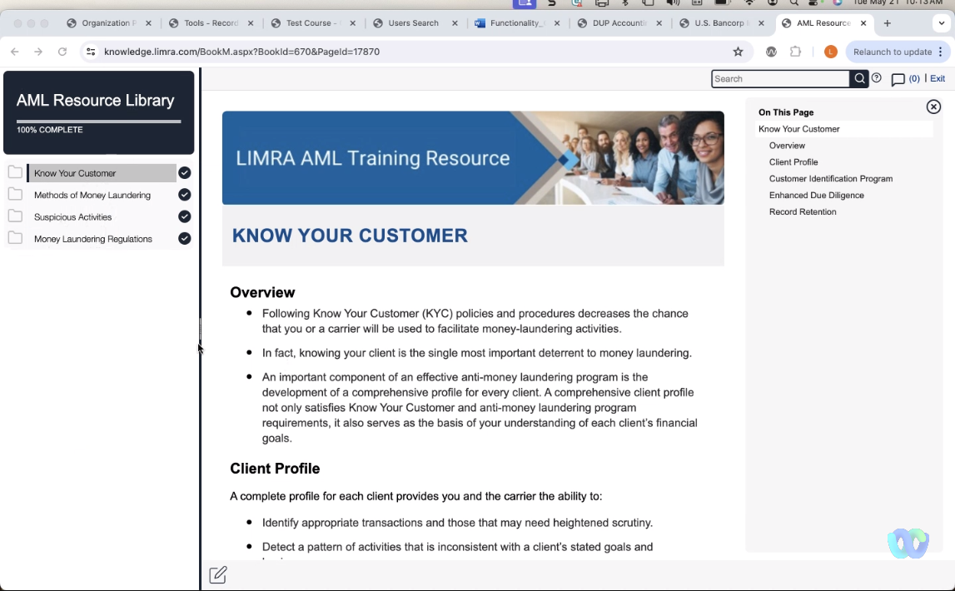


Resource Library Content & Awareness Posters
AML Resource Library available 24/7 for review
Awareness posters in resource library can be downloaded and shared
Notes:
Our training site includes a Resource Library that is available 24/7 for anyone who has been enrolled in our courses.
Here, users can review important AML basics and download awareness posters to share digitally or print out and post. We developed the messaging on the awareness posters with input from our members about what they wanted their employees to pay attention to.

Slide 9

AML Home Office Course outline
Overview of Money Laundering: Placement, Layering, Integration, Structuring, Regulations, Specified Unlawful Activities, Risk Considerations.
Know Your Customer: Client Profile, Customer Identification Profile, Customer Due Diligence Rule, Enhanced Due Diligence, PEPs, SDNs, Record Retention.
Activity Monitoring & Reporting: Red Flags, Methods of money laundering in insurance, Check Fraud, Suspicious Activities
Notes:
Here’s a high-level outline of the LIMRA AML Home Office base course content. The course takes about 40 minutes to complete, and includes scenario-based knowledge checks along the way.
The course can be taken on any device and can be stopped and restarted later, with progress stored. This is helpful for employees who prefer taking training in shorter chunks.

Slide 10
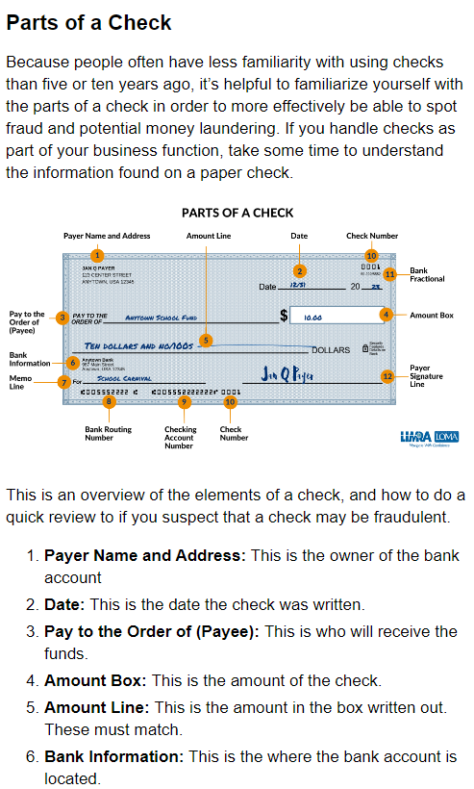
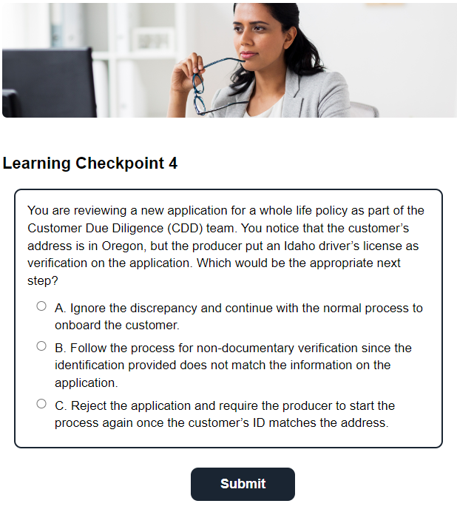
Home Office AML Course Sample Content
Notes:
This shows screen shots of the actual Home Office course. See the section on the left – Parts of a Check?
We learned from members that they were having issues with younger employees not recognizing counterfeit checks, because they weren’t familiar with what a check looks like. We included this section to help them be better prepared to recognize when something looks off.
Again, this course can be taken on a computer, phone, or tablet, and saves progress from device to device. Or you can integrate it with your internal LMS for seamless delivery.

Slide 11

AML for Home Office Employees Features
Scenarios focus on what your employees need to know and aligns with what producers are learning.
Industry review ensures relevancy.
Annual course updates include timely topics.
Course is short, online, and device-responsive.
Real-time admin access for viewing completion data.
LMS Integration available.
Easy to enroll and check progress.
Company can assign multiple users to administer the AML program.
Notes:
Here are some features of the course that make it easy for companies to feel confident in using LIMRA to train their employees on detecting and stopping money laundering.

Slide 12


Enthusiastic responses from LIMRA AML Course-Takers
Do you feel the LIMRA AML Course prepared you to recognize and report potential money laundering activities?
Based on your experience with this LIMRA AML course, would you recommend LIMRA compliance courses to a colleague?
YES
YES
Notes:
Perhaps the most important information about our AML courses is the feedback we receive from those who take the course.
Starting in 2024, we invited people to complete a brief survey at the conclusion of the course to let us know their feedback.
We were delighted with the responses that showed statistically 100% thought the course prepared them to recognize and report money laundering (1,210 out of 1,213 respondents)
And 99% would recommend LIMRA compliance courses to a colleague (1,197 out of 1,205 respondents).

Slide 13
Just a few feedback comments from the survey…
Well done; clear instructions; thorough; informative; educational and worthy of high scores for course objectives.
Very up to date information and a great refresher!
The course is a must do.
Most entertaining of all recent certifications.
This was one of the clearer courses I have had to sit through in over twenty years in the business.
This course is refreshingly direct and focuses on the most important concepts. Some insurance "training" has tests that ask stupid questions about when a law was put into place that don't do anything to help with doing our day-to-day business. I appreciate the way the content is delivered that makes it engaging and relevant to improving our conduct with our customers. Thank you!!
Notes:
The comments section of the survey was even better, with hundreds of comments similar to those above.
Even though it’s a required compliance course, people like it and appreciate what they learn.

Slide 14
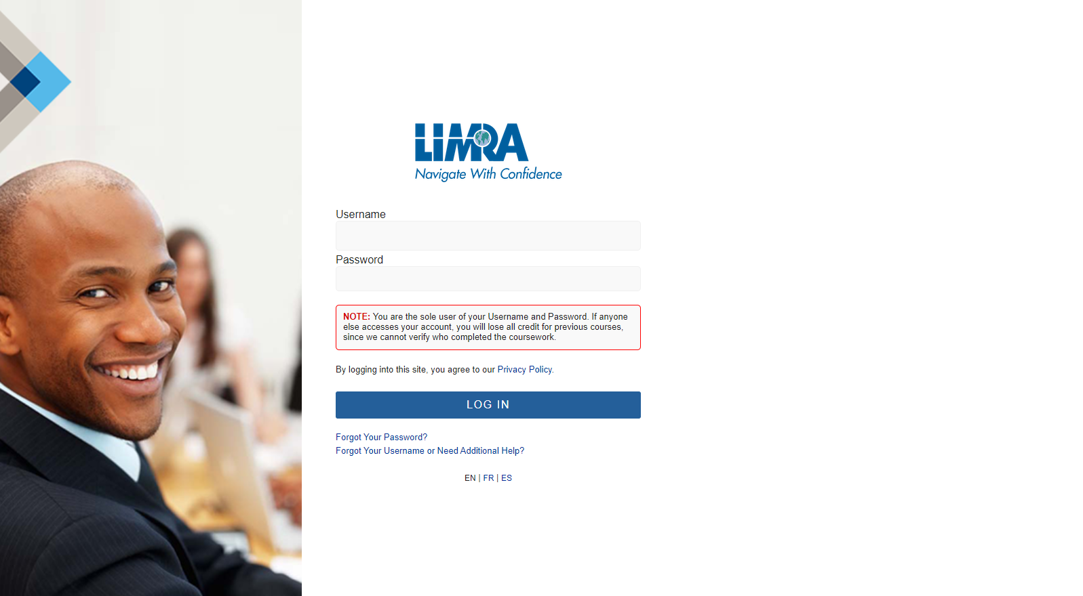
How can we help you?
Demo course
Review course outline
Discuss technology requirements
Send proposal
Notes:
So, how can we help you from here?
Would you like to demo the course or talk to our technology team about integration?
Can I send you a proposal?
If yes: approximately how many employees? Do you have any financial professionals/producers that you would also be enrolling? Should I include information on any of our other courses? (Recognizing Financial Exploitation and Best Interest – NY Reg 187).

Slide 15







Additional Member Benefits
Contact Your Member Relations Director
Visit Our Websites
www.limra.com
www.loma.org
Enter Name
Enter Title
LIMRA and LOMA
Contact Our Info Centers
Subscribe to Our Publications
LOMA
infoctr@loma.org
LIMRA
infocenter@limra.com
Notes:
In addition to all the benefits I just went through, your membership gives you access to a team of dedicated professionals who can help you navigate all of your member benefits.
You also have access to our Info Center staff who can provide you with research or articles on topics of interest – think of it as access to your own industry library.
Our websites houses all of our research and our courses and are a great resource for your teams to stay on top of timely topics and events.
And finally, you can subscribe to our various publications.
MarketFacts is our digital magazine that includes thought leadership on emerging trends and pertinent topics authored by our researchers and our members.
News2use is an easy to digest, weekly digital newsletter that aggregates all of the news in our industry and summarizes the top articles and announcements.

Slide 16
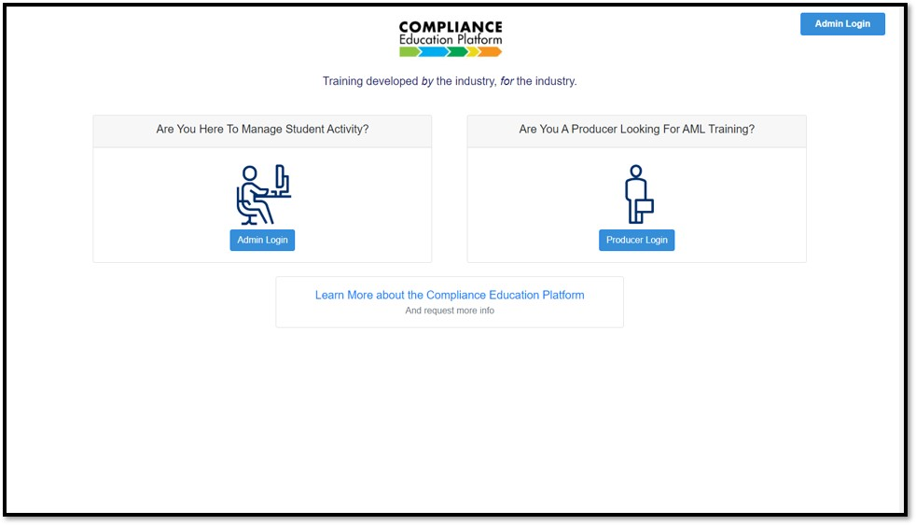
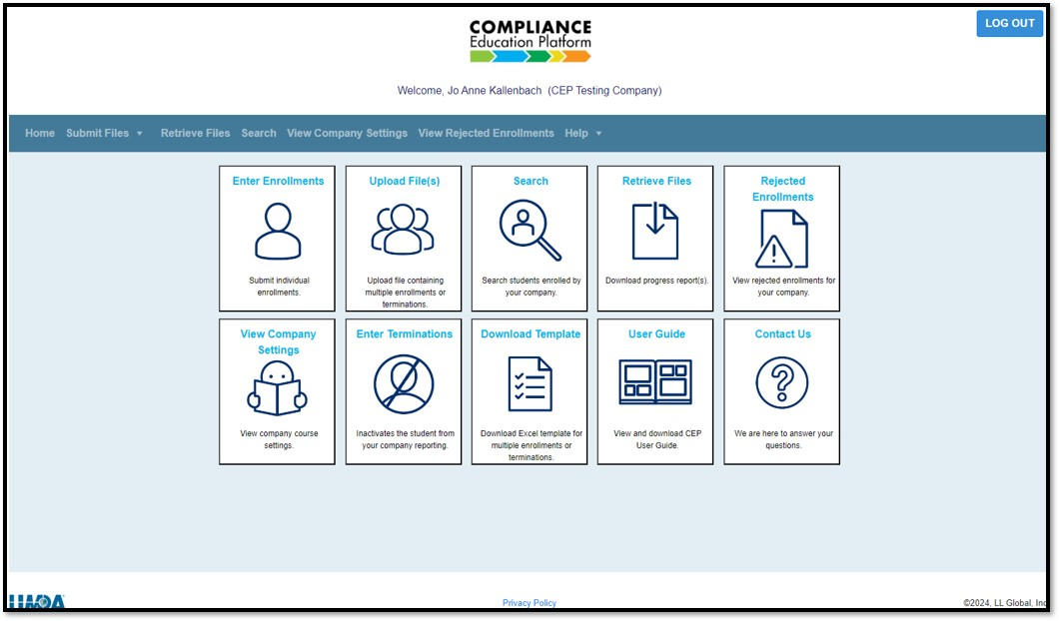
Company Access to the Compliance Education Platform Portal
Landing Page
Selection Page
Notes:
The rest of the slides we have provide more technical detail about the company’s user experience with the course. We’re happy to go through those if you are curious. Obviously for those using the program, we provide a detailed onboarding experience so you can make full use of the program.
If this level of detail isn’t helpful to you right now, I can skip these (go to slide 18).
This is the landing page and selection page for the company that uses the LIMRA AML program. It uses both icon and word tabs to navigate to the selection actions.

Slide 17
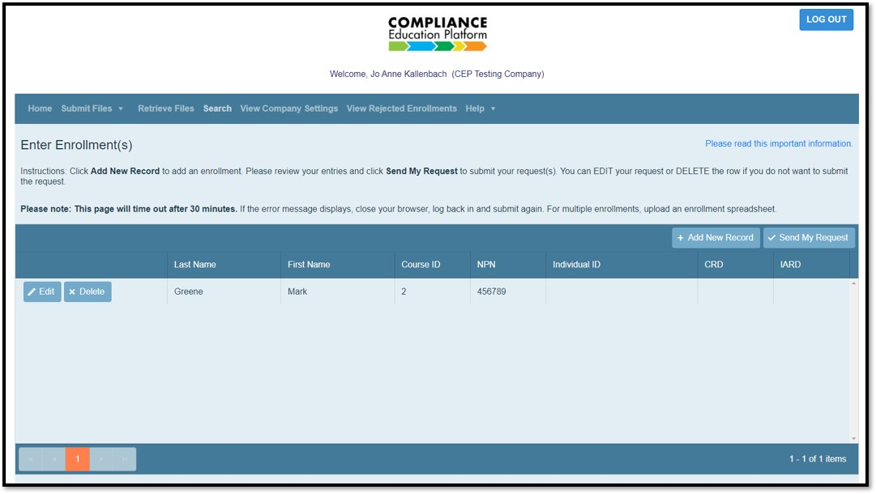
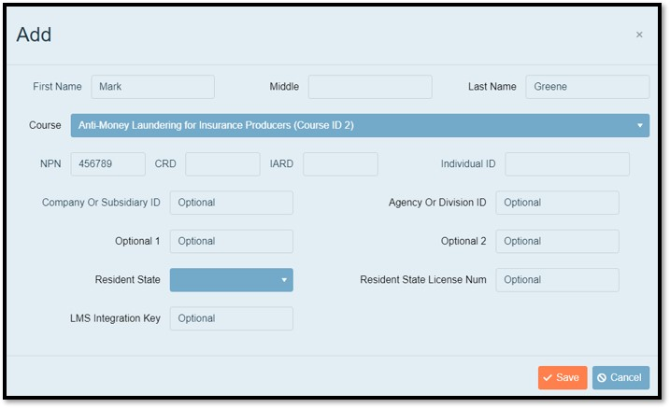
Company Enrolls in a Batch or Individually
Required: first name, last name, Individual ID (no PII is acceptable)
Notes:
This shows where a company can enroll students. Enrolling can be done here, on the company portal, by uploading a spreadsheet or even individually, when a new employee joins the firm, for example.
However, most of our companies have an automated feed to and from the LIMRA system for both enrolling and receiving completion data. We also work with other technology vendors to set up data feeds if a company uses them to manage producer appointments, for example.

Slide 18
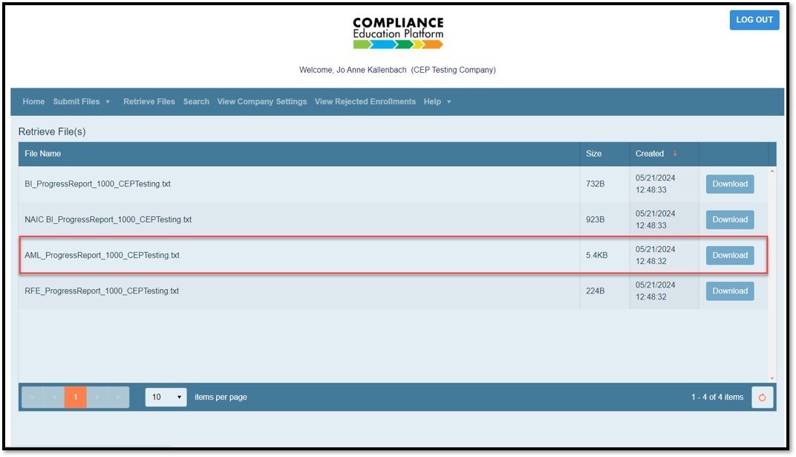
Completion data returned
Includes course name, date and time completed
Notes:
The completion data that the company receives includes the course name, the date and the time that it was completed.

Slide 19
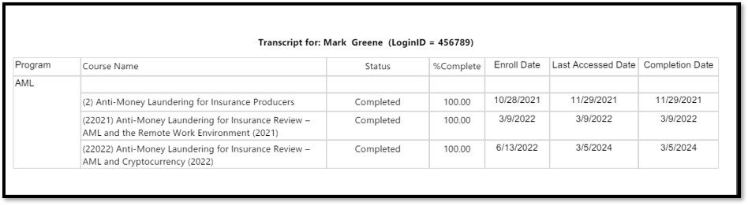
Individual Transcripts Can be Accessed on the Customer Portal
Notes:
Individual transcripts can be accessed to see multiple courses completed by an enrolled individual.

