Slide 1
Verification Retrieval Service
Industry Solutions

Slide 2
About Us
trade association in the world serving financial services
LARGEST
LIMRA
LOMA
Premier financial services industry research organization
Flagship for industry professional development
Serving members for over 100 years
Over 700 member companies in 66 countries
2
Notes:
A fun fact you may not know is that LIMRA and LOMA represent the largest trade association serving the financial services industry. LIMRA is widely known for providing industry benchmarking and research. And, LOMA is known for providing professional development and education. For more than a century, we’ve served as the largest trade association supporting the financial services industry. Today, we’re working with over 700 member companies, in 66 countries, to help them confidently navigate the changing industry by helping them understand trends, inform their strategies, develop their talent, and create solutions that advance the life insurance, annuity, and workplace benefits industries.

Slide 3
Empowering Our Members
Advancing the
financial services industry
by empowering our members with:
KNOWLEDGE
INSIGHTS
CONNECTIONS
SOLUTIONS
Notes:
Now that you know a little bit more about us and our membership let’s now focus on what exactly we do.
Our purpose is to advance the industry by empowering our members through insights, connections, knowledge and solutions. I’m going to talk about each one of these and the products and services we offer to live up to that purpose and support our membership.

Slide 4
Collaborative Industry Solutions
FraudShare®
Compliance
Combated over 570 account takeover incidents targeting over $170 million in account values.
Meet training requirements quickly and protect your customers, financial professionals and company.
+3.5 million
Course Completions
1
Applying analytics to identify fraud and generate alerts
2
Anti-Money Laundering (AML) Training
Compliance Education Platform
Enabling preventive actions
3
Benchmark fraud experiences versus peers
100%
Financial professionals surveyed said they would recommend the AML course, and it prepared them to recognize and report money laundering.
Notes:
Our experience with insights, connections, and knowledge enables us to help our members in additional ways, specifically through the development of industry solutions. Today, we’re reviewing the AML Home Office course, and what I’d like to note is that we work with our members to understand key issues and then develop solutions that effectively address the issue, minimize disruption, and provide a cost advantage for our membership.
One of our latest industry solutions, FraudShare, was also created using this proven model.
FraudShare was developed to specifically address account takeover fraud. Think of it as an industry-wide neighborhood watch for detecting and preventing fraud attempts. We have recently announced a partnership with The SPARK Institute, designed to enhance fraud prevention measures within the retirement services industry. We continue to look at strategic alliances including another one we established about a year ago with Verisk that will enable us to enhance fraud prevention across our industry.
Similarly, our Compliance Solutions, which include AML Courses for Home Office Employees and Financial Professionals, Recognizing Financial Education Training, a Course covering New York’s Reg 187 Best Interest requirements, Annuity Training, and background checks, were created using this same model. The industry identifies a need, LIMRA convenes broad perspectives from members and others, and builds a solution to meet those needs in a cost-effective way.
We also offer various connection points, through conferences, study groups, committees, executive forums and webinars. These interactive opportunities provide members with the ability to exchange ideas; discuss common issues; and network with peers and colleagues from across the industry.
We’d be happy to work with you to see if there are some compliance or learning and development groups that might be a good fit for someone in your company.

Slide 5
We want to hear from you!
How are you currently verifying AML course completion for financial professionals?
For how many financial professionals/ agents/producers do you typically need AML completion proof?
Which carriers’ products do your financial professionals/ agents/ producers typically sell?
What do you like about your current method? What would make it better?
Notes:
NOTE TO PRESENTER: This is your opportunity to learn what they are currently doing. Please pass any feedback or intel along to the product manager.
What you’re looking for is how are they currently managing verifying AML completion?
How many producers?
Which companies?
What is working, what do they wish they had?

Slide 6
The Course - Behind the Checkmark
LIMRA is the trusted source for AML Training
Updated annually by industry experts
Reviewed and accepted by member companies prior to publishing.
Access to resource library
Access to awareness material
Notes:
Before we jump into VRS, let me share what’s behind the scenes with our course:
LIMRA is the trusted source for AML training. Our product team is reading Reddit threads and tracking SEO and checking out online forums for insurance industry employees for feedback, and LIMRA is universally considered the top choice.
Our yearly refresher course provides the latest and greatest in AML hot topics and keeps learners interested with new content.
All of our courses are reviewed by multiple member companies to ensure the information is accurate and hits the mark. Their review also enables us to incorporate various experiences and scenarios from these companies. This is where we really get the benefit of being a member organization.
Each company that uses our program can include a “Company Page” on the training site. Review of this site is reported as a course completion, and this branded page includes information about who to contact in the company regarding money laundering concerns. It can include links, and policy and procedure information as well. As you probably know, companies are required to ensure their employees are aware of this information, so this helps you meet that requirement and prove that you have done so. Regulators tend to look kindly on data that proves compliance.

Slide 7
Verification Retrieval Service (VRS) – LIMRA AML Training
The LIMRA VRS program gives organizations that need verification and do not believe they need to enroll – agencies, IMOs, BGAs, and other supervisory organizations that work with independent producers – the ability to request and receive digital validation of course completion for LIMRA’s industry-approved AML Training courses.
Notes:
This slide explains who VRS is for and how it helps them.

Slide 8
Verification Retrieval Service (VRS) – LIMRA AML Training
Features:
Access data from 500,000 individual producers and 120+ companies.
Instant retrieval verifying AML course completions (within the past 2 years).
Limited input required to request and receive real-time results.
Consume the data in several ways:
Customer Portal
Export to Excel
API interface
Subscription model available for usage & pricing.
Notes:
What you get with our VRS program:
With 500,000 individual producers in our database and used by 130+ companies, you are more likely to find results you request
Data is returned in seconds,
NPN, first name, last name is the only input required
You get back the most recent completions from the past two years. Most companies will not accept completions outside of this window.
You have access to the data in multiple formats
On screen via Compliance Education Platform
Export list to Excel
Upload results to your system via excel or API

Slide 9
Verification Retrieval Service (VRS) – LIMRA AML Training
Benefits:
Easy-to-use online Customer Portal.
Real-time verification of completion status.
Resolve producer/financial professional AML training issues more efficiently.
Minimize application delays and cancellations.
Let the system do the checking.
Notes:
Instant retrieval allows your team to seamlessly continue their work on a producer record or inquiry. You can have as many people across your organization logged into the CEP platform as you need
Multiple access points to accommodate your workflow and processes
VRS is meant to help your organization
streamline your process for verifying producer AML status
Save you time
Ensure that the information you receive is valid
Resolve producer issues quickly

Slide 10
Company Access to Verification Retrieval Service Portal
Notes:
In the rest of the slides, we provide more technical detail about the company’s user experience with the course. We’re happy to go through those if you are curious. Obviously for those using the program, we provide a detailed onboarding experience so you can make full use of the program.
If this level of detail isn’t helpful to you right now, I can skip these (go to slide 14).
This is the landing page and selection page for the company that uses the LIMRA AML program. It uses both icon and word tabs to navigate to the selection actions.

Slide 11
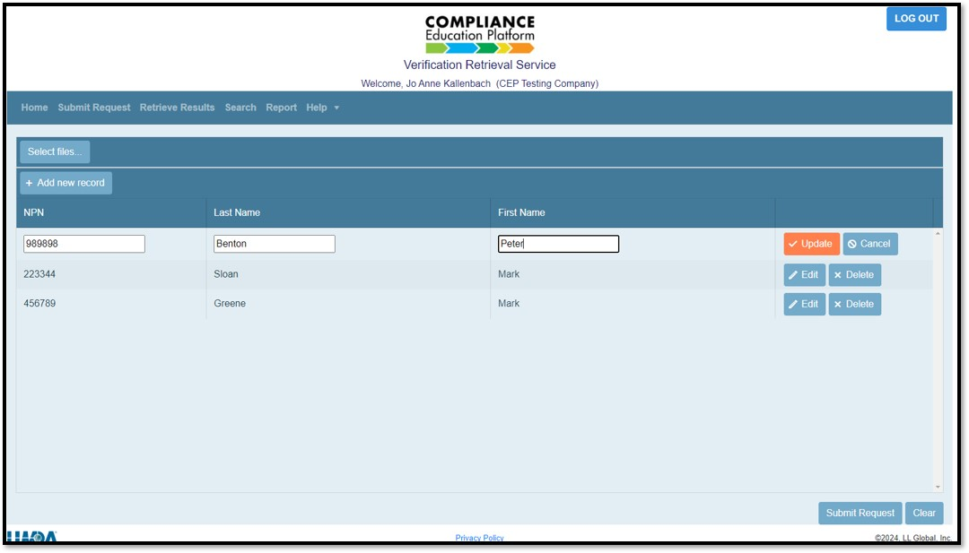
VRS Portal – Simple Data Input Requirements
Data Required:
National Producer Number (NPN)
Last name
First Name
Notes:
Data required is simply: NPN, Last Name, First Name.

Slide 12
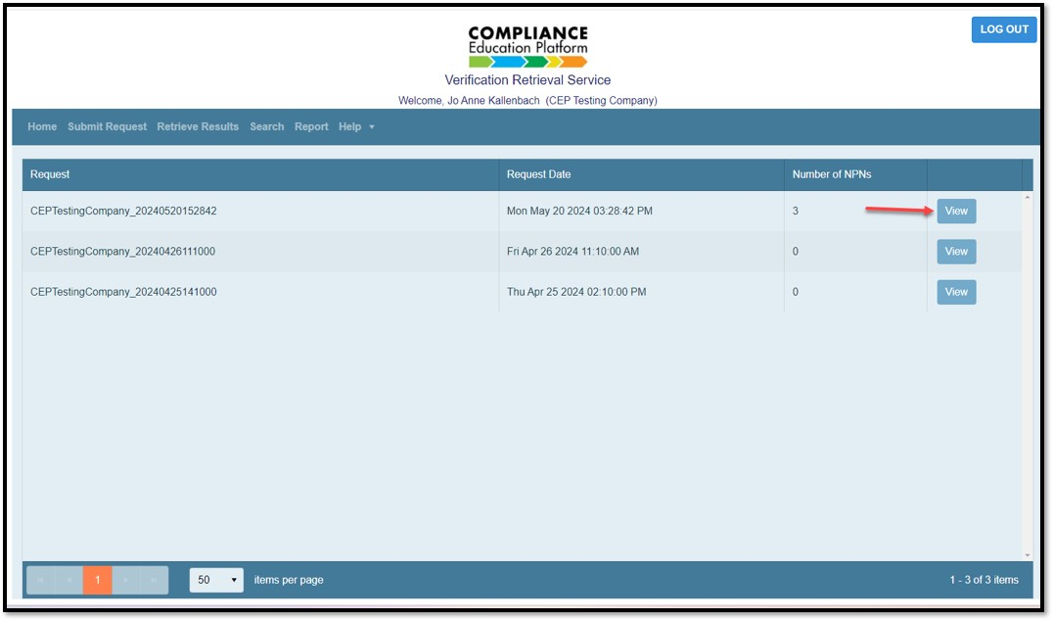
AML Training Results Retrieval
Highlight:
Date / time submitted
Number of NPNs submitted
View your requested results
Notes:
When you get the results back, the data includes when the request was submitted, the number of NPNs submitted, and of course your requested results of Aml completions.

Slide 13
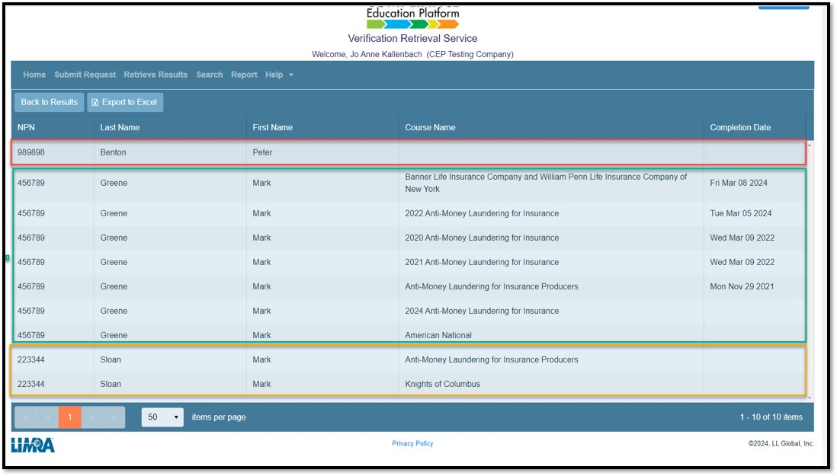
AML Training Results – Export to Excel
Three types of data returned:
Producer has no records
Producer completion record data. Courses, completion dates
Producer has been enrolled in course(s) but has not completed them
Notes:
The results data will tell you one of the following:
The producer has no records in our system
The producers’ completed courses, along with the dates completed.
OR the producer has been enrolled in courses they haven’t yet completed. In those cases, the producer can be advised to go in a finish the course at no additional charge.

Slide 14
Upcoming Enhancements
Auto Enrollment
Self-Registration Services (SRS)
For AML for producers that are currently not in our system.
Producers will be able to self register for LIMRA AML training and receive electronic certificate or digital badging.
Notes:
On the roadmap are some improvements to make the system even more robust. In the future, any producer for who data is entered will receive a free course enrollment, so they can go in and complete the course and get to the sale quickly.
Additionally, we are working on a system where producers will not have to wait for a carrier or distributor to enter them into the system, but will be able to get access themselves to take the course.

Slide 15
Additional Member Benefits
Contact Your Member Relations Director
Visit Our Websites
www.limra.com
www.loma.org
Enter Name
Enter Title
LIMRA and LOMA
Contact Our Info Centers
Subscribe to Our Publications
LOMA
infoctr@loma.org
LIMRA
infocenter@limra.com
Notes:
In addition to all the benefits I just went through, your membership gives you access to a team of dedicated professionals who can help you navigate all of your member benefits.
You also have access to our Info Center staff who can provide you with research or articles on topics of interest – think of it as access to your own industry library.
Our websites houses all of our research and our courses and are a great resource for your teams to stay on top of timely topics and events.
And finally, you can subscribe to our various publications.
MarketFacts is our digital magazine that includes thought leadership on emerging trends and pertinent topics authored by our researchers and our members.
News2use is an easy to digest, weekly digital newsletter that aggregates all of the news in our industry and summarizes the top articles and announcements.

