Slide 1
FraudShare®
The Neighborhood Watch for the Financial Services Industry
Name • Department
Date

Slide 2



Fraud Is on the Rise
$20B
Fraud is a $20 Billion problem in the life industry
Primary fraud prevention tool used by the life industry
Created by the industry for the industry
Low relative cost
Partnership with Verisk will provide more value
20%
increase in fraud incidents last year
Notes:
Fraud is a $20billion problem in the life industry
Account take-over fraud continues to growth very fast—20% increase in incidents last year
In 3 years, FraudShare has become the primary fraud prevention tool used by the life industry
While individual company tools are valuable, true strength comes from the industry working together. FraudShare is the only tool in the market that does this.
As a non-profit, FraudShare fees are extremely low relative to other tools offered by competitors

Slide 3
FraudShare Clients Report ATO as a High Risk
Top 3 Financial Crime
Exposures in 2022¹
Standard Customer Identifiers
are the Primary Method for Authenticating Customers
(DoB, SS#, Name, Contract Number)
81%
Authenticate via their IVR
91%
Authenticate via their call centers
ATO
Claim
Fraud
Agent
Misconduct
1. Financial Crimes Services and Fraud Prevention Study, LIMRA, 2022

Slide 4
We Help Members Navigate with Confidence
FraudShare®
The Neighborhood Watch for the Financial Services Industry
Effective
Efficient
Non-Profit Pricing
  Power and strength in the industry working together
  192 3rd party ATO incidents targeting $31M in account values¹
  54 companies actively using FraudShare
  Distinct set data with actual or known fraud events
  Helps eliminate false positives saving time and investigative expense
  Easy access to incident and threat data via incident and threat data APIs
  As a non-profit trade association, we can offer FraudShare to maximize participation which delivering maximum value
1. FraudShare Annual Report, 2021
Notes:
Why Us- We help members Navigate with Confidence
-As your trade association, LIMRA sits at the center point of the industry which enables us to engage across the eco-system and deliver an effective & efficient solution
- LIMRA is the trusted broker of the industry; positioning us to bring impartial solutions to industry wide challenges

Slide 5
In Good Company – Stronger Together
    70%
    of Industry Life Premium
    17
    of the top 25 Life Insurance Carriers
    60%
    of Annuity Sales
    9
    of the top 25 DC Record Keepers
    18
    of the top 25 Annuity Carriers
    25%
    of Retirement Planning Assets
Notes:
Remember, LIMRA sits at the center point of the industry which enables us to engage across the eco-system and deliver an effective & efficient solution

Slide 6









Stand Alone or Integrate With Your Other Solutions
FraudShare Works Great All By Itself and Even Better When Integrated with Other Fraud Prevention Solutions
*FraudShare provides easy access to its threat data enabling companies to enhance their other solution capabilities.
Notes:
FraudShare works great all by itself and even better when integrated with your other solutions

Slide 7
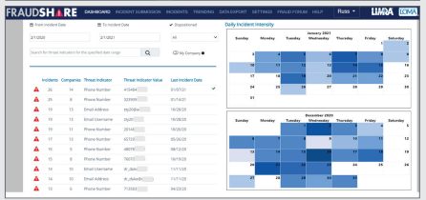
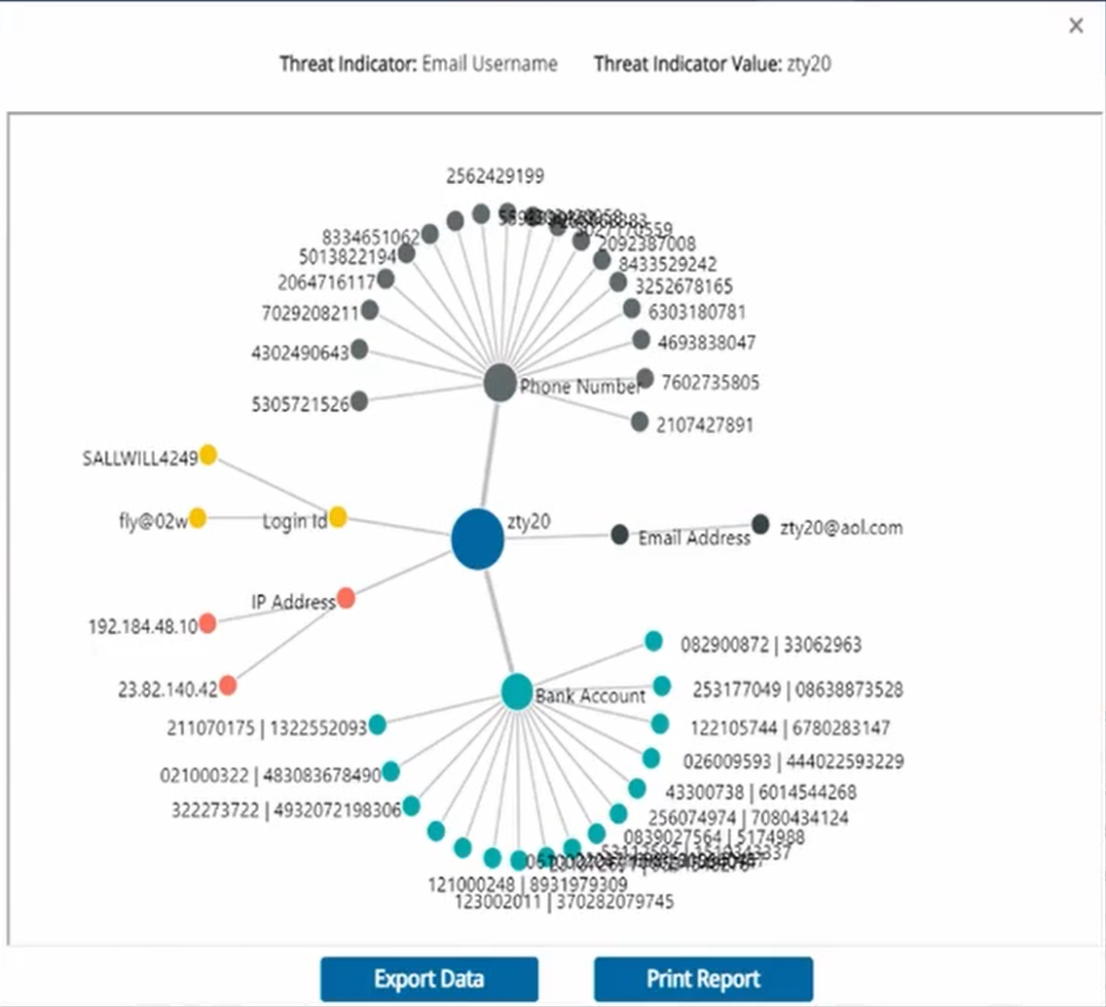
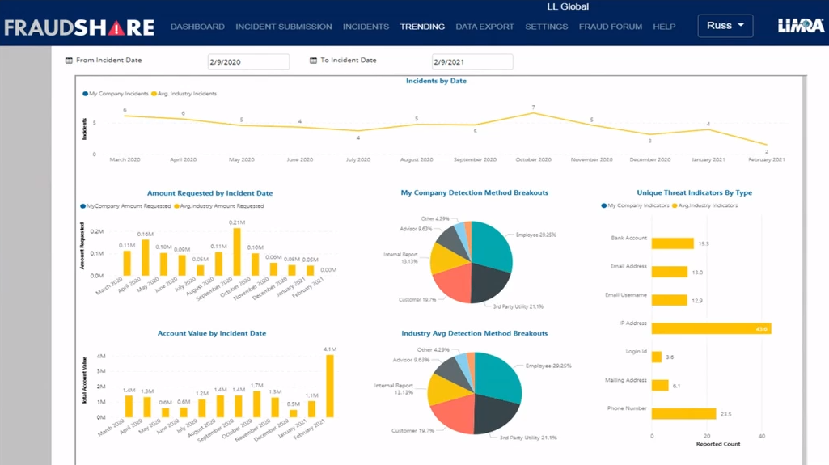
Impactful and Insightful Data
Threat Indicators & Intensity Data
Correlation Analysis
Insightful Trends
Gain insights into which threat indicators are being used to target your peers and when fraud incidents are taking place.
Benchmark your ATO experience against your peers.
Provides additional threat intelligence to assist your investigative process

Slide 8
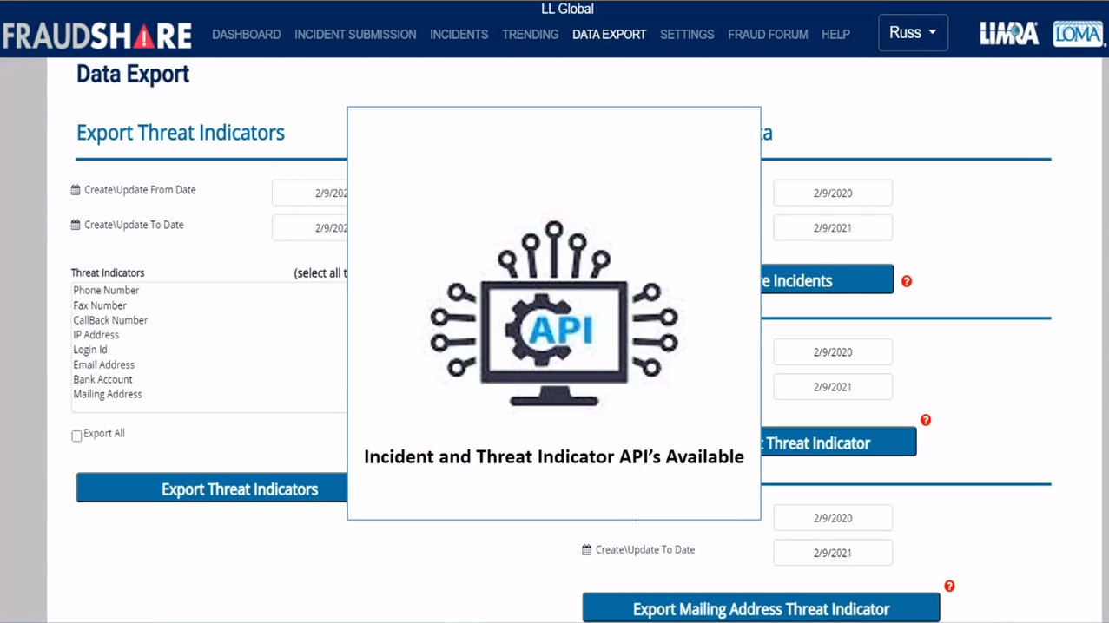
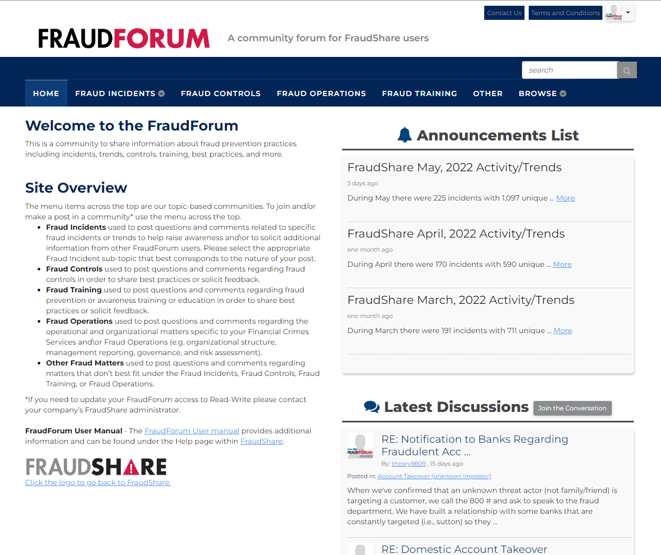
Trends, Access, and Sharing Information
Full Data Access
FraudForum
Access to all data via export or API functionality to integration to your systems.
Expand your fraud expertise by discussing and collaborating with industry peers regarding best practices, trends, and other fraud related topics.

Slide 9


Proven Effectiveness
“
“
FraudShare has been a great addition to support our fraud fighting efforts. The integration has already helped Securian Financial prevent fraud.
Scott A. Helgeson
Business Operations Director
Securian Financial
“

Slide 10



FraudShare
A groundbreaking
anti-fraud alliance
LIMRA and Verisk are working together to enhance data, analytics, and technology capabilities to forge a more potent weapons against fraud.
www.LIMRA.com/FraudShare

Slide 11
Schedule a Demo
Russell Anderson, CFE
Head of Financial Crimes Services
Randerson@LIMRA.Com
Sharyn Kessler, ACS, ALMI
Financial Crimes Services Program Owner
Skessler@loma.org
www.limra.com/FraudShare
Notes:
Working together, by the industry, for the industry to protect against 3rd party account take over fraud.

Slide 12


Appendix

Slide 13
Protecting Your Brand While Fraud is on the Rise
  3.28 B
  exposed passwords
  2.18 B
  leaked emails²
307%
Increase in ATO attacks between 2019 and 2021¹
ATO leads directly to brand abandonment:
74% of consumers surveyed say they would stop engaging with a site or app and select another provider if their account was hacked on that site or app. ¹
48%
of ATO victims have had their accounts compromised between two and
five times. ¹
  75-85%
  of all login attempts in the second half of 2020 were account takeover attempts
ATO attacks increased 307% between 2019 and 2021/
Account Takeover Implications for Financial Institutions
The Rise in Customer Account Takeovers and How to Prevent Them

