Slide 1
LIMRA LOMA Key Employee Findings and Resources
Kelly Fehring, Member Relations Director, Barb Kimball, Member Solutions Director, and Mike Rand, Member Solutions Director
June 12th, 2024

Slide 2
Introductions and About Us

Slide 3
Agenda
Annual Benefits and Employee Attitude Tracker: What do we know?
Your LIMRA/LOMA Resources and Solutions
Thrivent: How can we help you?

Slide 4
Benefit and Employee Attitudes Tracker

Slide 5
Important Factors in a Potential Employer
Based on all employees. Employees ranked the top five most important factors they would look for in a potential employer
Source: 2024 BEAT Study, LIMRA..

Slide 6
Important Employer Factors Over Time
Represents the percent of employees who ranked the given factor in their top five.
Source: 2024 BEAT Study, LIMRA.

Slide 7
Factors Associated With Employee Loyalty
Represents the number of times more likely an employee who agrees with an attitude is to want to stay with their employer over the long term, compared with employees who disagree with the attitude. Disagreement rated 0–4 and agreement rated 6–10 on a 0–10 scale.
Source: 2024 BEAT Study, LIMRA.

Slide 8
Overall Job Satisfaction
“Overall, I am happy with my job”
Which types of employees are happiest?
Baby Boomers
Higher income workers
Senior executives
Employees at small/midsize companies
Remote/hybrid workers
Agreement was rated on a 0–10 scale; some categories were merged as follows: Disagree = 0–2, Somewhat disagree = 3–4, Neutral = 5, Somewhat agree = 6–7, Agree = 8–10.
Source: 2024 BEAT Study, LIMRA.

Slide 9
Plans to Change Jobs
Source: 2024 BEAT Study, LIMRA.

Slide 10
Understanding of Benefits
Based on employees who are offered the given benefit.
Source: 2024 BEAT Study, LIMRA.

Slide 11
Understanding by Quality of Communication
Represents percent of employees who say they understand the benefit extremely or very well. Based on employees who are offered the given benefit and have had an open enrollment within the past two years.
Source: 2024 BEAT Study, LIMRA.

Slide 12
Confidence in Benefit Decisions
Based on employees who are offered insurance benefits and have had an open enrollment period within the past two years.
Source: 2024 BEAT Study, LIMRA.

Slide 13
Frequency of Communication
Based on employees who are offered insurance benefits and have had an open enrollment within the past two years.
Source: 2024 BEAT Study, LIMRA.

Slide 14
Prevalence of Mental Health Challenges
Represents frequency with which employees have experienced mental health challenges in the past year.
Source: 2024 BEAT Study, LIMRA.

Slide 15
Interest in Mental Health Benefits
Based on all employees.
Source: 2024 BEAT Study, LIMRA.

Slide 16
Are Employers Invested in Mental Well-being?
Agreement rated 8-10 on a 0-10 scale.
Source: 2024 BEAT Study, LIMRA.

Slide 17
Desired Mental Health Benefits
Based on all employees.
Source: 2024 BEAT Study, LIMRA.

Slide 18
Your LIMRA/LOMA Resources and Solutions

Slide 19
Empowering Our Members
Advancing the financial services industry
by empowering our members with
Insights
Connections
Knowledge
Solutions

Slide 20
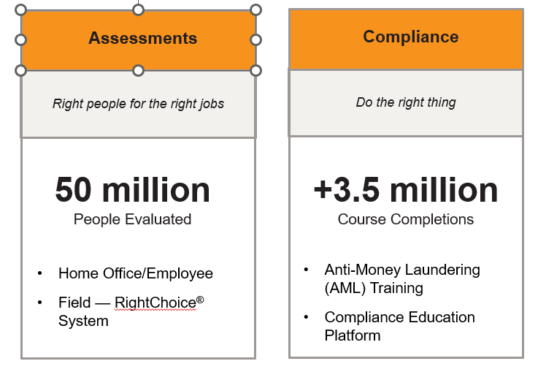
Industry-Leading Solutions
Solutions

Slide 21
LOMA Professional Development Solutions
Onboard Effectively
Develop and Retain
Succession Planning/Leadership Development
Strategic Leadership Experience
in partnership with
Wharton Executive Education
Finance for Insurance Leaders
Accelerate Impact Suite
Certificate Programs
Facilitated Learning
Industry Advantage
Talent Mobility Suite
Designation Programs
Industry Advantage

Slide 22
How can we help you?

Slide 23
Thrivent
How may we help you?

Slide 24
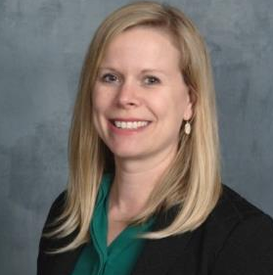
Your Partnership Team
Kelly Fehring, FLMI, ACS, CLU
Member Relations Director
kfehring@limra.com
(513) 384-8061
Mike Rand
Member Solutions Director
mrand@limra.com
(860) 285-7871
Barb Kimball
Member Solutions Director
bkimball@limra.com
(860) 214-3350
Notes:
(next slide)

