Slide 1
Trustworthy Selling Product Line
Transforming transactions into enduring relationships
Sales Playbook – INTERNAL USE ONLY

Slide 2
Using This Playbook
This is YOUR resource. It’s NOT FOR MEMBERS.
This Playbook is designed to help you sell Trustworthy Selling. It is for internal use only and no part of it should ever be shared with members, prospects, existing clients, or anyone outside of our organization. Only approved marketing collateral should be sent to members/prospects.
The Playbook provides information on the courses, target markets, pricing, competition, FAQs, and a specific sales approach to follow. It also includes step-by-step instructions on how to get important information to members so that they can evaluate our program. Additionally, there are links to important resources and job aids to help you succeed in selling the program.
If you study the Playbook, you should be well prepared to execute our sales plan. The more we all use it, the easier it will be for everyone to succeed..

Slide 3
Table of Contents
Program Overview
Target Markets, Selling Points, and Pricing
Selling the Program
Onboarding Resources

Slide 4
Program Overview

Slide 5
Trustworthy Selling
What it is…
Trustworthy Selling and it’s many iterations is for financial sales professionals who are seeking to improve their ability to succeed (productivity and retention wise) in financial services sales. Trustworthy Selling is a sales effectiveness program that teaches sales professionals to sell by listening, advocate rather than pressure, and to partner and foster relationships for the long game. Unlike many of our competitors Trustworthy Selling was built by our industry for our industry.
What it does… Trustworthy Selling provides the tools to grow from within and the confidence to build enduring relationships. It teaches that there is tangible meaning in what we do and comfort with its success.

Slide 6
Telling the Trustworthy Selling Story – “Selling is Serving”
Best interest means taking prospects and clients through a process that:
is grounded in a deep understanding of the prospect’s unique situation
educates them on how financial services products & solutions are designed to help them meet their goals
uses simple language to explain complex products to ensure the prospect agrees the solution fits their best interest
is transparent and builds trust – motivating the prospect to take action
Notes:
Trustworthy Selling has always centered on the premise that “selling is serving”. From our POV, the move to a best-interest standard is a no-brainer. In order to motivate effectively, financial representatives truly need to be on the same side of the table as their prospects and clients and function at all times in their best interest.
This means taking them through a process grounded in a deep understanding of the prospects unique situation and educating them on how the products and services of our industry are designed to help them meet their goals.
It means taking them through a process that uses simple language to explain complex products to ensure the prospect agrees that the solution being recommended fits their best interest. It means taking them through a process that is transparent and builds trust – motivating the prospect to take action.
As your organization evaluates how you can better serve your clients’ best interests, know that Trustworthy Selling provides a proven process to do just that. For trustworthy financial professionals The PROCESS is the Product!

Slide 7
Why We Built Trustworthy Selling
The industry has evolved a lot in the last ten years. Product, systems, and technology enhancements – however selling techniques and marketing approaches haven’t kept pace with changing consumer attitudes or buying behaviors.
Today, buyers often see financial sales professionals as intimidating, confusing, and having a self-serving agenda. In fact, according to LIMRA research, more than 40% of consumers are afraid of making a mistake with financial decision-making. And when they finally meet with an agent or advisor, over 70% report feeling more confused afterwards.
Overcoming these psychological barriers take new approaches that win confidence and put buyers at ease.
LIMRA and the Hoopis Performance Network collaborated to create this program specifically for the insurance and financial services industry. It is a courageous partnership that is founded on making a difference and changing the industry that’s been searching for an answer.

Slide 8
Target Participants
New to the career
Experienced
Multi-Line
Less than 6 months in career
6 months or more in career
Selling both P&C and Life products

Slide 9
Three Versions
New to Career — Trustworthy Selling Quick Start
Designed for brand new recruits to get them off to a fast start in the business.
It replaces sales/soft skills training and enhances your organization’s existing, proprietary initial training program.
TS Quick Start provides new recruits with the skills, language and confidence they need to be productive immediately and sustain that success in today’s market.
Key point: Do not use “layer on top of existing sales training” use “replaces/enhances current sales skills” message for this edition.
Experienced — Trustworthy Selling Professional
Designed for experienced financial professionals to increase vertical growth productivity
TS Pro was also developed to help organizations overcome the retention cliff that has plagued the industry and typically occurs in the 2nd to 5th year in the business by re-engaging those producers who have plateaued in their career.
TS Pro provides experienced representatives with in-depth insight into consumer behavior, buyer and seller psychology and sales techniques utilized by the top producers in the industry.
Trustworthy Selling Multi-line
Created specifically to help property and casualty agents improve their ability to pivot between the personal line the life conversation with prospects and customers.
Multiline agents who can do this successfully and improve their cross-line sales ratio are going to experience increased new business, higher retention, and more referrals.
We have a Quick Start and a Professional version for Multiline.

Slide 10
Editions of the Program
Full Program (10 modules of content)
Full Program
Multiline Edition
Modularized
Program
SkillSet powered by TS
(Bus Dev & Coll Disc)
New to the Business
Quick Start
Experienced
Professional
Notes:
Trustworthy is expanding. Outside of all of the translation work we are doing for our international markets, we are creating new iterations of the program in order to accommodate our member company’s development needs.
For a LI and RM advisor development opportunity we offer our full program (10 modules of content) in a Quick Start edition for those brand new agents to get them launched quickly into the business, and a Professional edition for those FPs that have been in the business for 6 or more months.
And, for the Multiline agent the Quick Start and Professional editions are also available.
In 2022 we brought the Modularized content design to the market. We have this content available in a Quick Start Edition and a Professional Edition. Providing our client companies with the ability to pick and choose the modules right for them.
And, in 2023, we created the SkillSet version of the program. Again available in the Quick Start and Professional editions. SkillSet is designed for sales professionals who have been in the career for 5 years or less and have a good understanding of a company’s sales process, products, and have a client base to work with. These individuals are looking for ways to:
Sharpen their skills to drive higher productivity.
Grow their business by accelerating the process from business development to sale.

Slide 11
Full Program Components
Comprehensive learning system comprised of 24 hours of training content
10 Instructor-Led Modules covering array of content:
Strategic insights from consumer research
Tactical application of insights to grow sales
Psychological awareness of self and others
2 Industry-validated assessments
Personality Styles Profile
Sales Booster
Supplemental Resources
Infographics
eLearning Knowledge Reviews
Resources for Results that provide step-by-step processes, sample language and tools
Coaching Tools and Resources

Slide 12
Modularized Program Components
Our Modularized Trustworthy Selling content focuses on the tactical training modules from the Trustworthy Selling House of Sales that deliver the sales skill elements which support your sales professional’s development opportunities to take their business to the next level.
Pick and choose the modules right for your organization:
Understanding Today’s Consumer
Understanding & Adapting Your Selling Style
Business Development Strategies
Engagement Strategies
Collaborative Discovery
Gaining Commitment
Deepening the Client Relationship
Seller Psychology
Supplemental Resources
Infographics
eLearning Knowledge Reviews
Resources for Results that provide step-by-step processes, sample language and tools
Coaching Tools and Resources

Slide 13
SkillSet powered by TS Program Components
SkillSet is a 1-day program (6 total hours of delivered content) that can be delivered in a live classroom setting or virtually.
SkillSet offers a pre-learning opportunity which introduces the learner to Trustworthy Selling and our Trustworthy Selling model.
SkillSet focuses on the core sales effectiveness skills of
Business Development Strategies
Collaborative Discovery
with the goal of helping sales professionals get in front of the right potential clients, build trust quickly, and identify the needs and desires of the potential client through the art of questioning so they can make proper recommendations.
SkillSet is easy to implement, easy to execute!

Slide 14
Program Materials
Subject matter expertise delivered via online video
Fully-scripted facilitator guide
Digital participant guides
Multimedia platform for in-program and post-program learning
Targeted skill assessments
Developmental assessments
Wall charts
Digital coaching guides
Notes:
Trustworthy Selling was built as a totally immersive, learning program that packages together everything needed to deliver a first class and effective training program. There is no content to tailor, or modify, it’s a turnkey system.
The subject matter expertise in the program is delivered via online video. So facilitators don’t have to become subject matter experts which removes a tremendous amount of heavy lifting off their shoulders. This also creates consistency in the message being delivered in the core content as well as scalability as it pertains to implementing company-wide.
Fully scripted facilitator guides tell exactly how to tee up content, debrief content, lead group discussions and run adult learning activities.
Participant guide – interactive digital guide with field-tested resources to keep learner engaged (in-person or virtual in 3 languages)
Website – hosts videos, multimedia tools and resources as well as access to videos via TS mobile
Skill assessments & profiles – scientific feedback and skill development based on industry best practices.
Developmental assessments – industry validated to personalize the learning experience.
Wall charts – Each of core concepts of the program (TS model, Four Facets of Trust, Behavioral Economics Techniques and more) are captured in wall charts so that they stay top of mind during the program and beyond
Coaching guides - Participants, coaches and facilitators receive coaching materials, so that this critical accountability component stays in focus throughout the curriculum.

Slide 15
Program Differentiators
Based on your clients needs – share with them and discuss the three (3) that are most relevant
1. Relevant – built for the industry, by the industry – content is financial services specific, no tailoring required.
2. Proven Results – Proven impact-based on more than 2 dozen impact studies we have seen a 26% average lift in productivity since inception.
3. Built-in Reinforcement – provides ongoing skill development tools and coaching resources via a state-of-the-art platform for 6 months or more following the program.
4. Consistent & Scalable – the majority of the subject matter expertise is delivered via streaming, online video. The facilitator’s primary role is to facilitate the program by leading discussions, conducting debrief activities and providing their own practical insights on certain topics. This ensures quality and consistency of program delivery across the enterprise.
5. Proven Deployment Strategies – We take the worry out of large-scale training implementations by providing personal consultation on implementation in your sales culture. ***KEY CONCERN***
Notes:
This program can cover all your customer-facing representatives, as a key element in your risk management policies.
Scalable delivery – self-paced, cost-effective solution built on a platform many companies are already connected to for AML and Elder-Abuse training. We can integrate with a company’s own Learning Management System with single-sign on.
The program is flexible – companies may choose to combine Fiduciary Essentials with Role Specific courses, or they may choose to use one or the other.

Slide 16
Program Differentiators (cont.)
6. Marries the Science Behind How People Buy with the Art of How Top Professionals Sell – The science is the research-based data featuring industry trends, the consumer mindset, behavioral economics and more. The art is the skills, language and best practices utilized by the top financial professionals in the industry.
7. Combines Assessment & Development – integrates two assessment into development and coaching which leads to a very personalized experience for our participants. No other sales effectiveness program offers industry validated assessments to support understanding, growth, and development.
8. Measuring Impact – ROI - on how we measure impact. Scientific way to measure impact of a training program.
9. Professional Development – qualifies as an elective for the American College FSCP designation and for C-E credit with the Institute in Canada.
10. Best Interest of the Consumer – the only industry-specific sales effectiveness program that supports alignment with best interest standards. Selling is serving has always been our mantra.

Slide 17
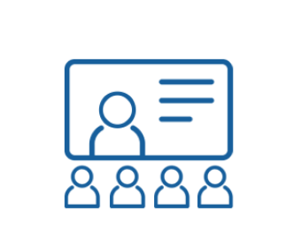
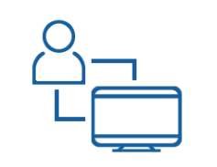
Live Classroom
Virtual Classroom
Self Study
Blended Learning
Notes:
Our materials are designed for Instructor lead delivery – either live in a classroom setting or in the virtual classroom; and we offer some modules in a self-study format to help break up your inperson delivery sessions. So, you can basically have it your way (Blended Learning)… delivering the foundational modules in a self-study format, delivering the tactical modules in the live classroom, delivering Seller Psychology in the virtual classroom and then bring everyone back to together for Capstone in the live classroom.
Trustworthy Selling is highly structured and highly flexible to accommodate any delivery model. The LIMRA/HPN team is in a unique position when it compared to other training organizations. We understand you, understand the industry, and know the product inside and out. We know what success looks like across many different organizations and channels. As such, we can consult with you to develop the most suitable delivery model for your unique needs, whether that be through the standard delivery model or something tech-enabled using our team of skilled facilitators.
The standard delivery model is designed for traditional, instructor-led classroom delivery, using certified company facilitators. The subject matter expertise is provided through streaming video, enabling consistency and standardization of training. A key role for the facilitator is to bridge the agency’s culture with the Trustworthy Selling concepts. Facilitator certification is conducted through virtual delivery, so extensive time is not taken out of the field.

Slide 18
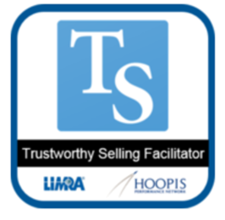
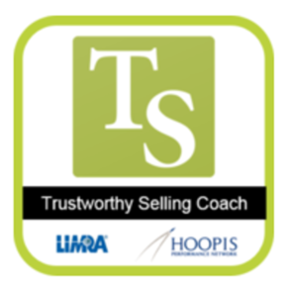
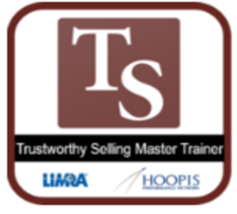
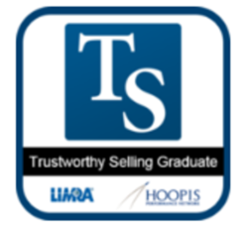
Recognizing Our Participants
Digital Badges are here!
Notes:
Outside of great results, one of our projects for 2021 into 2022 was to get our digital badge system up and running so participants can be recognized for their commitment to completing this program. We issue badges for all program completions to the following groups – certified facilitator, certified coach, certified master trainer, and tsprogram graduate.

Slide 19
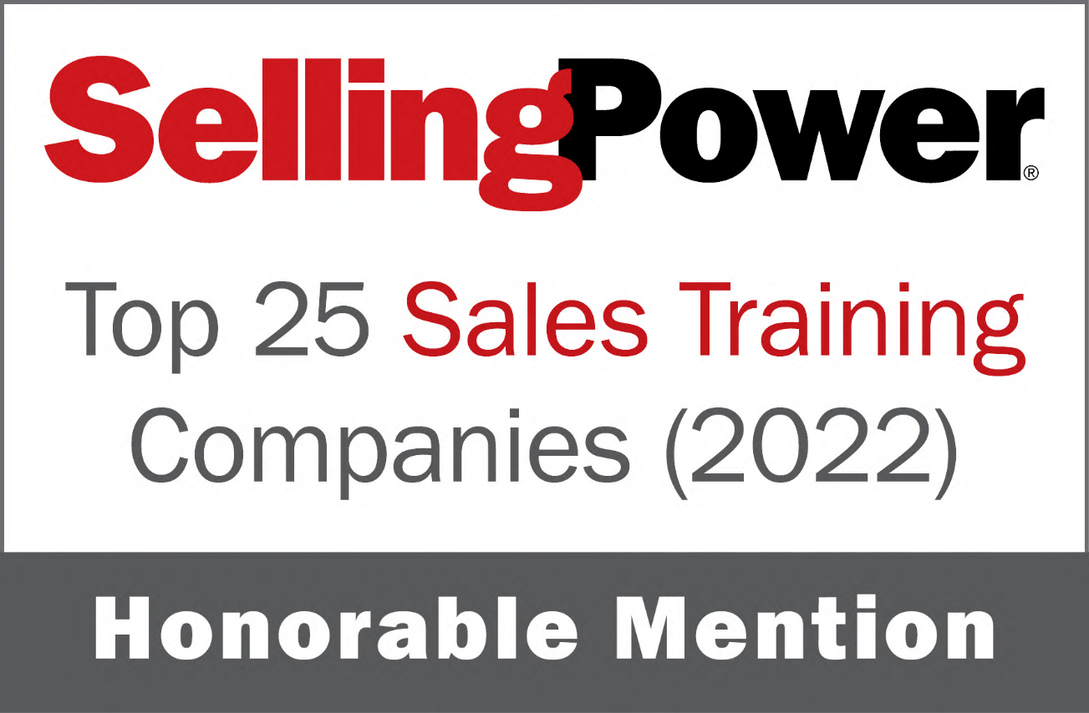
Notes:
We have something to boast about!
For the fourth year in a row, we have been mentioned by Selling Power magazine as one of the top 25 sales training companies in North America!

Slide 20
Target Markets, Selling Points, and Pricing

Slide 21
Current Roster of Companies
Captive Distribution
1847Financial
Aditya Birla Sun Life – India
AIA China
AIA Philippines
Allianz Philippines
Canada Life
Catholic Financial
CITIC Pru - China
Desjardins Financial Security Network
FWD - Thailand, Malaysia; Philippines
Guardian (content license)
Industrial Alliance (Canada)
Investors Group (Canada)
Manulife – Japan
Modern Woodman
Mutual of Omaha
Old Mutual – South Africa
Pan American Life – Trinidad
Prudential
Sanlam – South Africa
Sun Life (Canada)
Western & Southern
Zurich - Malaysia
Independent Distribution
Ameritas
Multi-line Distribution
Co-operators (Canada)
Farm Bureau Iowa
Farm Bureau of Michigan
Horace Mann
Indiana Farm Bureau
Patriot Life
You may cite these firms in a conversation, although you should NOT circulate the list!!

Slide 22
Discontinued Opportunities
Captive Distribution
AAA Life
AIA – Singapore
AIG
Baltimore Life
Bankers Life
Catholic Order of Foresters
FaithLife Financial
Financial Horizons
First Protective
Genworth
Great West Life/London Life
GPM
Great Eastern - Singapore
Great West
Guardian (pilot)
Knights of Columbus – Canada
Lafayette Life
Legal & General
Liberty Group – South Africa
Manulife - Singapore
Maritime Financial
Mass Financial Group
Mass Mutual – OK; Hoopis; Home Office
New York Life (pilot)
Northwestern Mutual – Home Office; Derrickson Financial Group; Hubbell FG; Ricci FG; Theodore FG
NorthStar Resource Group
One America
Penn Mutual
PPI – Canada
Principal Financial
Protective Life
Prudential (Singapore)
RBC
Sanlam – South Africa
SSQ – Canada
Tata AIA – India
TD Insurance
Thrivent
USAA
WAEPA
ZLC Financial (Canada)
Independent Distribution
Financial Horizons
First Protective
Foresters Financial (Cetera)
Great West
Ivari - Canada
Sun Life - Canada
Multi-line Distribution
Alfa Insurance
American National
Cincinnati Life
Country Financial
Desjardins
You may cite these firms in a conversation, although you should NOT circulate the list!!

Slide 23
Target Buyers – Key Roles Involved in Evaluating and Deciding on a Solution
Target Positions | Where to Find
VP, Sales | Salesforce
VP, Training & Development | Salesforce
CDO, Distribution | Salesforce
CAO, Agency | Salesforce
Managing Partners/Directors | Salesforce

Slide 24
Broad Pain Points – What to listen for…
Getting new agents and advisors off to quick start
Increasing agent productivity, efficiency, and results
Agent and advisor retention training and the right resources to do so
Nailing the right language for referrals, sales and overcoming prospecting objections
Building trust in sales and financial services
Ensuring and maintaining up-to-date resources and information for the field
Implementing new solutions with ease
Supporting field management with coaching and training resources to improve their effectiveness
Pivoting to multi-line products

Slide 25
Competitive Landscape
Company | Financial Company’s using product | Product | Pricing | Delivery Options | Overview of offering
Sandler Training | MassMutual; New York Life; US Bank | Programs focused on Prospecting, Social Selling, Enterprise Selling, Customer Success, Sales Management, Selling Into the C-Suite, and Coaching result in common processes, culture, and sales language within client organizations, translating to increased revenue and more accurate forecasting. | Online, individual, sales courses – click on each to see price | Translated into over 20 languages. Virtual led, live -in person led, online courses reinforced with online tools | Sandler Selling has been in the business for 50+ years. They were born out of the B2B and enterprise selling space; however has developed expertise and presence in the B2C space for sales training within financial services. Their training is delivered through 250+ franchisees locally (domestically) and internationally.
Integrity Solutions | American Family Insurance; Ameriprise; Amica; Athene; AXA; Guardian; The Hartford; Lincoln; MetLife; Modern Woodmen; Principal; Transamerica | Integrity Selling is very process-driven, built around a 6-step sales process. | Workshop description for indiv. / group discount – Integrity Selling (facilitator led virtual) $1,950 per person | Blended mixes (live, virtual, self guided, hands on) | There is no emphasis on business development – instead a focus on “demonstrate, validate, negotiate,” not as relevant to financial services. It doesn’t cover collaboration, creating ongoing relationships, or client retention like Trustworthy Selling does. It stresses honesty and integrity but overlooks the importance of competence, reputation and consumer behavior. It is an old program; the author is gone.
Rain Group | Bank of America; John Hancock; Fidelity; TransAmerica; SwissRe; BCBS MA; | Rain Group offers sales training programs, consulting, and coaching to help improve financial services sales. | All programs refer to contacting them | Live, virtual, asynchronous | Banks and financial institutions struggle to engage conversations that lead to new business and generate the internal referrals necessary to grow accounts as much as they should. Financial services companies who have overcome these challenges experience much greater profit and revenue growth than the rest. Claim to have Financial Services expertise and base their content on research.

Slide 26
Competitive Landscape
Company | Financial Company’s using product | Product | Pricing | Delivery Options | Overview of offering
Wilson Learning | Very secretive! | Counselor Selling has been around for the past 55 years and was the sales training standard of the 20th century. CS has added courses such as Selling in a Virtual Environment; CS in a Virtual Environment since 2020. Both programs also have similar steps in the sales process that correspond and build on relating, discovering, advocating and supporting. For the advisor and sales leader they have 31 courses designed to support Financial Services sales effectiveness. | Public seminar registration page, scroll to see various program title and price per person –click on “sign up online” for prices. May also be corporate custom programs. | Virtual | The Trustworthy Selling approach complements Counselor Selling in that it also addresses knowledge and skills, tools and processes, measurement and feedback, and ongoing management and coaching. Trustworthy Selling looks also at becoming a “conscious competent” – not only knowing what to do but also understanding why it works. CS is available in 50 countries.
Janek | New York Life; MapFre; Blue Cross Blue Shield; March; Great American; Optum; Blue Shield of California; TIAA; Santander; LPL Financial; HSBC; East West Bank | Critical Selling Skills; Critical Negotiating Skills; Selling Virtually are programs Janet offers to companies in the Financial Services space. | Workshops for hands on – (not dedicated corporate) schedule and costs | Onsite or virtual instructor led; blended (e-learning and face to face) | Janek helps sales teams win more often. They implement proven sales training and sales consulting solutions that are customized to the challenges and culture of your organization, driving results that speak for themselves. The Janek sales training approach is designed to shift thinking from what you’re selling to how you’re selling it, giving you the tools to respond to the needs of modern buyers.
Brooks Group | Wells Fargo; Chase | Brooks Group’s repeatable steps of the IMPACT business sales training program allow sales teams to meet prospects and customers where they are in the buying process to maintain alignment, build credibility, improve the predictability of the sales funnel, and engage in meaningful dialogue that progresses the sale. | Pricing Guide https://brooksgroup.com/wp-content/uploads/2020/09/thebrooksgroup_gsaguide20200324.pdf Or – under “Sales Training” on website, can select specific programs to view price when trying to enroll (works for programs for individual but not teams) | Virtual, live | Financial planning and investment advising is a complex role that requires frequent personal interactions and exchanges. Your sales team will master the techniques of understanding buyer behavior style and adapting their personality to approach the prospect in the most effective way during sales conversations.

Slide 27
Competitive Landscape
Company | Financial Company’s using product | Product | Pricing | Delivery Options | Overview of offering
Sales Readiness Group | LPL Financial; AIG; Kemper; Johnson bank (Johnson Financial Group); MassMutual; GenRe; | SRG customized sales training programs give sales professionals a complete selling framework, essential skills, and practical tools to proactively create new opportunities and close more profitable deals — even in an increasingly competitive market. | Online Sales Training Comprehensive Selling Skills - $595 /1 yr access Same price for Online Individual High Impact Sales Coaching Costs for private or public training programs (indiv or small group) filter by ‘delivery option’ to see all programs | Interactive workshops, virtual, in person, blended | Turn your team into top performers, trusted advisors, and master negotiators with selling skills training that actually sticks We provide a complete system that includes assessment, customization, engaging training, and ongoing reinforcement, so you get the lasting behavioral change that drives sales results. Interactive workshops feature scenario-based learning, business-specific exercises, and role-playing. The program content will benefit different sales roles across organizations, not just sales reps. Salespeople get a consistent approach and common language to apply and adopt in the field.
Richardson Sales Performance | Northwestern Mutual; Chubb; MetLife; Aetna; Liberty Mutual; Cigna; Willis Towers Wilson; Gallagher; QBE; Goldman Sachs; Capitol One; Charles Schwab; PNC; BMO Harris Bank; Societe Generale | Connected Selling Curriculum 2021: new, forward-thinking sales methodology: Sprint Selling™. Sprint Selling™ stands on the shoulders of two of the most powerful selling approaches ever to exist: Solution Selling and Consultative Selling. This new methodology […] into a single effective program to increase win rates, reduce cycle time and drive revenue. | Capital One; Goldman Sachs; KPMG; Oppenheimer Funds; Charles Schwab; PNC | live, virtual, and digital | Grounded in behavioral science, Connected Selling Curriculum addresses all selling roles and all phases of the sales cycle to give teams the right learning at the right time. Speed to proficiency is crucial for today’s competitive sales teams looking to upskill.

Slide 28
Pricing
Participant fees are pay as you go.
Pricing applies to all editions of Trustworthy Selling.
Term is for 2 years.
50% higher fees for non-members.
For ALL pricing options, see next slides

Slide 29
Full Program Pricing Schedule
*Number of Participants | **Total License Fee
Per Participant | $895 per participant
100 | $59,500
101 to 250 | $123,750
251 to 500 | $225,000
501 to 1,000 | $395,000
Pricing applies to all versions of Trustworthy Selling: Professional, Quick Start and Multi-Line
*Companies have up to 24 months to use all participant licenses. ** Total License Fee is due upon signed Service Agreement.

Slide 30
SkillSet Pricing Schedule
*Number of Participants | Cost per Participant | **Total Licensing Fee
Up to 25* | $495.00 | $12,375
Up to 50* | $450.00 | $22,500
Up to 75* | $425.00 | $31,875
Up to 100* |  | $39,500
Up to 250* |  | $87,500
Up to 500* |  | $162,500
Up to 1,000* |  | $295,000
Pricing applies to all versions of SkillSet: Professional, Quick Start
*Companies have up to 24 months to use all participant licenses. ** Total License Fee is due upon signed Service Agreement.

Slide 31
Modular Enterprise Pricing Schedule

Slide 32
Other Fees
Facilitator Certification
$750/facilitator
Coach Certification
$195/coach
Printed Participant Guides
TBD
Includes:
Self-paced, E-learning Certification
Live Demonstration Webinar
E-learning program foundation modules
Video demonstrations
Facilitation materials
Website Access
Self-paced, E-learning Certification
Coach kit
Digital Participant guide
Coach’s guide – includes detailed content and applications projects aligned with the 10 modules
Website access
2 developmental assessments
Digital guides are included standard with the program
Master Trainer Certification
$250/facilitator
Must be Facilitator Certified
Notes:
Our costs:
LMS to LMS integration ($3000 to CFM); allow 2-4 weeks to implement
Company-specific tailoring $1,000 per course for the first two courses ($500 to CFM);
$500 per course for courses 3 – 8 ($250 to CFM); allow 5-10 business days to implement

Slide 33
Selling the Program

Slide 34
General Campaign – Sales Presentation

Slide 35
5 Touch Sales Campaign – General Campaign
The General Campaign for this program has been designed to be completed in 5 major touches/contacts with the member/prospect. We know every sales interaction is unique, but your job is to guide the member through the process by proactively managing to this outlined approach.
Initial Call
Use the appropriate Discussion Questions
Follow-up Email/NDA
Send follow-up email and NDA
Follow-up Call
Follow-up from material review
Proposal Email
Qualify interest – Do you have the right person?
Send proposal email with Proposal
Acquire details for proposal
Sales Presentation
Understand decision criteria
Fully tell product story
Gain buy-in for our solution
Create deeper interest
Identify material reviewers
Send materials email once executed

Slide 36
Step 1. The Initial Call
Objective: Qualify Interest in our Program, Introduce the program
Opening Statement: As you are well aware, our industry is going through a business transformation. Companies need to interact with their clients. We are operating in a new world and most of the companies I work with are evaluating their sales training programs.
Is this the case at your company?
What you may not know is that several years ago LIMRA, in partnership with the Hoopis Performance Network, launched a sales effectiveness program called Trustworthy Selling. As the name implies, TS is grounded in the best interest of the client, as it centers on the premise that “selling is serving”. Built on a framework of LIMRA’s consumer research, we set out with a hypothesis that if financial reps spent less time selling product and more time motivating consumers to act on their own visible intentions to buy, we would actually grow sales.
Since that time we’ve had some outstanding results. In fact, every member company that has adopted the program has experienced a positive impact on sales AND on investment production as well.
I’m thinking this is a program that is worth a look by companies like yours, who are transforming their sales culture and their sales training to meet the demands of an uncertain future.
Purpose of My Call: I wanted to be sure that a) you know about Trustworthy Selling as you are exploring training for your consumer-centric initiatives, and b) I’d like to enlist your help in putting together a group of key stakeholders at XYZ who should also know about the program.

Slide 37
Step 1. The Initial Call – Discussion Questions
What are your thoughts about the new era of consumer centric selling and ensuring sales behavior that aligns with the best interest of our clients?
How confident are you in your team’s ability to meet the needs of today’s consumer?
What would you need to increase your confidence level?
How critical do you think this is? How urgent?
How do you see this year’s training and development focus being different from previous years?
If you could change one thing about how your team executes, what would that be?
How confident are you that this year’s training and development focus will deliver significant sales results?
What initiatives are underway or planned for the next 12 months to grow sales? (or productivity if more appropriate)
How will you measure success of those initiatives?
Have you considered sales effectiveness training to boost vertical growth for experienced and veteran reps?
When was the last time XYZ updated their new agent training?
How open is your training department in leveraging outside resources so they can focus on execution? Or do they prefer to build internally (and why)?

Slide 38
Step 1. The Initial Call
Closing Statement: Based on our discussion I’d like to suggest we schedule a virtual overview. I’m sure you’d agree, a more in depth review of our discussion today with your team and ours would save you time and also allow both teams to share any questions and concerns. After the virtual overview, your team members can decide whether or not to review the content. Does that sound fair?

Slide 39
Step 2. The Sales Presentation
Objectives: During your 2nd touchpoint with the prospect you should be maintaining their interest and learning as much as you can in order to fully advance and review the materials. Remember to start by asking questions. Don’t just go into “pitch” mode.
Confirm what you learned in the initial call, so that you know it is still true.
Ask questions that help you understand how they’ll use the program, what aspects are important to them, what their concerns are, what positions will be trained, other programs they considering, etc.
Communicate our TS Story
Gain buy-in for our solution
Understand the prospects decision criteria
Communicate next steps
Get a commitment to have committed evaluators review the materials.
Gather necessary information for evaluators.
Link to Sales Presentation

Slide 40
Step 3. Follow-up Email/NDA
Dear <NAME>:
Attached is our Non-Disclosure Agreement for review of the Trustworthy Selling materials and website.
Please return an executed electronic copy to me at your earliest convenience. Once I receive this, the Trustworthy Selling materials will be shipped and we will facilitate access to the website.
Thank you!

Slide 41
Step 3. Materials Email
Dear <NAME>
Attached please find the fully executed Non-Disclosure Agreement for review of the Trustworthy Selling program. By way of this email, I’d like to introduce two colleagues on the Trustworthy Selling team that will help facilitate next steps. <INSERT LIMRA ACCOUNT MANAGER NAME> with LIMRA will coordinate the shipment of printed materials to you, and <INSERT HPN ACCOUNT MANAGER> with HPN, will coordinate your website access. I understand you will be looking at <INSERT TS EDITION>, so we’ll plan to sending that/those edition(s) to you.
Please feel welcome to contact me via email or at the number below if I can answer any questions in the meantime. We look forward to your review!

Slide 42
Step 4. Materials Follow-up Call
Objective: During this touchpoint with the prospect you should be following up on the materials review and prepping for the Consideration Stage
Make sure to:
Ask about the materials review experience. Address any questions/concerns/issues
Secure critical information for complete proposal including decision maker, timeframe, target rollout date, etc.
Secure commitment for follow-up date after proposal is sent

Slide 43
Step 5. Proposal Email
Dear <NAME>:
Per your request, we are pleased to present our proposal for Trustworthy Selling®. This document provides a summary of the program, its results, standard pricing and deliverables. Our specific recommendations for implementation and pricing appear on pages <INSERT PAGE #’s>.
I would like to set up a mutually convenient time to answer any questions you may have following your review and discuss our recommendations. Please let me know what dates and times work best for you and I will schedule this follow up call.

Slide 44
On-boarding Resources

Slide 45
On-Boarding Process – Key Resources
LIMRA’s Talent Solutions department is responsible for onboarding Trustworthy Selling client companies. Primary contact at: info@tsprogram.com
Secondary contacts at:
LIMRA
Cindy Shaw (cshaw@limra.com)
Sasha Henry (shenry@limra.com)
HPN
Melissa Peck (melissa@hoopis.com)
Samantha Blyth (samantha@hoopis.com)

Slide 46
On-Boarding Process
Fully Supported Deliveries
The LIMRA/HPN team consults with each company as to what delivery methods are best for their corporate culture and provides implementation best practices including sample calendars and launch strategies. We are practitioners in this industry — we know you. This is a KEY DIFFERENTIATOR between us and other training organizations. No other delivery partner provides the level of detailed support or time commitment to their customers during implementation or on-going delivery.
NDA Signed for Material/Website Review
License Agreement
Account Manager Assigned from both HPN/LIMRA
Implementation Calls Scheduled (depending on company size)
Sample Delivery Models Provided
Facilitator Certification
Coach Certification
Facilitator Launches first class

