Slide 1
Financial Wellness & Diverse Populations
SHARE-A-PAGE Graphics:
Please be sure to use the source reference below each graphic when using in your own organization’s collateral.
Additionally:
Please submit a copy of use to
DDupont@LIMRA.com.
Deb Dupont, Assistant Vice President
Institutional Retirement Research

Slide 2
About the Research
Released Spring 2024
5,006 consumers, age 18+
  3,523 workers
*Includes those who are separated.
**Native Alaskan, Native Hawaiian, or other Pacific Islander.
Source: Financial Wellness Diverse Populations,” ©2025, LL Global, Inc.

Slide 3
A Common Definition
Being confident in your
financial situation,
1. Emotional
able to withstand unexpected expenses, and
2. Objective/Current
able to plan for a financially secure future.
3. Forward-looking
Source: Financial Wellness Diverse Populations,” ©2025, LL Global, Inc.

Slide 4


“Wellness” Is Decreasing; “Stress” Is Increasing
For Workers
Financial: 4.86
Emotional: 5.08
Physical/Health: 5.64
Financial
Emotional
Physical
Change 2022–2024
5.18
-4%
2024
4.95
5.49
-6%
-11%
5.57
5.83
5.39
Source: Financial Wellness Diverse Populations,” ©2025, LL Global, Inc.
LIMRA Financial Wellness Index® based on sample of 2,744 full- and part-time workers, ages 18-75. LIMRA, October 2024.

Slide 5


Comparing Populations… Financial Wellness
Generation
Gender
Income
Employment
LGBTQ+
Race/Ethnicity
Education
Black/African American
Part-time
All
4.95
$50–$75k
4.64
4.61
4.88
4.26
4.32
Hispanic
4.32
4.67
4.32
Unemployed
4.10
4.2
4.19
Gen Z
4.09
Women
3.94
3.89
$35–$50k
High
school
Millennial
3.4
Self-employed
LGBTQIA+
<$25k
$25–$35k
Native American
Source: Financial Wellness Diverse Populations,” ©2025, LL Global, Inc.

Slide 6
Comparing Populations… Financial Wellness
Generation
Gender
Income
Employment
LGBTQ+
Race/Ethnicity
Education
Baby Boomer
Retired
$250k+
6.32
Asian
6.33
6.25
Post-Grad
Men
5.42
5.6
$75–99k
5.26
5
Part-time
All
4.95
Black/African American
$50–$75k
4.64
4.61
4.88
4.26
4.32
Hispanic
4.32
4.67
4.32
Unemployed
4.10
4.2
4.19
Gen Z
4.09
Women
3.94
3.89
$35–$50k
High
school
Millennial
3.4
Self-employed
LGBTQIA+
<$25k
$25–$35k
Native
American
Source: Financial Wellness Diverse Populations,” ©2025, LL Global, Inc.

Slide 7
Income & Wellness
Source: Financial Wellness Diverse Populations,” ©2025, LL Global, Inc.

Slide 8
Look Back:
How have the stress levels in your life changed over the past 12 months?
Much
More
Somewhat More
About the Same
Somewhat
Less
Much
Less
3.24
Source: Financial Wellness Diverse Populations,” ©2025, LL Global, Inc.

Slide 9
Financial Stress Is Rising for Most…
5
Much more stressed than12 months ago
1
Much less stressed than12 months ago
Source: Financial Wellness Diverse Populations,” ©2025, LL Global, Inc.

Slide 10
Expectations of Future (12 months) Stress
5
Expect much more stress in coming 12 months
1
Expect much less stress in coming 12 months
Source: Financial Wellness Diverse Populations,” ©2025, LL Global, Inc.

Slide 11
Sources of Stress
STRESSED
WELL
Work
Caregiving
Daily Life
Source: Financial Wellness Diverse Populations,” ©2025, LL Global, Inc.

Slide 12
Common Stressors
STRESSED
WELL
Source: Financial Wellness Diverse Populations,” ©2025, LL Global, Inc.

Slide 13
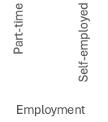
Stressors — Work Related
Source: Financial Wellness Diverse Populations,” ©2025, LL Global, Inc.

Slide 14
Stressors — Caregiving
Source: Financial Wellness Diverse Populations,” ©2025, LL Global, Inc.

Slide 15
Stressors — Personal Life
Source: Financial Wellness Diverse Populations,” ©2025, LL Global, Inc.

Slide 16
Household Confidence
I am confident about my household’s financial situation.
5
Strongly Agree
3.45
Agree
Neutral
Disagree
1
Strongly Disagree
Source: Financial Wellness Diverse Populations,” ©2025, LL Global, Inc.

Slide 17
I am confident about my household’s financial situation
Source: Financial Wellness Diverse Populations,” ©2025, LL Global, Inc.

Slide 18
Household Confidence
5
My household is able to withstand unexpected expenses of $500 or more.
Strongly Agree
3.76
Agree
Neutral
Disagree
1
Strongly Disagree
Source: Financial Wellness Diverse Populations,” ©2025, LL Global, Inc.

Slide 19


Able to withstand an unexpected expense…
Source: Financial Wellness Diverse Populations,” ©2025, LL Global, Inc.

Slide 20
Enjoyment
5
Strongly Agree
I can enjoy life because of the way I/we are managing money.
3.55
Agree
Neutral
Disagree
1
Strongly Disagree
Source: Financial Wellness Diverse Populations,” ©2025, LL Global, Inc.

Slide 21
I can enjoy life because of how I/we are managing our money
Source: Financial Wellness Diverse Populations,” ©2025, LL Global, Inc.

Slide 22
Achieving Financial Goals
5
I am comfortable with the planning I/we have done to achieve our financial goals.
Strongly Agree
3.52
Agree
Neutral
Disagree
1
Strongly Disagree
Source: Financial Wellness Diverse Populations,” ©2025, LL Global, Inc.

Slide 23
Comfort in planning for financial goals
Source: Financial Wellness Diverse Populations,” ©2025, LL Global, Inc.

Slide 24
“I have the appropriate amount of…”
76%
56%
41%
42%
Source: Financial Wellness Diverse Populations,” ©2025, LL Global, Inc.

Slide 25
Appropriate Insurance — by Generation
5 = Appropriate Amount
Source: Financial Wellness Diverse Populations,” ©2025, LL Global, Inc.

Slide 26
Appropriate Insurance — by Gender/LGBTQIA+
5 = Appropriate Amount
Source: Financial Wellness Diverse Populations,” ©2025, LL Global, Inc.

Slide 27
Appropriate Insurance — by Race/Ethnicity
5 = Appropriate Amount
Source: Financial Wellness Diverse Populations,” ©2025, LL Global, Inc.

Slide 28
Appropriate Insurance — by Marital Status
5 = Appropriate Amount
Source: Financial Wellness Diverse Populations,” ©2025, LL Global, Inc.

Slide 29
Appropriate Insurance — by Income
5 = Appropriate Amount
Source: Financial Wellness Diverse Populations,” ©2025, LL Global, Inc.

Slide 30
Appropriate Insurance — Education & Employment
5 = Appropriate Amount
Source: Financial Wellness Diverse Populations,” ©2025, LL Global, Inc.

Slide 31
Work Distraction/Employee Engagement
I often feel distracted at work due to personal financial worries.
Source: Financial Wellness Diverse Populations,” ©2025, LL Global, Inc.

Slide 32
I Often Feel Distracted at Work Due to Personal Financial Worries
Source: Financial Wellness Diverse Populations,” ©2025, LL Global, Inc.

Slide 33
Work/Life Balance
I feel I have a reasonable work/life balance.
Source: Financial Wellness Diverse Populations,” ©2025, LL Global, Inc.

Slide 34
Reasonable Work/Life Balance
35%
Source: Financial Wellness Diverse Populations,” ©2025, LL Global, Inc.

Slide 35
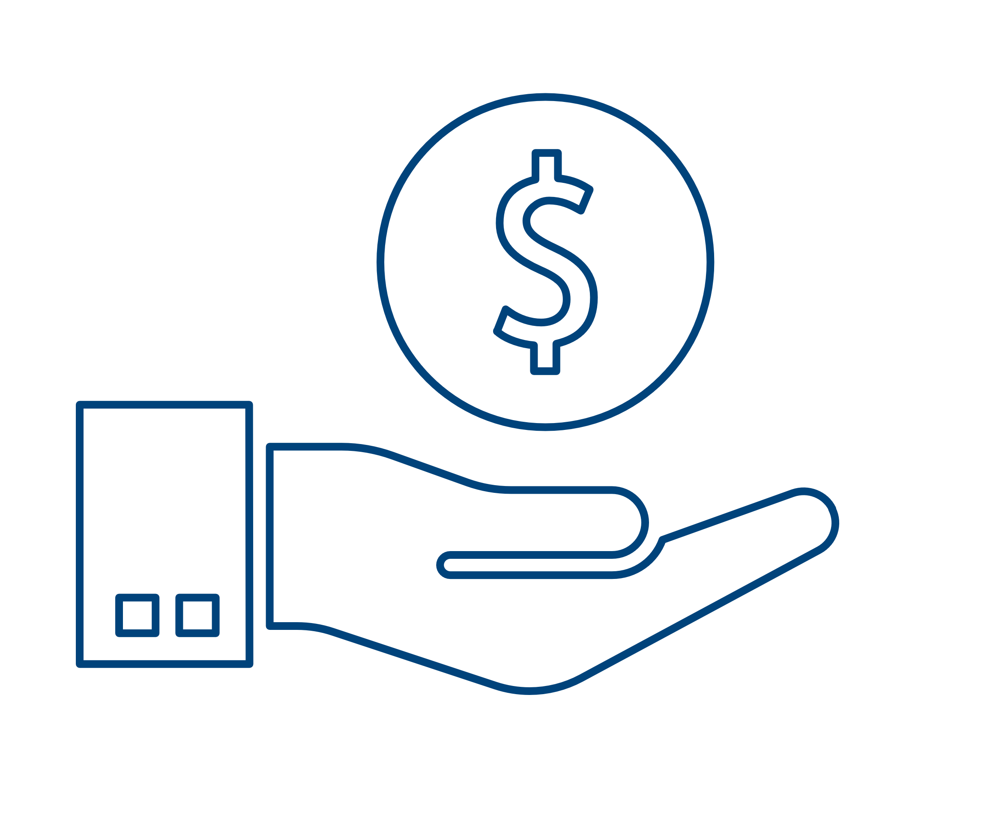
Reasonable Work/Life Balance — by Income
Source: Financial Wellness Diverse Populations,” ©2025, LL Global, Inc.

Slide 36
Employer Responsibility
“Employers should offer programs to
help employees with financial stress.”
Strongly Disagree
Disagree
Neutral
Agree
Strongly Agree
3.85
1
5
Source: Financial Wellness Diverse Populations,” ©2025, LL Global, Inc.

Slide 37
Belief That Employer Should Help…
5 = Strongest Agreement
Source: Financial Wellness Diverse Populations,” ©2025, LL Global, Inc.

Slide 38
Employee Benefits & Financial Wellness
“The employee benefits at work are
an important part of my financial wellness.”
Strongly Disagree
Disagree
Neutral
Agree
3.73
Strongly Agree
Source: Financial Wellness Diverse Populations,” ©2025, LL Global, Inc.

Slide 39
Employee Benefits & Financial Wellness
5 = Strongest Agreement
Source: Financial Wellness Diverse Populations,” ©2025, LL Global, Inc.

Slide 40
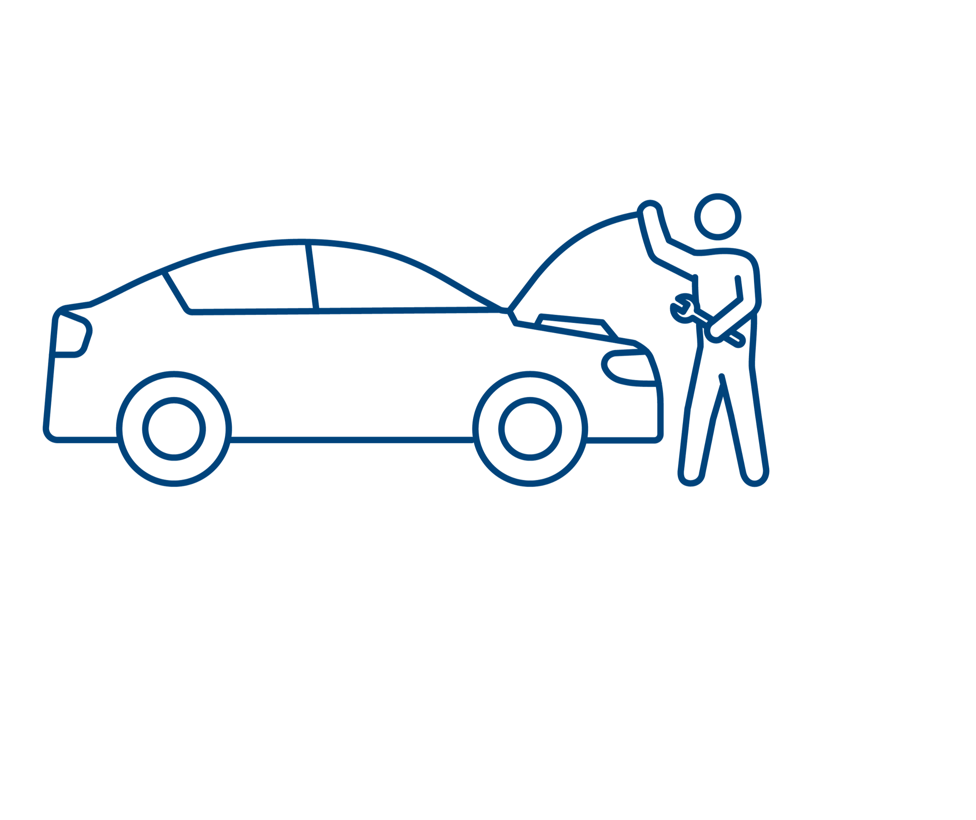
Would Use Emergency Savings if Available Through Employer
Available through employer
Not available, but would use it if it were
Source: Financial Wellness Diverse Populations,” ©2025, LL Global, Inc.

Slide 41

Student Loan Repayment
Available through employer
Not available, but would use it if it were
Source: Financial Wellness Diverse Populations,” ©2025, LL Global, Inc.

Slide 42

Tuition Assistance (Continuing Education)
Available through employer
Not available, but would use it if it were
Source: Financial Wellness Diverse Populations,” ©2025, LL Global, Inc.

Slide 43
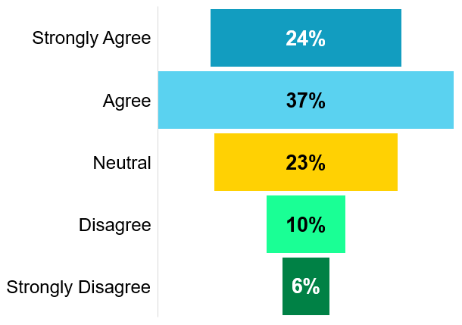
Appreciation for Financial Advice
Professional advice is necessary for good financial wellness…
61%
Source: Financial Wellness Diverse Populations,” ©2025, LL Global, Inc.

Slide 44
Appreciation for Professional Advice
Source: Financial Wellness Diverse Populations,” ©2025, LL Global, Inc.

Slide 45
Currently Working With a Financial Advisor
Source: Financial Wellness Diverse Populations,” ©2025, LL Global, Inc.

Slide 46
From Where Would/Do You Prefer to Receive Education?
Managing My Financial Life
Managing My Financial Future
52%
Employer & Employer-Endorsed
55%
Employer & Employer-Endorsed
Source: Financial Wellness Diverse Populations,” ©2025, LL Global, Inc.

Slide 47
Managing Daily Financial Life
Source: Financial Wellness Diverse Populations,” ©2025, LL Global, Inc.

Slide 48
Putting it Together
Wellness… A question of Degree
Reduce Stress… Improve Wellness
People, not Just Populations
Retail and Workplace Solutions
  Strong Role for Employers
Education and Products/Services
Solve for the Solvable
Deb Dupont
Assistant Vice President
Institutional Retirement Research
860-285-7745
ddupont@limra.com
Also visit:
www.limra.com
For More Information…
Source: Financial Wellness Diverse Populations,” ©2025, LL Global, Inc.

Slide 50
Our Organization and Brands

